Slide 1
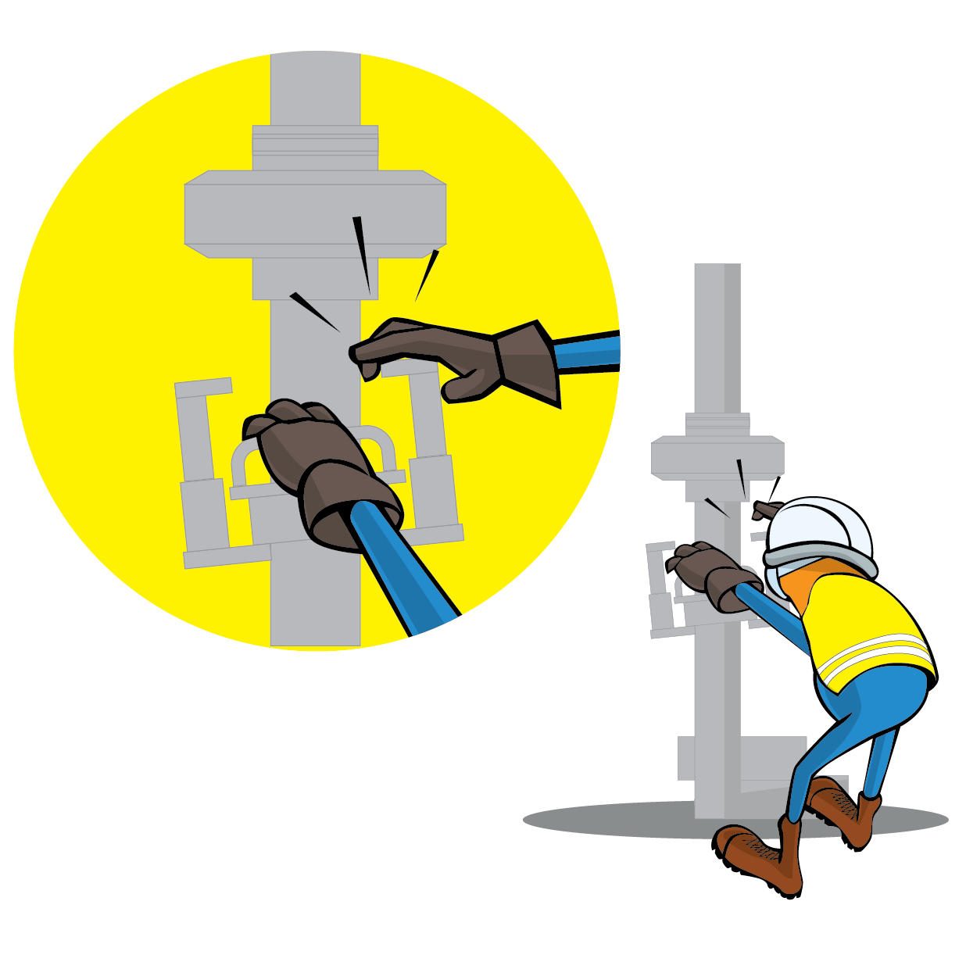
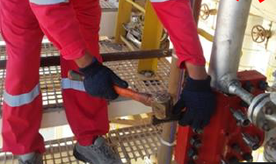
PDO Incident First Alert
Incident Type | LTI#24 | Pattern | Hands and Fingers
Date / Time | 27.10.2021@11:45hrs | Directorate
Location | Amal station | Dept
Target Audience
Drilling, Operations, Engineering & Construction
What happened
During a seal clamp bolting activity and while the Pipe Fitter was hammering on bolt hammer clamps to tightened it , he hit his left-hand thumb finger and causing a fracture .
Mr. Musleh asks the questions of can it happen to you?
Do you ensure you keep your hands and fingers away from pinch points?
Do you ensure you identify all hazards before starting a task?
Do you ensure using the correct tools to perform the task?
Do you ensure to intervene when observe unsafe act/condition?
Please disseminate this LTI notification to your teams and use it in your tool box talks and HSE meetings and notice boards.

