Slide 1
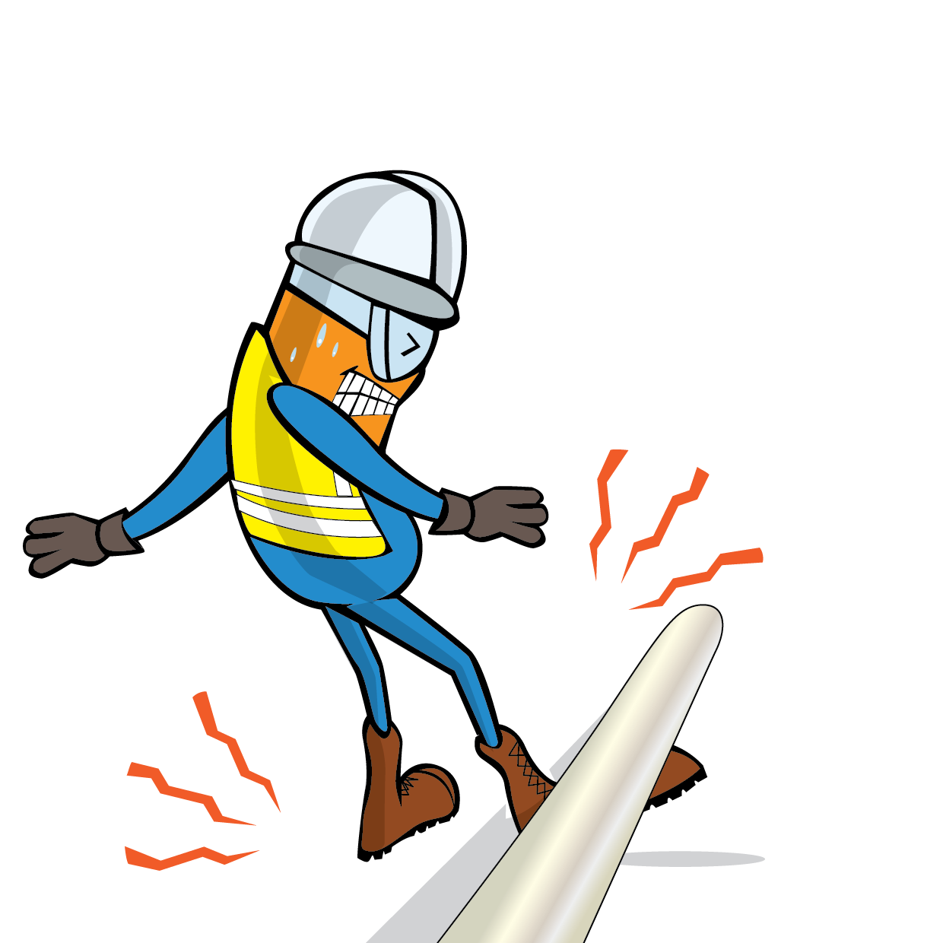
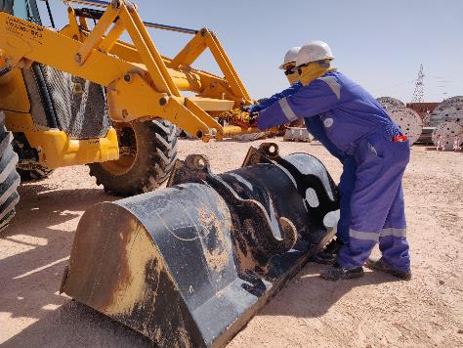
PDO Incident First Alert
Incident Type | LTI#25 | Pattern | Drops
Date / Time | 04.11.2021@07:25hrs | Directorate
Location | STS Yard-Marmul | Dept
Target Audience
Drilling, Operations, Engineering & Construction
What happened
Loader bucket link bracket
Operator
While disconnecting the suspended JCB bucket by the operator , the bucket fell on his left foot resulting in a fracture to his left foot.
Mr. Musleh asks the questions of can it happen to you?
Rigger
Do you ensure that you are stood in a safe place?
Do you ensure effective supervision on the job?
Do you identify all hazards in your surroundings?
Do you ask for the assistance from competent personnel whenever its required?
Please disseminate this LTI notification to your teams and use it in your tool box talks and HSE meetings and notice boards.

