Slide 1
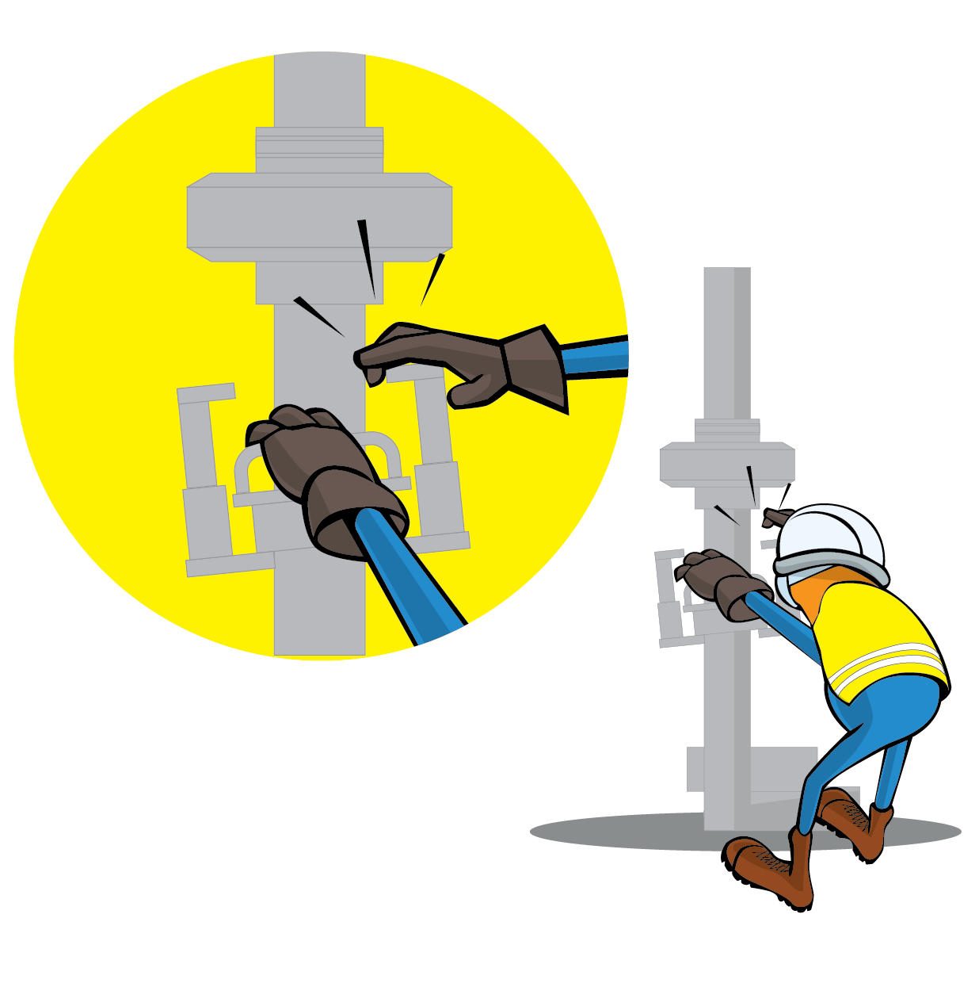
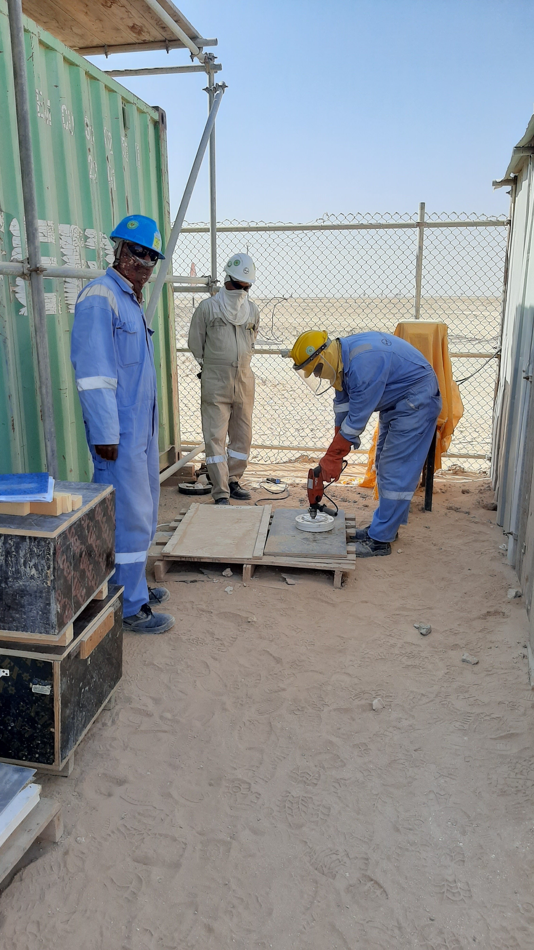
PDO Incident First Alert
Incident Type | LTI#26 | Pattern | Hands and Fingers
Date / Time | 29.10.2021@10:30hrs | Directorate
Location | Construction site, Yibal | Dept
Target Audience
Drilling, Operations, Engineering ,Logistics & Construction
What happened
While the Grinder was drilling a hole in a blind used for hydrotesting activity, the drill stuck leading the drill to reverse and hit his right hand causing fracture
Mr. Musleh asks the questions of can it happen to you?
Do you ensure you identify all hazards before starting a task?
Do you ensure using the right tool for the task?
Do you intervene whenever necessary?
Do you consider "What could go wrong”?
Please disseminate this LTI notification to your teams and use it in your tool box talks and HSE meetings and notice boards.

