Slide 1
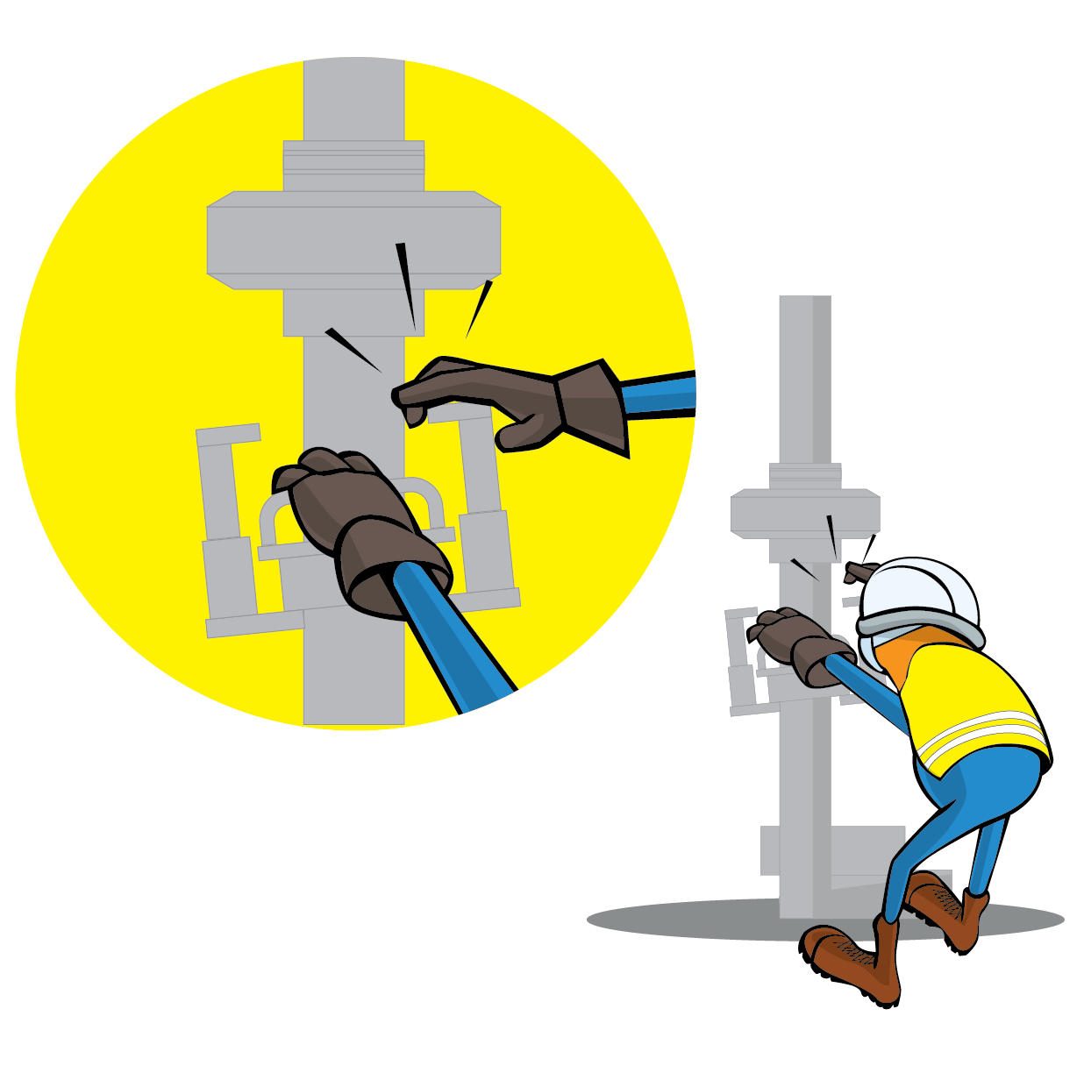
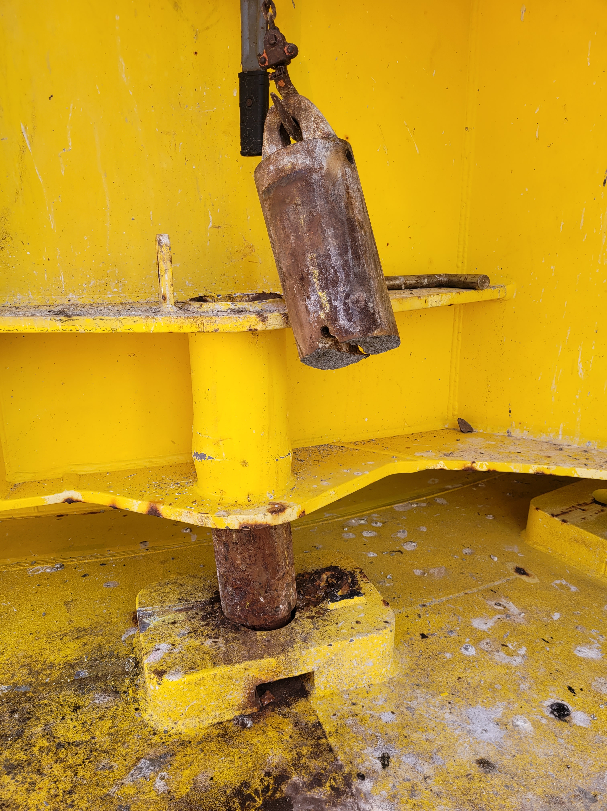
PDO Incident First Alert
Incident Type | LTI#30 | Pattern | Hands and Fingers
Date / Time | 08.11.2021@19:20hrs | Directorate
Location | Marine offshore- MAF | Dept
Target Audience
Drilling, Operations, Engineering & Construction
What happened
After completion Single Buoy Mooring maintenance (SBM) activity, the pin which secure the SBM turn-table was seen broken halfway down. While the Diver was lifting the lower section from locking pin socket it fell onto the deck and to Divers hand index finger causing fracture to his right index finger.
Mr. Musleh asks the questions of can it happen to you?
Do you ensure you keep your hands and fingers away from pinch points?
Do you ensure you identify all hazards before starting a task?
How do you ensure you handle equipment properly?
Please disseminate this LTI notification to your teams and use it in your tool box talks and HSE meetings and notice boards.

