Slide 1
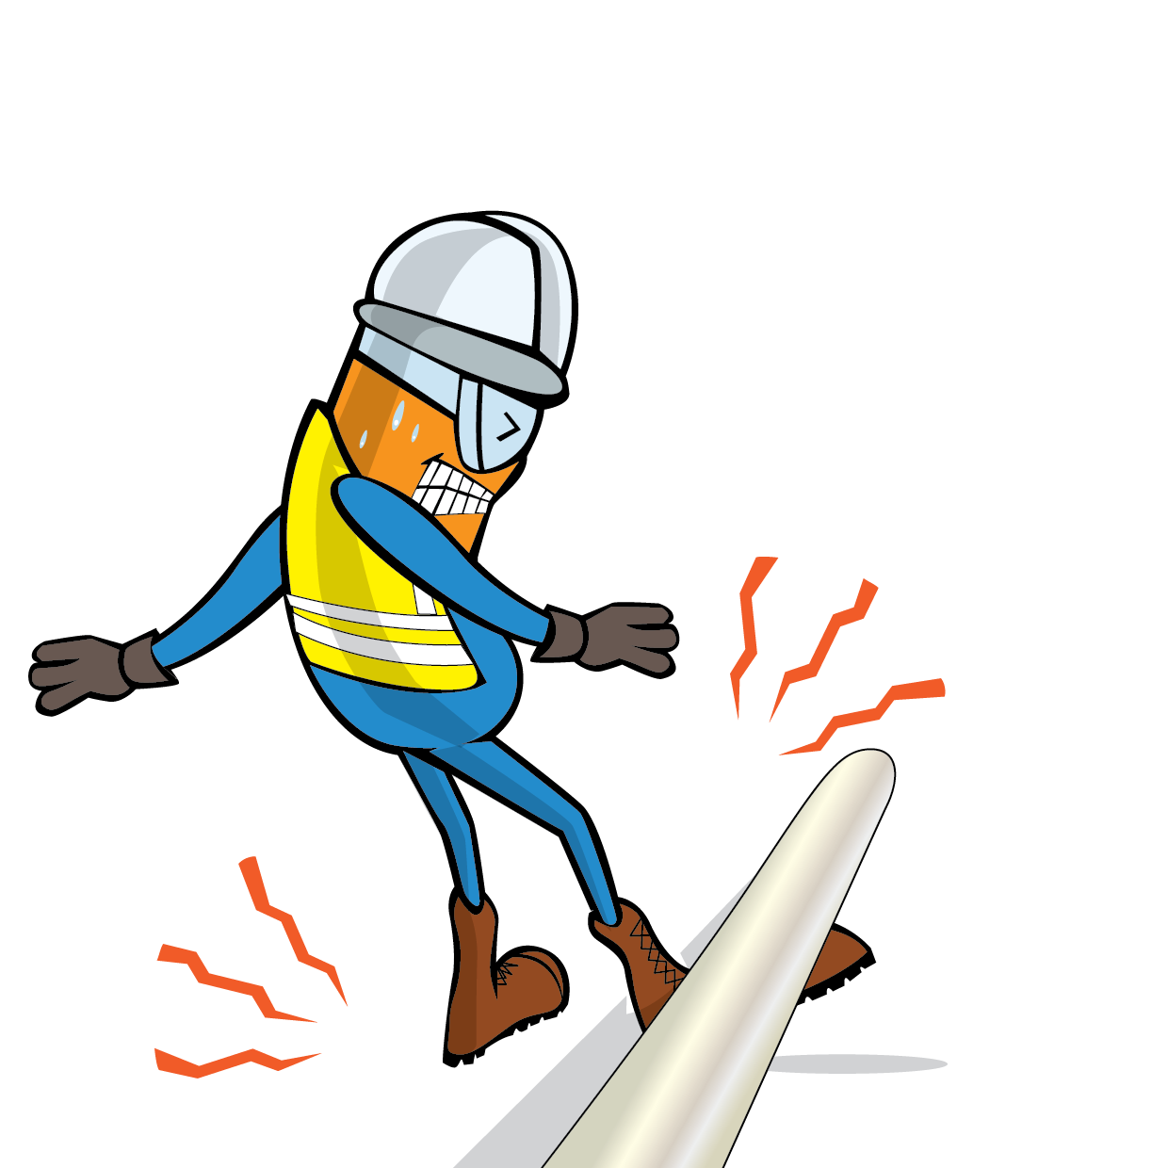
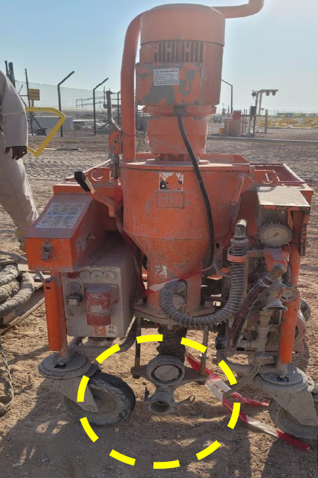
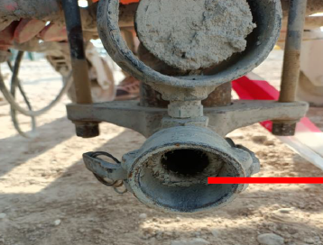
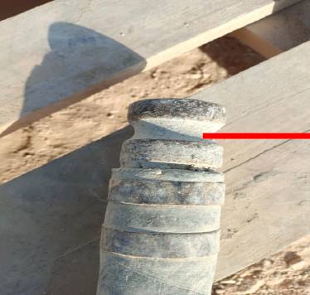
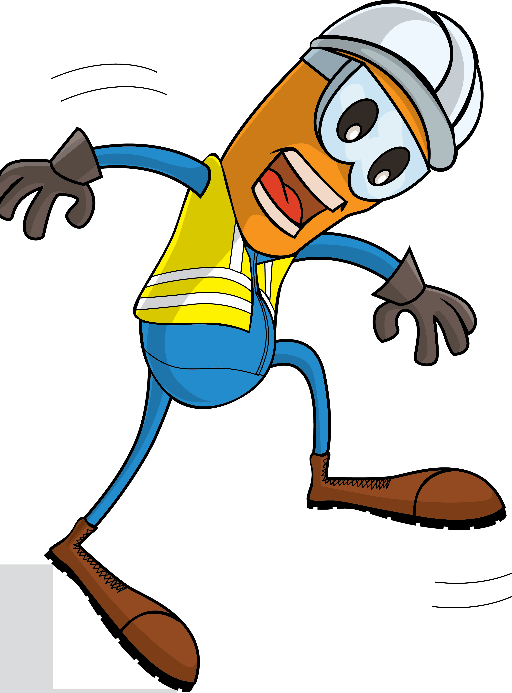
PDO Incident First Alert
Incident Type | LTI#31 | Pattern | Released Energy
Date / Time | 28.07.2021@15:15hrs | Directorate
Location | Raba Gathering station, Qarn Alam | Dept
Target Audience
Drilling, Operations, Engineering & Construction
What happened
During a cleaning work of the discharge hose which experienced a blockage and while the Operator was adjusting the flow parameter, the hose has disengaged from the machine and whipped his leg causing fracture to his right leg.
Mr. Musleh asks the questions of can it happen to you?
Female coupler hose joint
Do you ensure that you are stood in a safe place?
Do you ensure you are out of the “Line of fire”?
Do you ensure you identify all hazards before starting a task?
Do you ensure you follow the correct procedure to perform this task?
Male coupler that hit Operator's leg
Please disseminate this LTI notification to your teams and use it in your tool box talks and HSE meetings and notice boards.

