Slide 1
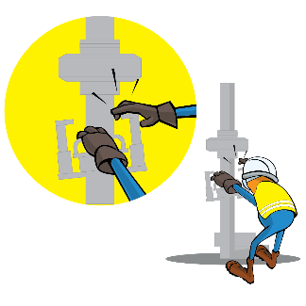
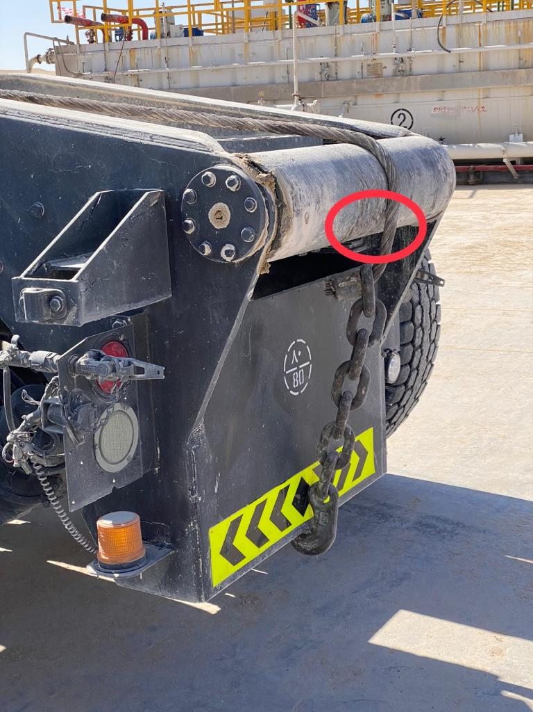
PDO Incident First Alert
Incident Type | LTI#35 | Pattern | Hands and Fingers
Date / Time | 05.12.2021@15:00hrs | Directorate
Location | Rig-96, Bahja | Dept
Target Audience
Logistics, Drilling, Operations, Engineering & Construction
What happened
During spooling of the winch line the helper was holding the winch rope with 1 hand whilst signaling the driver with the other during winch in operation. As the winch line has tightened his right-hand index finger has been crushed by the winch line.
Mr. Musleh asks the questions of can it happen to you?
Do you ensure you keep your hands and fingers away from pinch points?
Do you ensure you identify all hazards before starting a task?
Do you always consider if you are in the ‘line of fire’?
Do you ensure all equipment is inspected and maintained?
Please disseminate this LTI notification to your teams and use it in your tool box talks and HSE meetings and notice boards.

