Slide 1
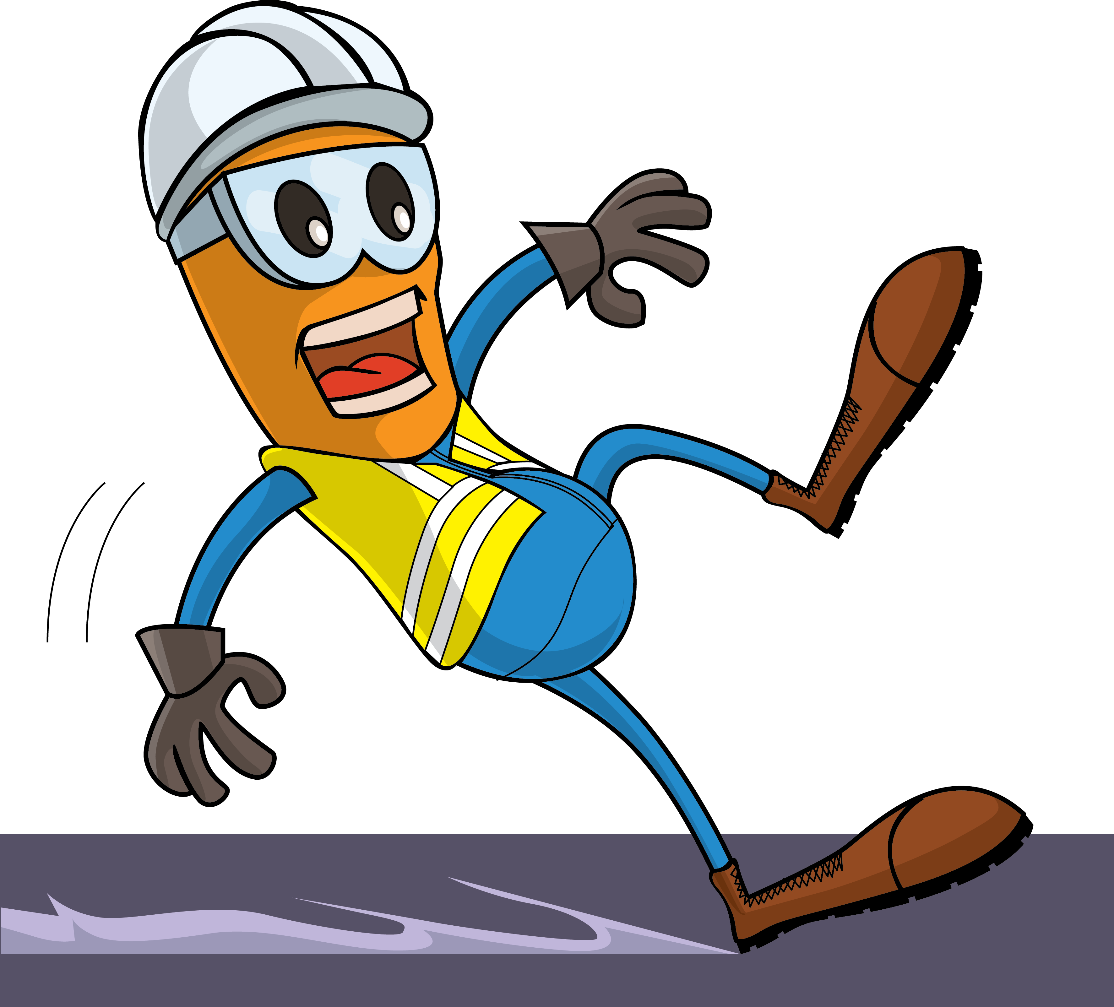
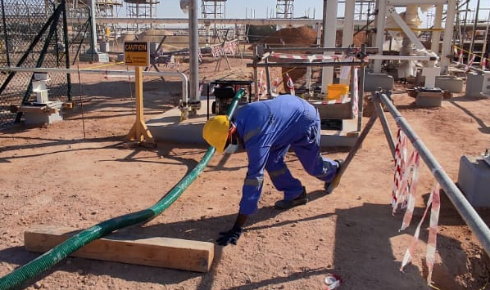


PDO Incident First Alert
Incident Type | LTI#37 | Pattern | Slip ,Trip and Fall
Date / Time | 16.12.2021@13:35hrs | Directorate
Location | Qarn Alam | Dept
Target Audience
Drilling, Operations, Engineering & Construction
What happened
While Helper was moving in the workplace to shift the water draining hose, he tripped on a barricade (hard barrier) and lost balance falling on the ground, his left hand hit the wooden runner causing left arm wrist fracture.
Mr. Musleh asks the questions of can it happen to you?
Do always pay attention to where you are stepping?
Do you ensure you are wearing the correct type of footwear?
How do you ensure you have safe access and egress?
How do you identify Slip, Trips and fall hazards around your working location?
Please disseminate this LTI notification to your teams and use it in your tool box talks and HSE meetings and notice boards.

