Slide 1
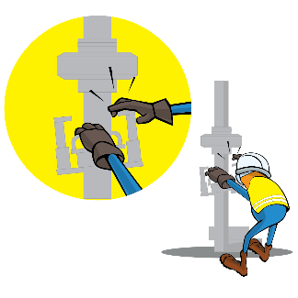
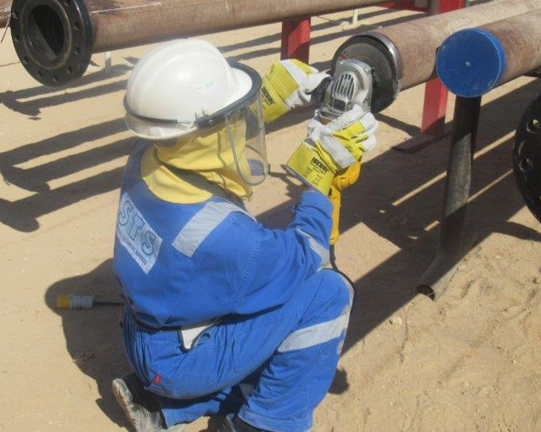
PDO Incident First Alert
Incident Type | LTI#38 | Pattern | Hands and Fingers
Date / Time | 17.12.2021@10:00hrs | Directorate
Location | Amal | Dept
Target Audience
Logistics, Drilling, Operations, Engineering & Construction
What happened
While the fabricator was preparing the pipe edge for welding using grinder machine at Fabrication yard, the grinder started to vibrate, slipped and cut through the gloves causing laceration wound on his right-hand middle finger.
Mr. Musleh asks the questions of can it happen to you?
Do you ensure you identify all hazards before starting a task?
Do you check that the grinder do not vibrate or operate roughly?
Do you always use both hands when holding the grinder?
How do you ensure you handle equipment properly?
Do you intervene whenever necessary?
Please disseminate this LTI notification to your teams and use it in your tool box talks and HSE meetings and notice boards.

