Slide 1
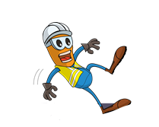


PDO Incident First Alert
Incident Type | LTI#02 | Pattern | Slip, Trip & Fall
Date / Time | 20.01.2022@09:45hrs | Directorate
Location | WPH-51, Fahud | Dept
Target Audience
Drilling, Operations, Engineering & Construction
What happened
While the Welder was hammering to remove the pins connecting two handrails that were placed on the ground, it got unbalanced and fell leading the Welder to lose his balance and fall hitting his chin on a metal basket and fracturing his jaw.
Mr. Musleh asks the questions of can it happen to you?
Do you ensure you identify all hazards before starting a task?
Do you ensure to seek proper assistance before starting the task?
Do you ensure adequate resources and Supervision during task?
Do you ensure proper planning and communication for the task?
Please disseminate this LTI notification to your teams and use it in your tool box talks and HSE meetings and notice boards.

