Slide 1
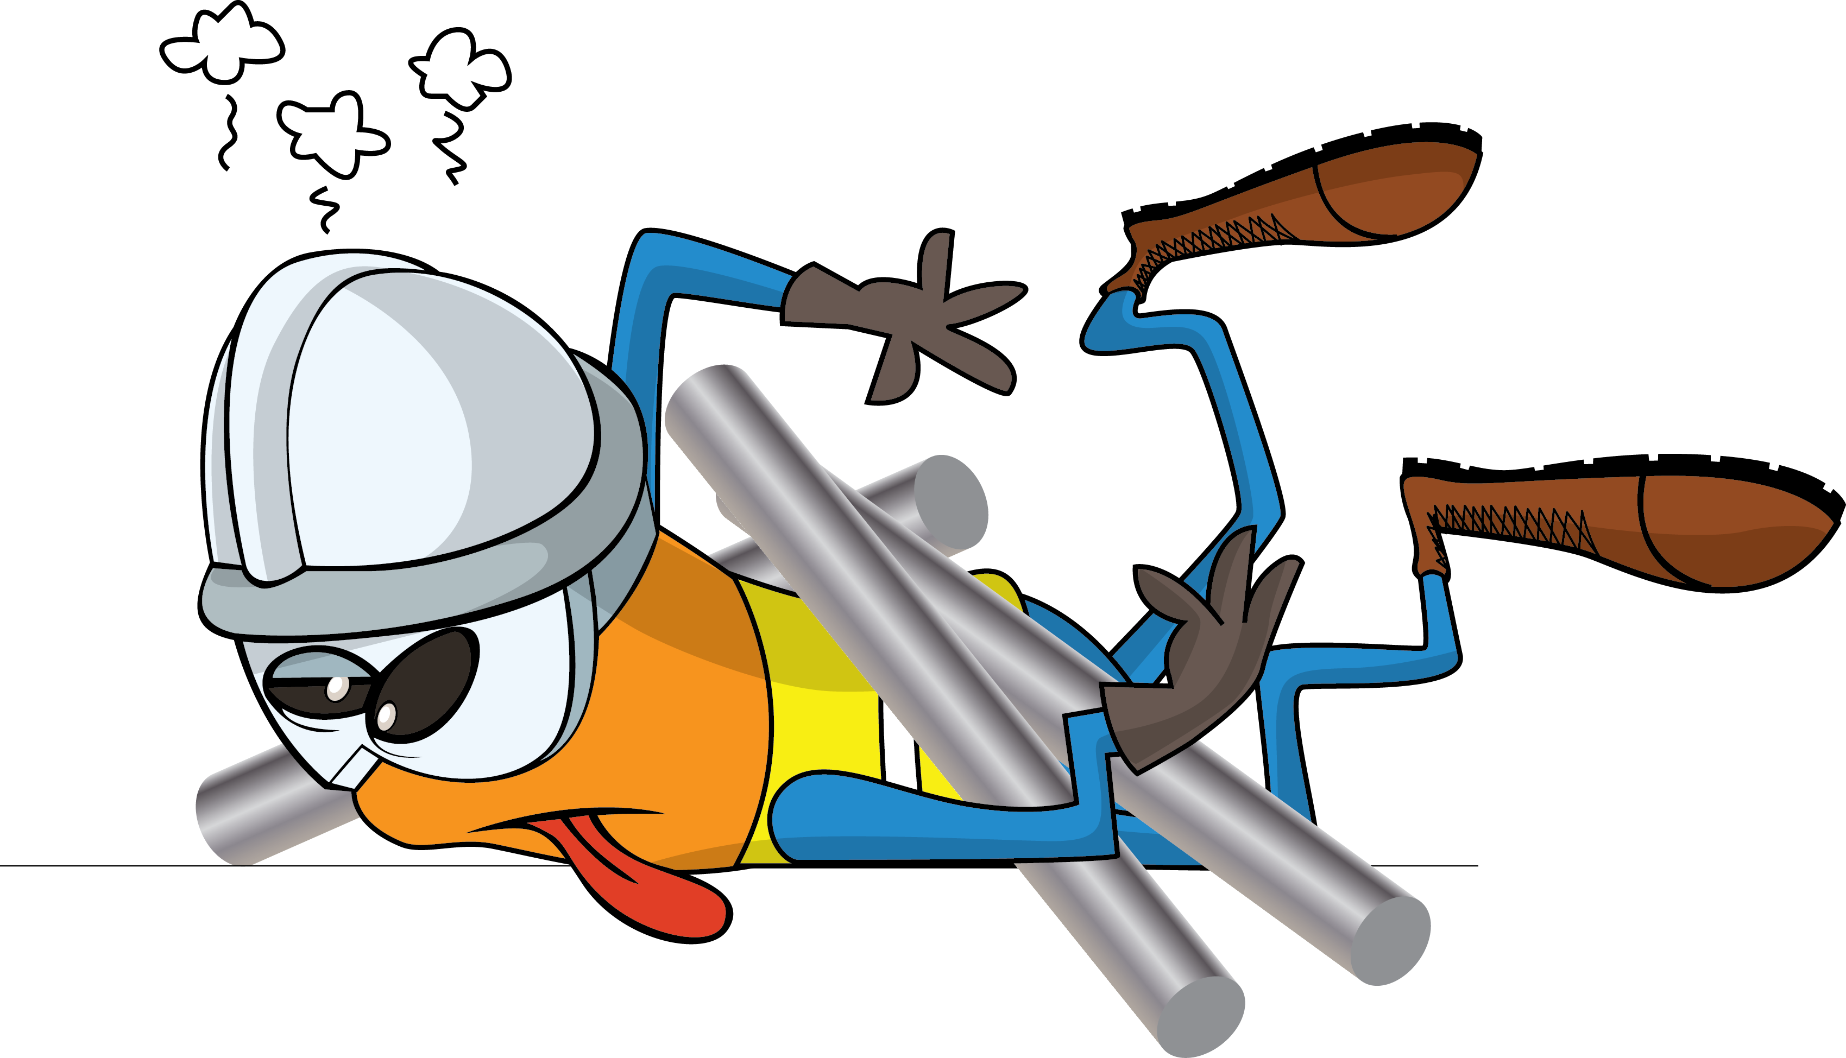
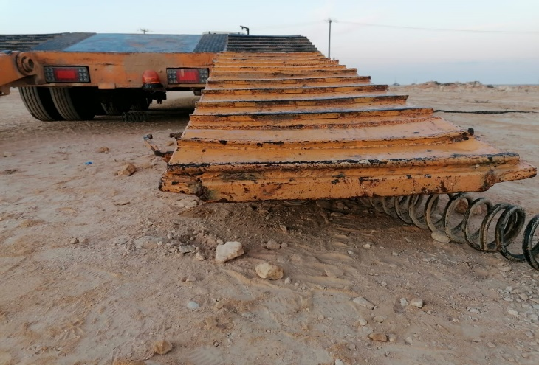
PDO Incident First Alert
Incident Type | LTI#04 | Pattern | Released Energy
Date / Time | 20.02.2022@00:20hrs | Directorate
Location | WPH-68, Marmul | Dept
Target Audience
Drilling, Operations, Engineering & Construction
What happened
During a loading activity of the cherry picker on a low bed trailer. While the Floorman was attempting to release the rear ramp of the low bed manually, the spring became loose and the ramp fell on the left side of his hip causing fracture .
Mr. Musleh asks the questions of can it happen to you?
Do you always keep yourself away from line of fire?
Do you ensure you identify all hazards before starting a task?
Do you ensure not try to fix problems you are not competent to fix?
Do you always seek for the proper assistance while performing the task?
Please disseminate this LTI notification to your teams and use it in your tool box talks and HSE meetings and notice boards.

