Slide 1
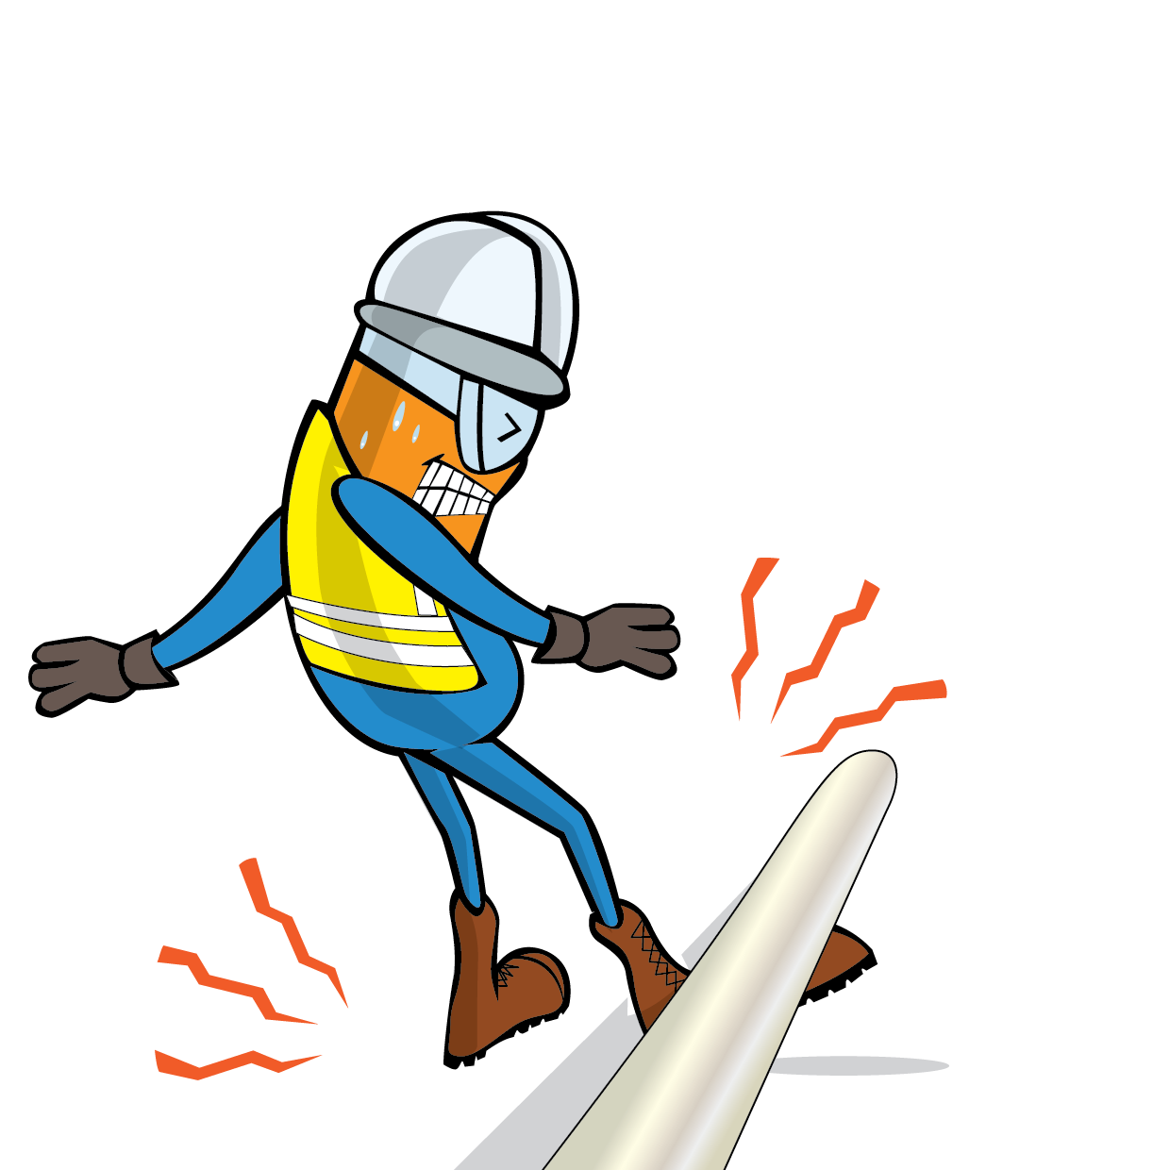
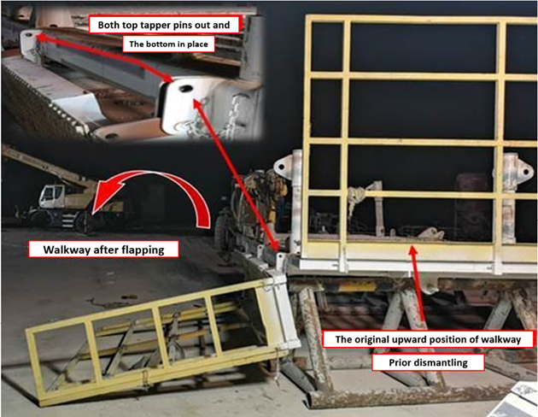
PDO Incident First Alert
Incident Type | LTI#05 | Pattern | Released Energy
Date / Time | 09.03.2022@23:45hrs | Directorate
Location | Rig-49, Qarn Alam | Dept
Target Audience
Drilling, Operations, Engineering & Construction
What happened
During the rig move process, while the night crew removed the upper pins of the monkey board walkway, the walkway flipped down due its own weight hitting the floorman on his right ankle resulting in fracture.
Mr. Musleh asks the questions of can it happen to you?
Do you always keep yourself away from line of fire?
Do you ensure you identify all hazards in your surroundings?
Do you ensure proper supervision while performing the task?
Do you ensure red zones are barricaded to prevent unauthorized person from entering?
Please disseminate this LTI notification to your teams and use it in your tool box talks and HSE meetings and notice boards.

