Slide 1
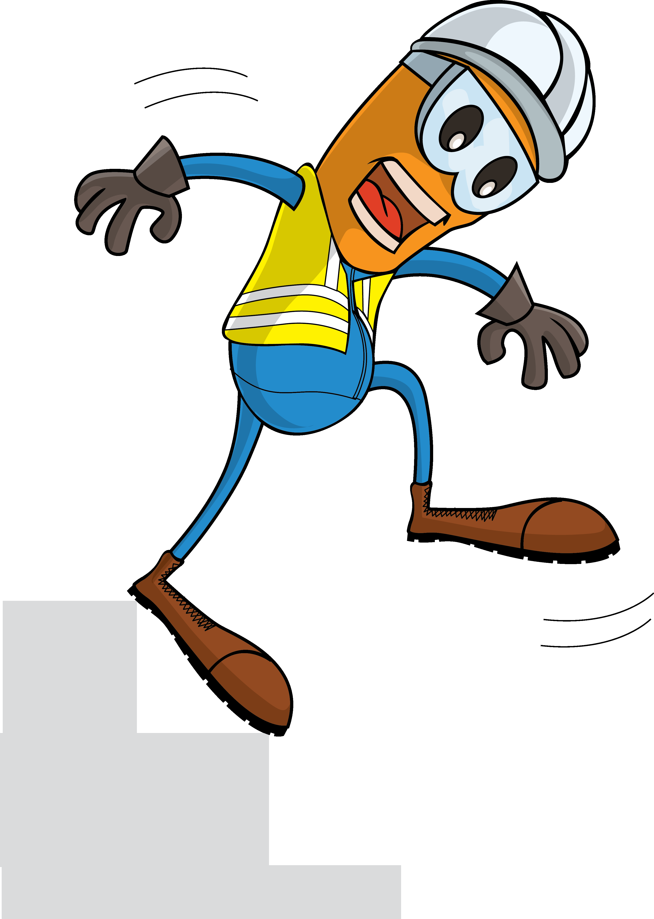
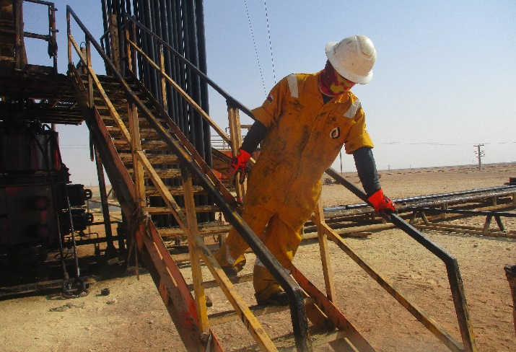
PDO Incident First Alert
Incident Type | LTI#06 | Pattern | Slip, trip & fall
Date / Time | 15.03.2022@23:30hrs | Directorate
Location | WPH-25, Nimr | Dept
Target Audience
Drilling, Operations, Engineering & Construction
What happened
While the Roustabout was descending from the hoist floor, he lost his balance, slipped and fell on the ground causing injury fracture to his left leg.
Mr. Musleh asks the questions of can it happen to you?
Do you always pay attention to where you are stepping?
Do you ensure to use three points of contact while ascending /descending stairs?
Do you identify Slip, Trips and fall hazards around your working location?
Do you ensure effective learning form previous similar incidents?
Please disseminate this LTI notification to your teams and use it in your tool box talks and HSE meetings and notice boards.

