Slide 1
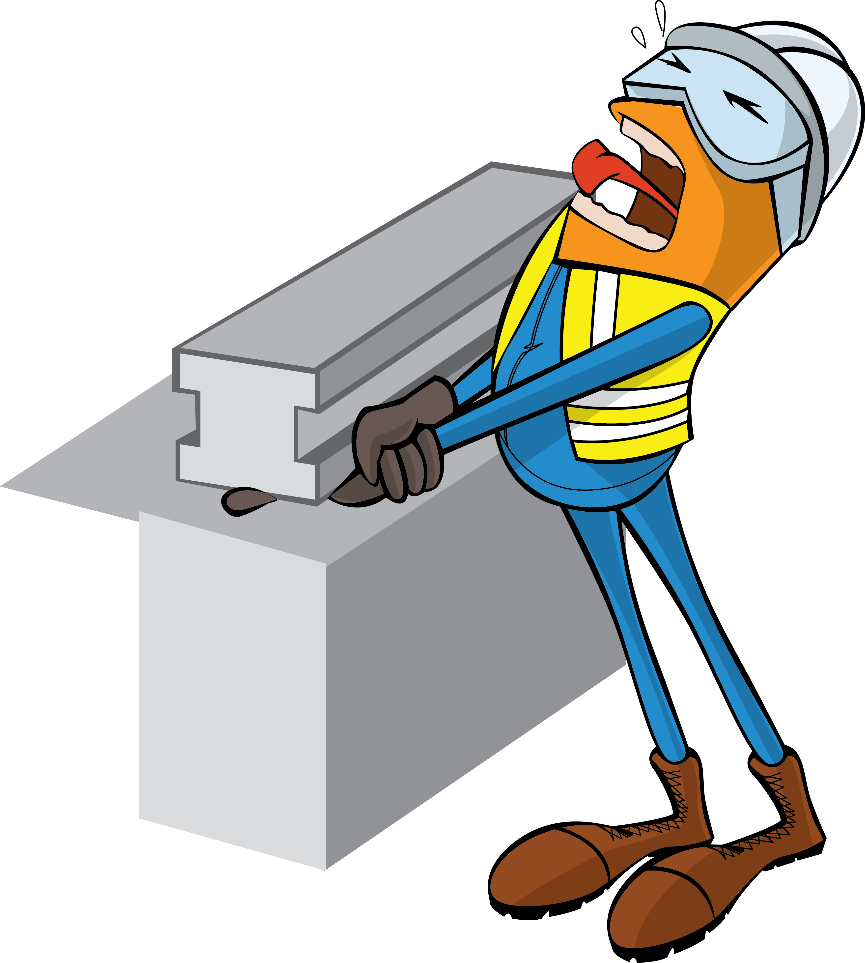
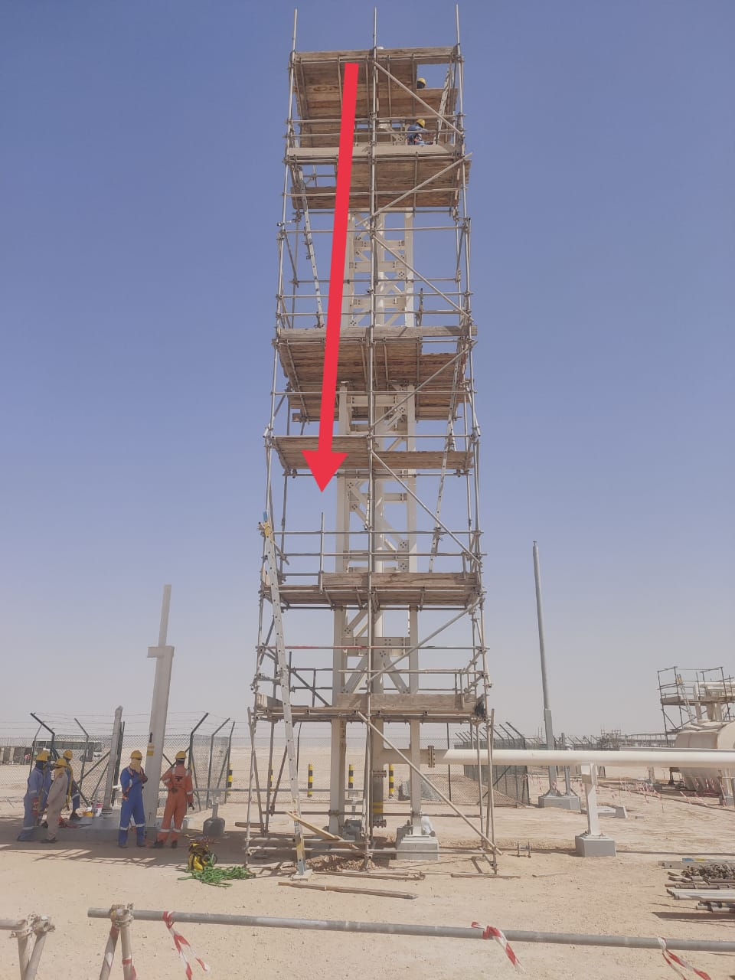
PDO Incident First Alert
Incident Type | LTI#08 | Pattern | Drops
Date / Time | 26.03.2022@09:40hrs | Directorate
Location | RMS2-construction site, Qarn Alam | Dept
Target Audience
Position of the wooden board
Drilling, Operations, Engineering & Construction
What happened
During scaffold dismantling activity and while transferring the wooden plank from 18-meter height, the plank slipped off and fell on the Charge Hand who was standing on the second level of the scaffold causing amputation of his right-hand index finger.
Mr. Musleh asks the questions of can it happen to you?
Do you ensure you stand in safe place away from line of fire?
Do you ensure you identify all hazards in your surrounding?
Do you consider the risk of working under possible falling objects placed at height?
Do you ensure no go zone barrier in place and adequately controlled?
Please disseminate this LTI notification to your teams and use it in your tool box talks and HSE meetings and notice boards.

