Slide 1
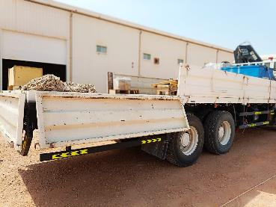
PDO Incident First Alert
Incident Type | LTI#35 | Pattern | Drops | In case of an emergency please call PDO Emergency Number (Toll Free): 2467-5555
Date / Time | 17.09.2022@08:30hrs | Directorate
Location | Harweel Warehouse | Department
Target Audience: Well Engineering, Infrastructure, Operations, Engineering, Project Delivery & External Affairs
What happened
While the driver was attempting to unlock the side door of the Hiab, the rear door dislodged and fell on his left arm causing fracture to his left forearm.
Mr. Musleh asks the questions if it can happen to you?
Do you ensure you identify all hazards before starting a task?
Do you pay attention to your surroundings?
Do you ensure proper assistance during the task?
Do you consider what could go wrong?
Please disseminate this LTI notification to your teams and use it in your tool box talks and HSE meetings and notice boards.

