Slide 1

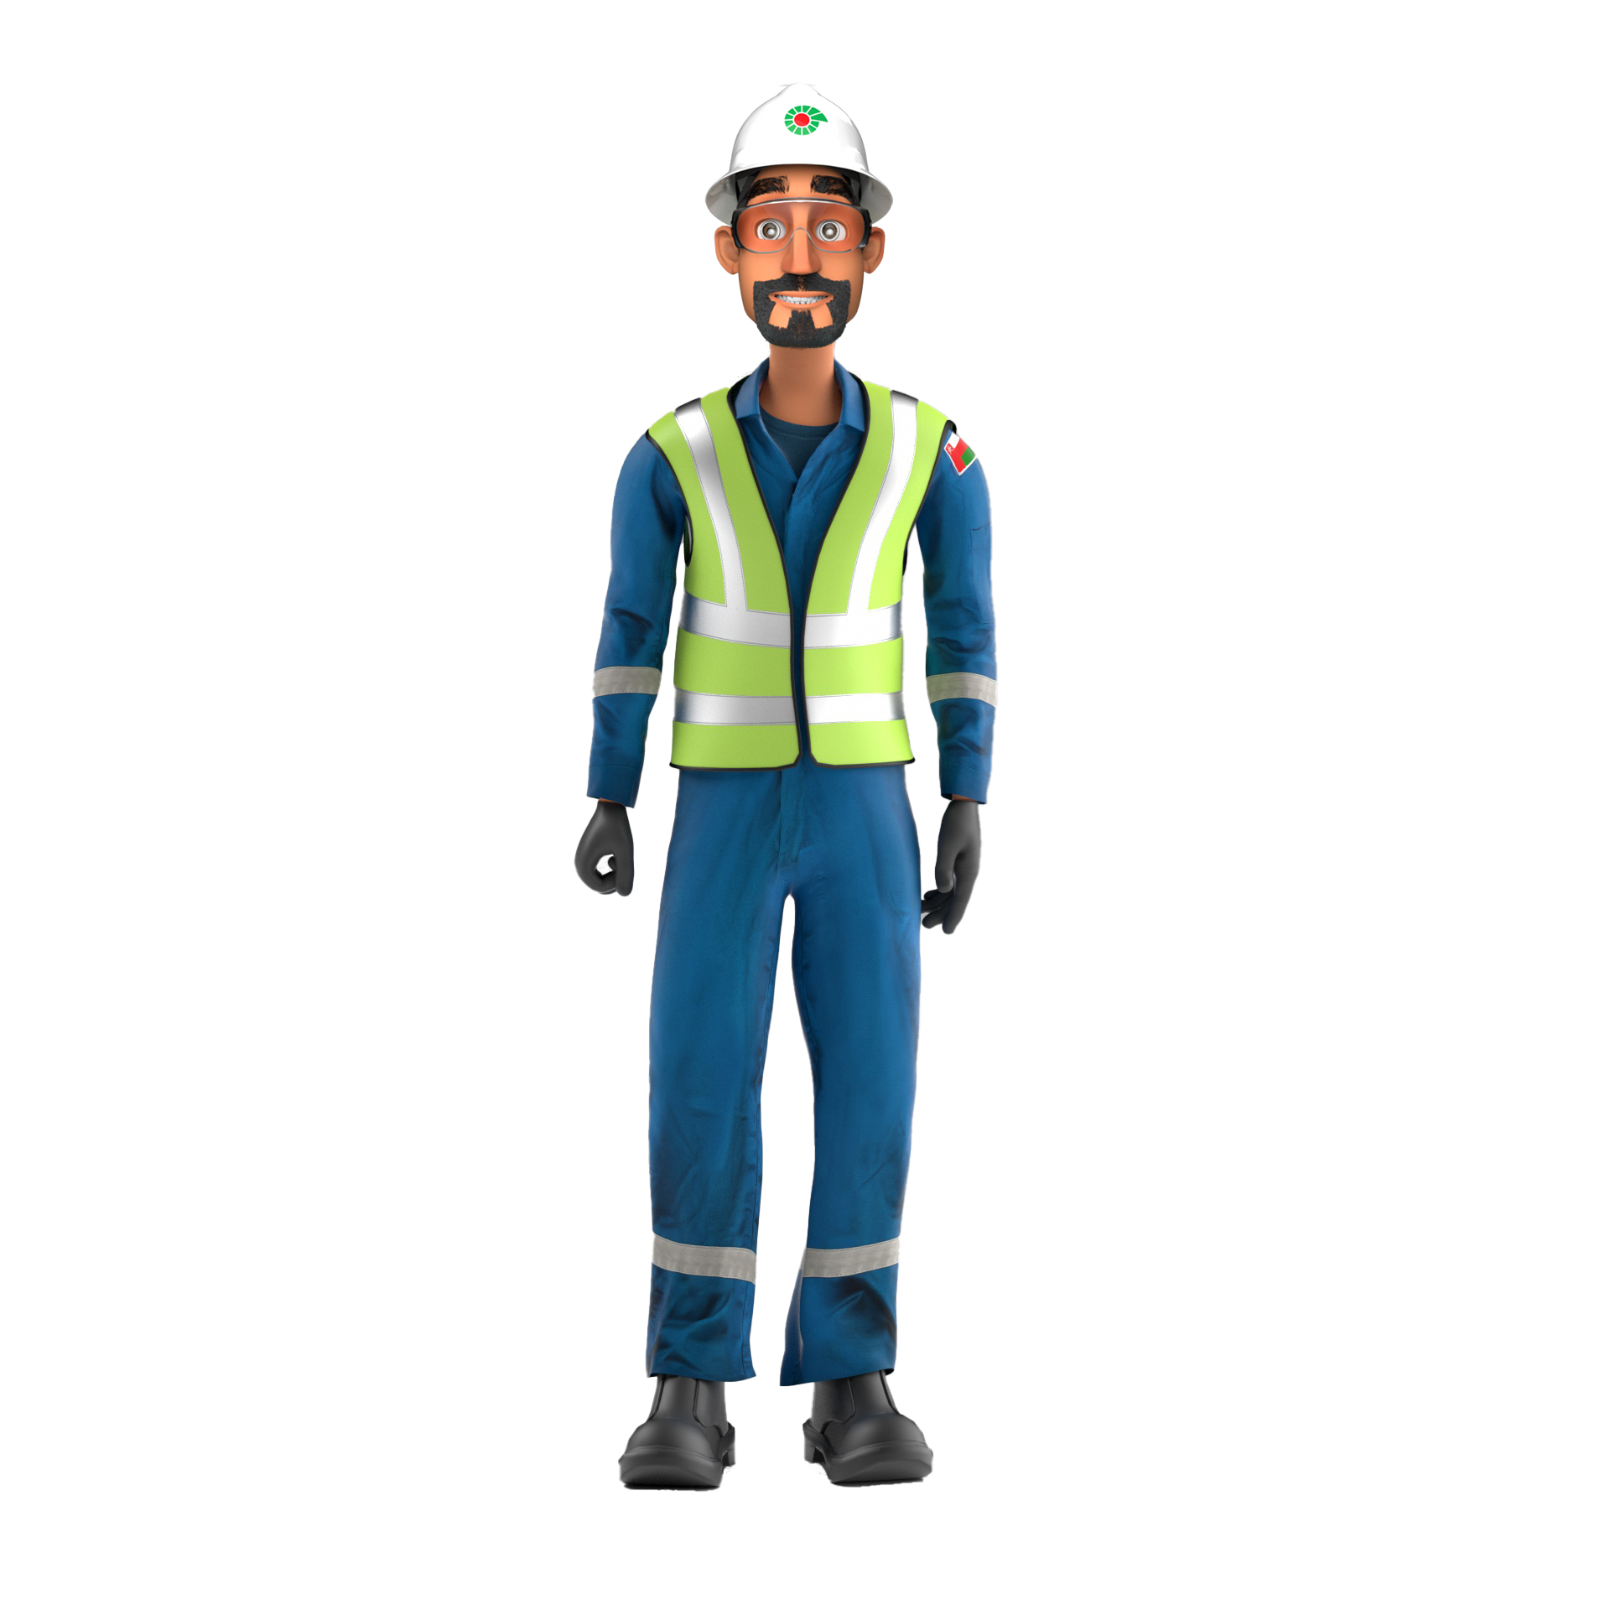
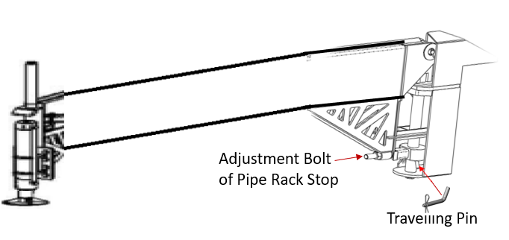


PDO Incident First Alert
Incident Type | LTI#36 | Pattern | Drops | In case of an emergency please call PDO Emergency Number (Toll Free): 2467-5555
Date / Time | 01.10.2022@01:15hrs | Directorate
Location | WPH-77, Lekhwair | Department
Target Audience: Well Engineering, Infrastructure, Operations, Engineering, Project Delivery & External Affairs
What happened
During rigging up hydraulic catwalk for pull out completion and while the roustabout was engaged in pulling the outrigger of the catwalk, it suddenly dropped and touched roustabout foot causing fracture of his left leg foot.
Mr. Musleh asks the questions if it can happen to you?
Do you ensure your body parts are away from Line of Fire?
Do you ensure you follow SOP for the task?
Do you ensure to inspect the equipment prior task to confirm its the right equipment (OEM) and the right setup?
Do you ensure proper supervision during the task?
Please disseminate this LTI notification to your teams and use it in your tool box talks and HSE meetings and notice boards.

