Slide 1
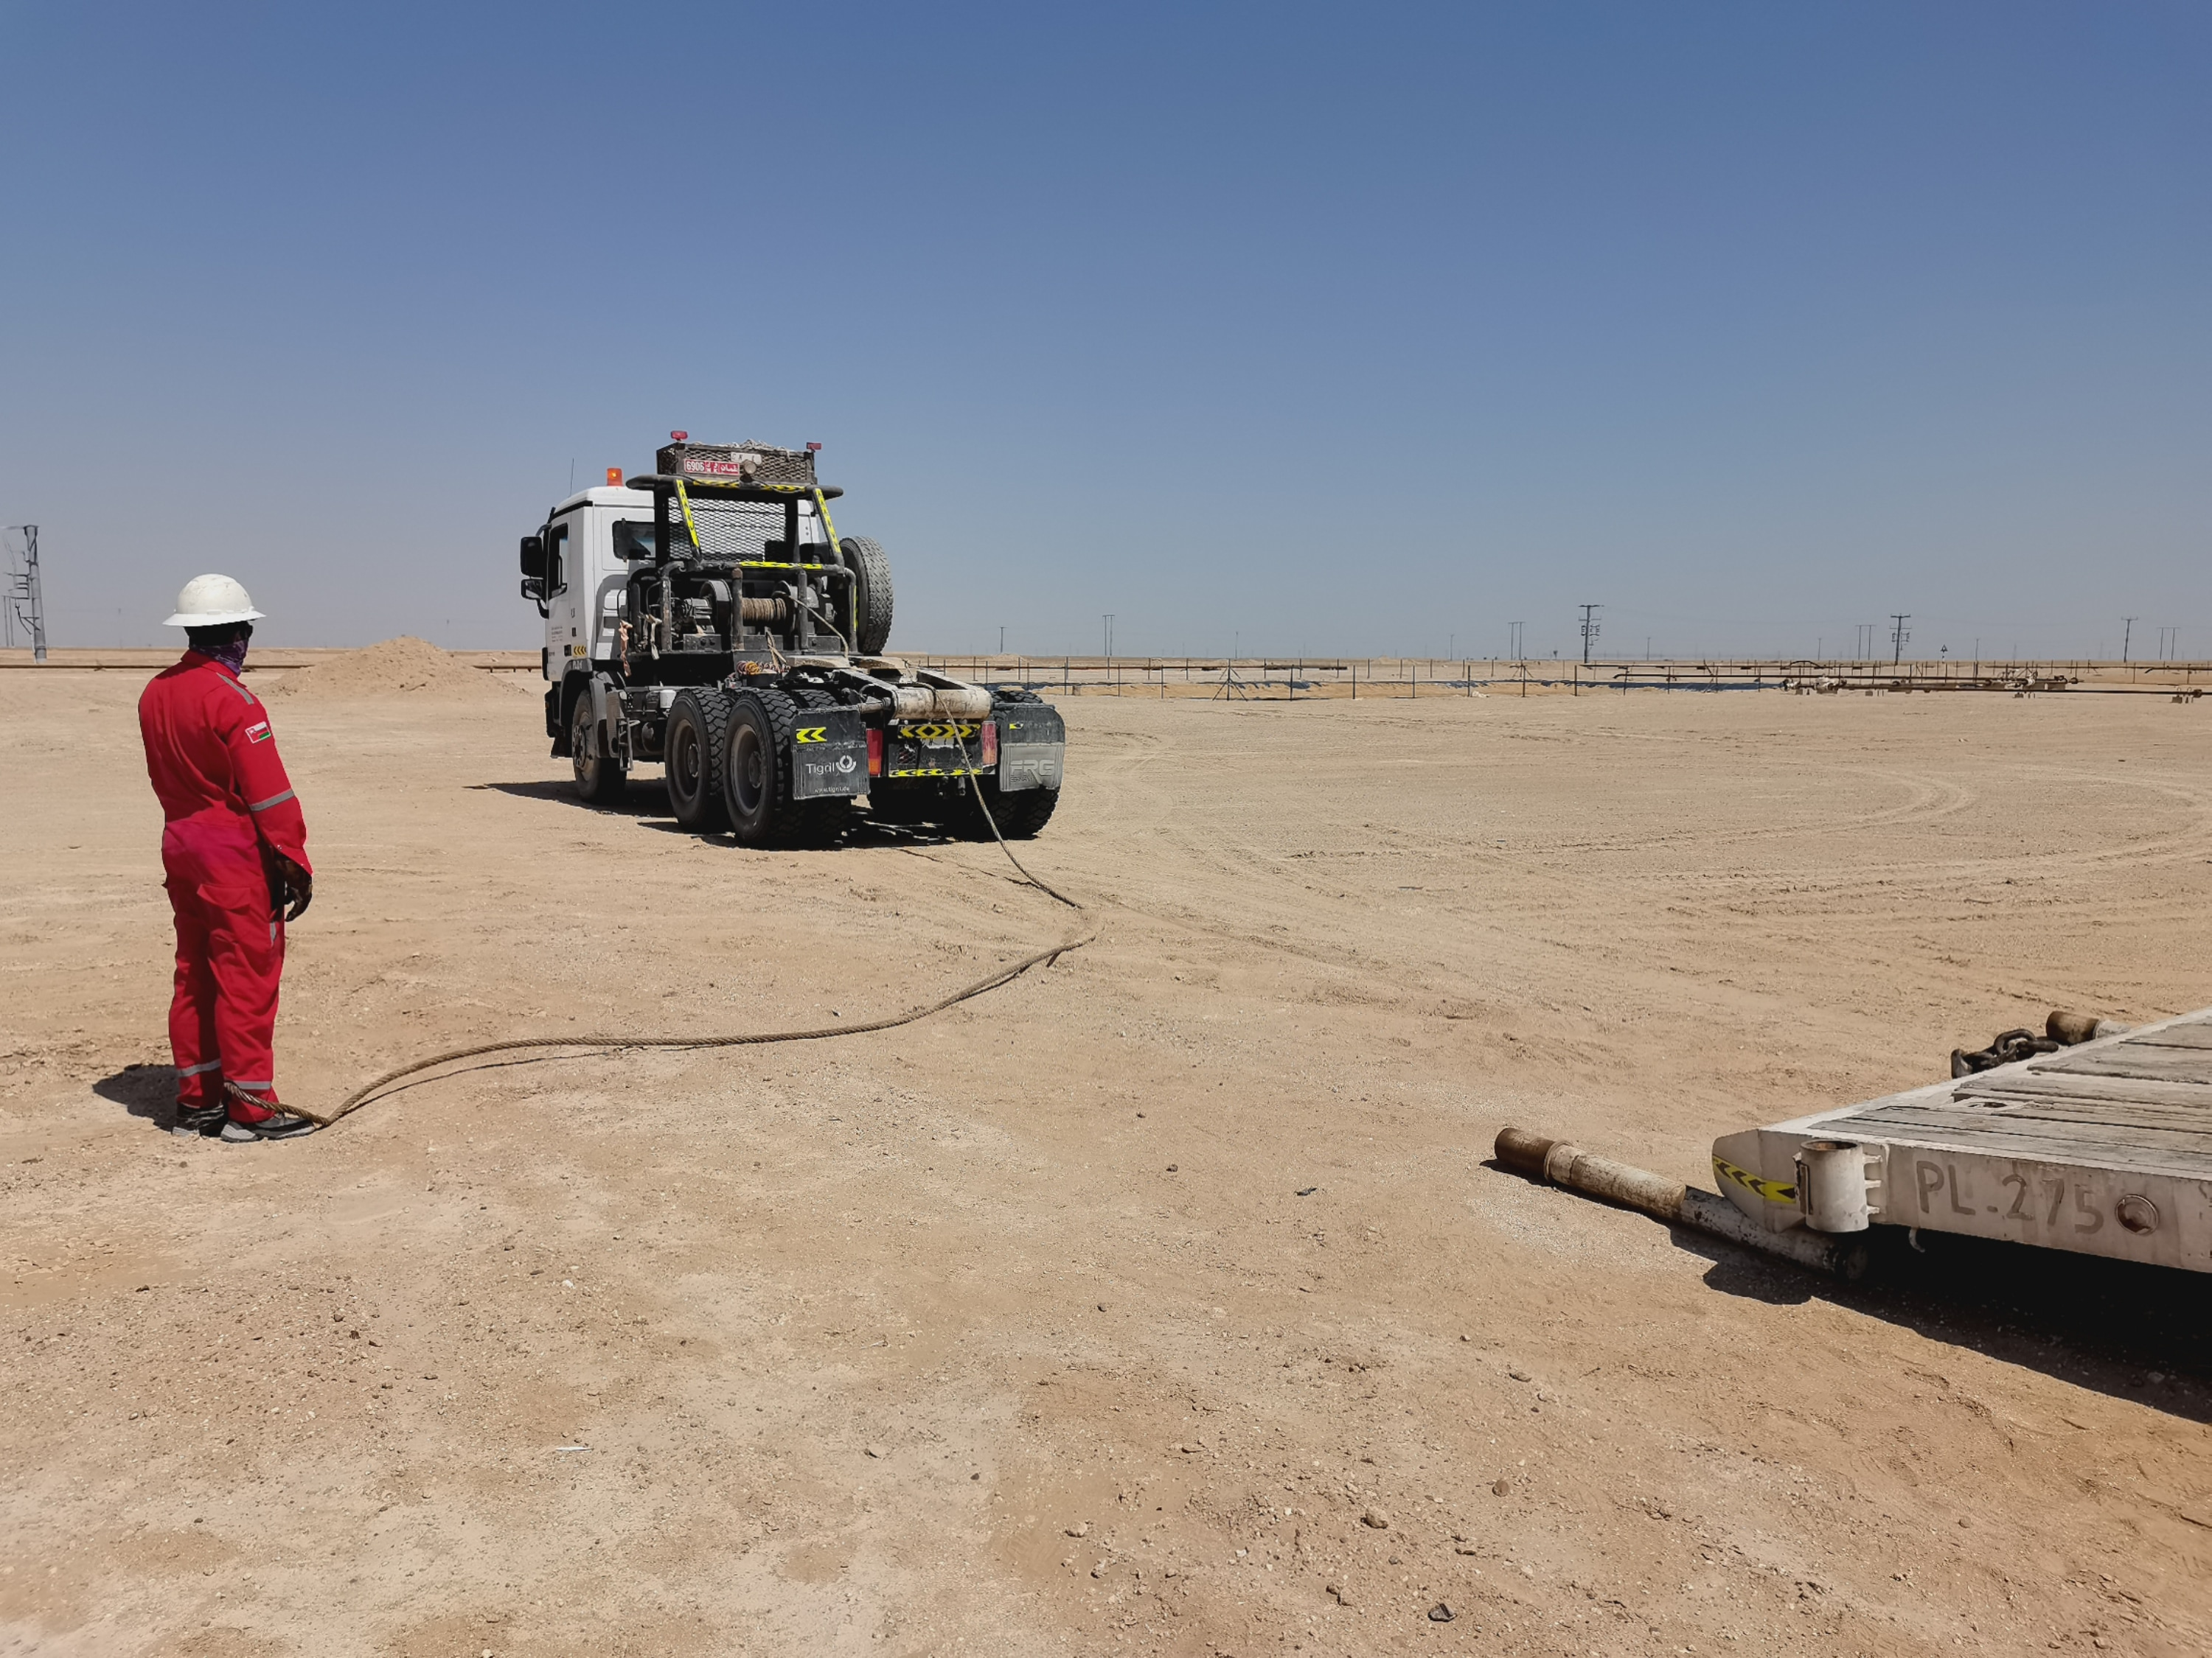
PDO Incident First Alert
Incident Type | LTI#37 | Pattern | Released Energy | In case of an emergency please call PDO Emergency Number (Toll Free): 2467-5555
Date / Time | 06.10.2022@17:30hrs | Directorate
Location | WPH-12, Qarn Alam | Department
Target Audience: Well Engineering, Infrastructure, Operations, Engineering, Project Delivery & External Affairs
What happened
While winching the trailer loaded with forklift, the sling got released and hit the forklift operators’ foot causing fracture to his right foot ankle.
Mr. Musleh asks the questions if it can happen to you?
Do you ensure that you are away from “line of fire”?
Do you ensure that you inspect the lifting gear before use?
Do you ensure proper supervision during the task?
Do you ensure proper controls in place while carrying out outside activities?
Winch trailer sling
Winch trailer sling moved towards operator
Please disseminate this LTI notification to your teams and use it in your tool box talks and HSE meetings and notice boards.

