Slide 1
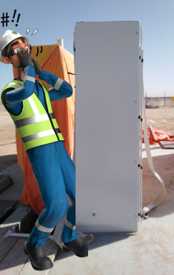
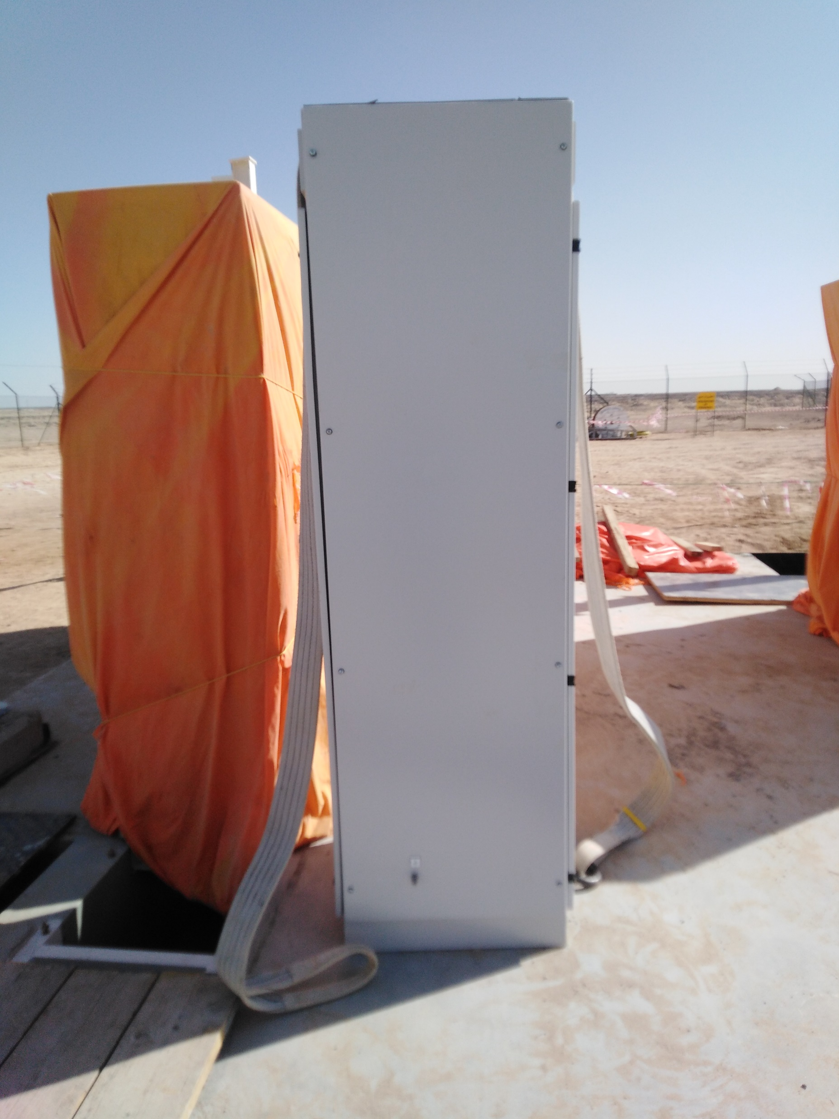
PDO Incident First Alert
Incident Type | LTI#38 | Pattern | Drops | In case of an emergency please call PDO Emergency Number (Toll Free): 2467-5555
Date / Time | 12.10.2022@14:20hrs | Directorate
Location | Saih Rawl | Department
Target Audience: Well Engineering, Infrastructure, Operations, Engineering, Project Delivery & External Affairs
What happened
While the Rigger was engaged in a lifting activity of a single cubical panel, it tilted between the lifting belts and fell on the rigger legs causing bilateral leg fracture.
Mr. Musleh asks the questions if it can happen to you?
Do you ensure you identify all hazards before starting a task?
Do you ensure you are in a safe position while performing a task?
Do you ensure to follow proper lifting procedures?
Do you ensure proper supervision during the task?
Please disseminate this LTI notification to your teams and use it in your tool box talks and HSE meetings and notice boards.

