Slide 1
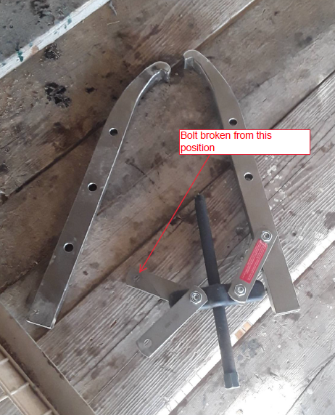
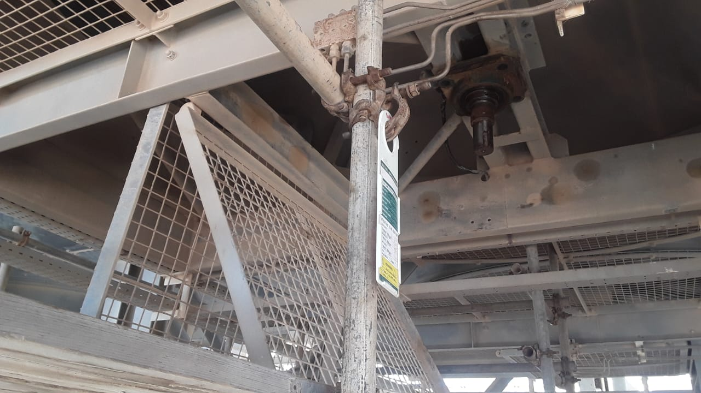
PDO Incident First Alert - PDO
Incident Type | LTI#39 | Pattern | Released Energy | In case of an emergency please call PDO Emergency Number (Toll Free): 2467-5555
Date / Time | 10.10.2022@16:00hrs | Directorate
Location | Amal steam plan On plot | Department
Target Audience: Well Engineering, Infrastructure, Operations, Engineering, Project Delivery & External Affairs
What happened
While the Mechanical Technician was assisting the crew in replacing the cooler fan bearing, using two arm puller, bolt broke from one arm and hit the technicians’ face causing multiple right side facial fractures
Mr. Musleh asks the questions if it can happen to you?
The Puller
Do you ensure you identify all hazards before starting a task?
Do you ensure you are in a safe position while performing a task?
Do you wear correct PPE for the task?
Do you ensure proper tool is used for the task?
Do you ensure proper supervision during the task?
Location of fan bearing
Position of the Technician
The bolt that hit the Technician
Please disseminate this LTI notification to your teams and use it in your tool box talks and HSE meetings and notice boards.

