Slide 1
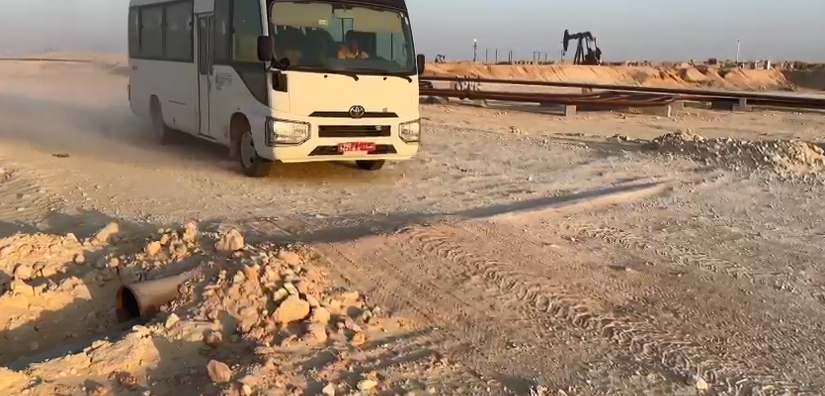
PDO Incident First Alert
Incident Type | LTI#40 | Pattern | MVI | In case of an emergency please call PDO Emergency Number (Toll Free): 2467-5555
Date / Time | 24.10.2022@06:32hrs | Directorate
Location | Rig-82, Marmul | Department
Target Audience: Well Engineering, Infrastructure, Operations, Engineering, Project Delivery & External Affairs
What happened
While the Assistant Mechanic was seated in a crew bus post his night shift duty, the bus crossed a hump at a graded road. Instantly, the Assistant mechanic felt a severe pain on his right hip and suffered fracture of right leg femur bone.
Mr. Musleh asks the questions if it can happen to you?
Do you ensure all vehicle occupants are wearing seat belts?
Do you intervene with the driver when you feel unsafe?
Do you reduce your speed while crossing speed humps?
Please disseminate this LTI notification to your teams and use it in your tool box talks and HSE meetings and notice boards.

