Slide 1
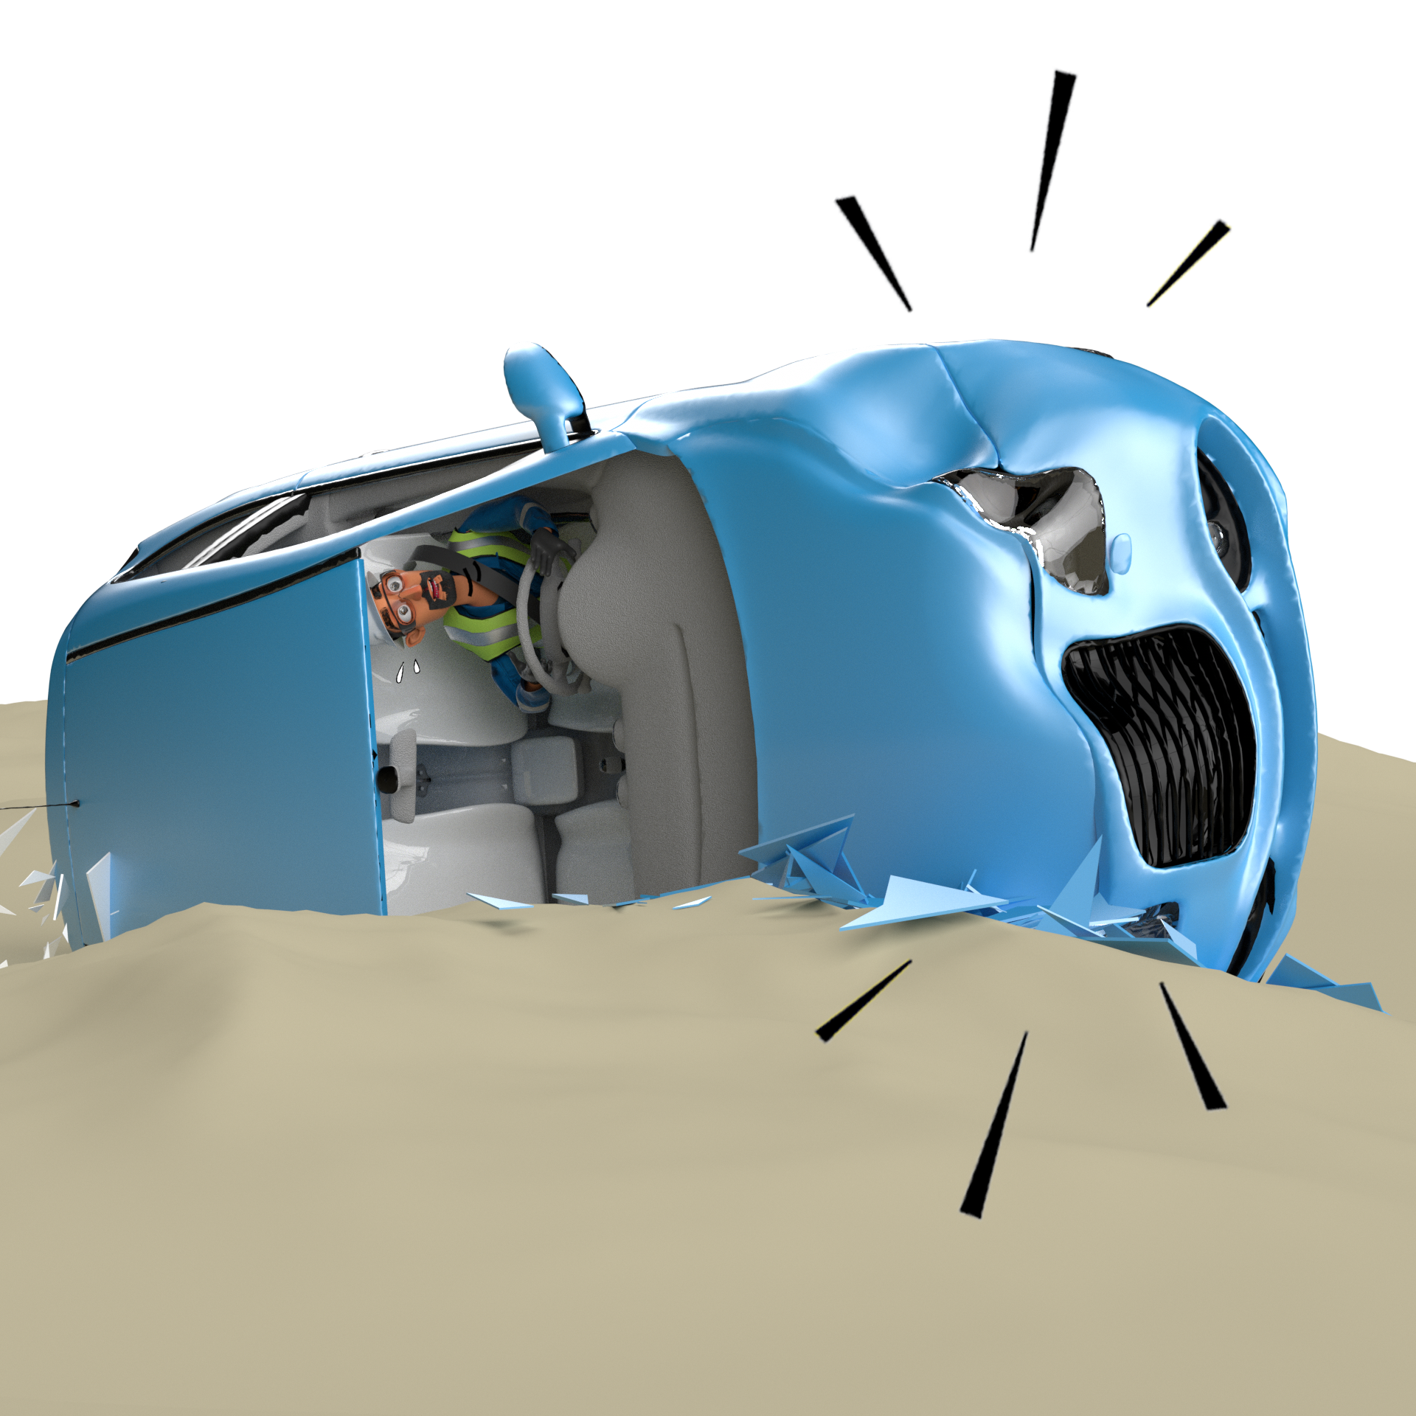
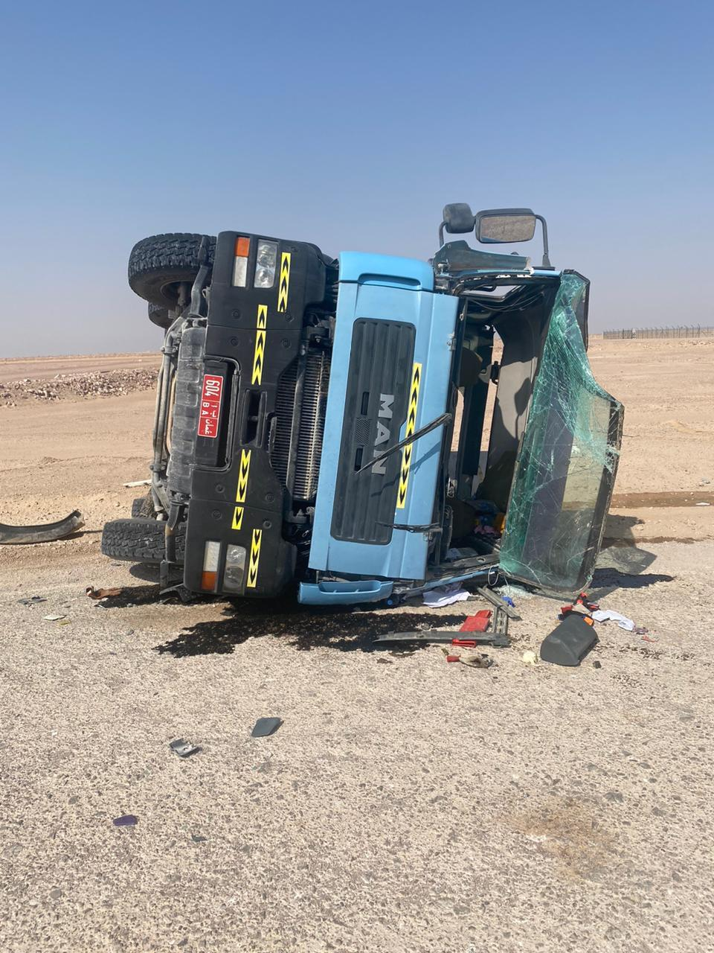
PDO Incident First Alert
Incident Type | LTI#41 | Pattern | MVI- Rollover | In case of an emergency please call PDO Emergency Number (Toll Free): 2467-5555
Date / Time | 09.11.2022@09:30hrs | Directorate
Location | Barik to Qarn Alam graded road | Department
Target Audience: Well Engineering, Infrastructure, Operations, Engineering, Project Delivery & External Affairs
What happened
While the Concrete Transit mixer Driver was travelling from Barik to Qarn Alam, he lost control and the vehicle rolled over to the left side resulting in multiple laceration at his right-hand fingers and left arm elbow.
Mr. Musleh asks the questions if it can happen to you?
Do you ensure you identify all road related hazards?
Do you always apply defensive driving techniques?
Do you Always ensure you conduct daily vehicle inspection before starting your journey?
Do you always ensure your speed is within approved limit?
Please disseminate this LTI notification to your teams and use it in your tool box talks and HSE meetings and notice boards.

