Slide 1

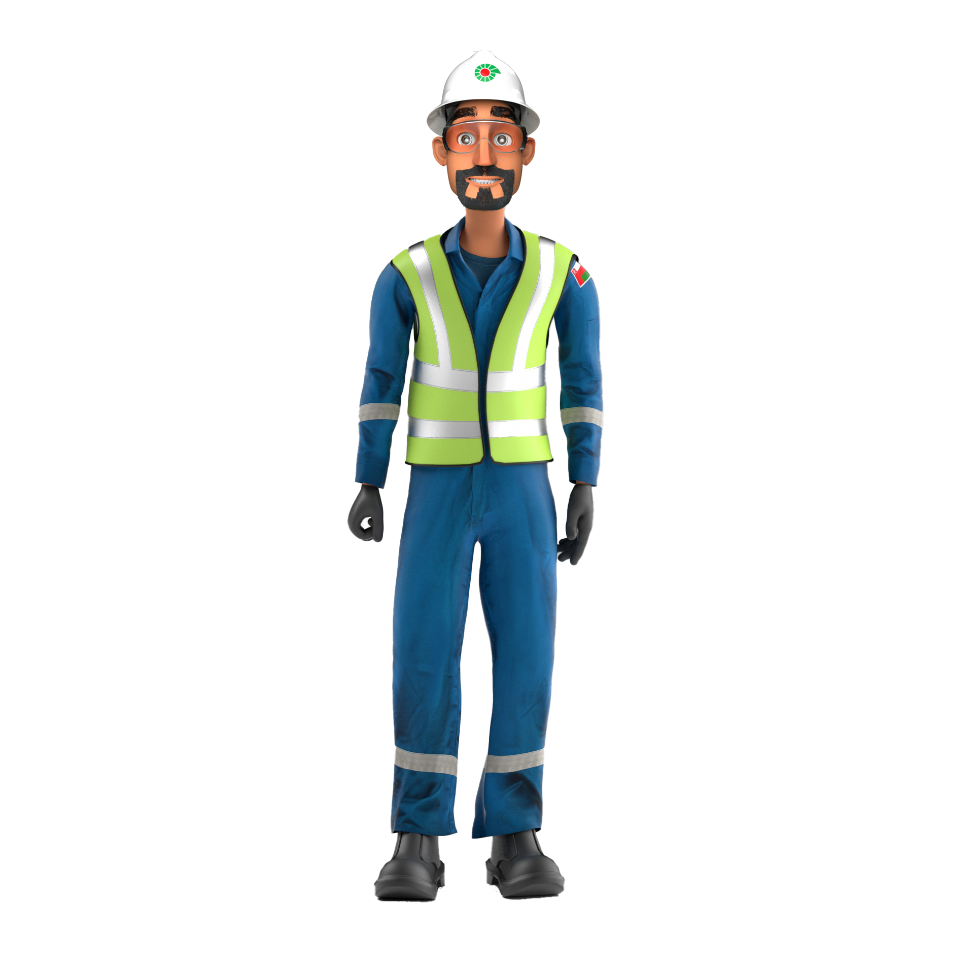
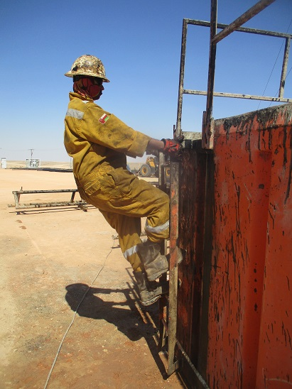


PDO Incident First Alert
Incident Type | LTI#43 | Pattern | Slip & Fall | In case of an emergency please call PDO Emergency Number (Toll Free): 2467-5555
Date / Time | 17.11.2022@16:00hrs | Directorate
Location | WPH-27, Marmul | Department
Target Audience: Well Engineering, Infrastructure, Operations, Engineering, Project Delivery & External Affairs
What happened
While the Floorman was descending from the active tank ladder , he lost his balance and fell on the ground landing on his right hand resulting in a fracture of hist right hand wrist.
Mr. Musleh asks the questions if it can happen to you?
Do you ensure you identify all slip, trip and fall hazards at your work location?
Do you always pay attention to where you are stepping?
Do you ensure to use three points of contact while ascending /descending ladders?
Do you consider what happens if you can fall from height?
Please disseminate this LTI notification to your teams and use it in your tool box talks and HSE meetings and notice boards.

