Slide 1
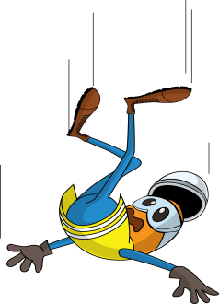
PDO Incident First Alert
Incident Type | LTI#30 | Pattern | Slip & fall | In case of an emergency please call PDO Emergency Number (Toll Free): 2467-5555
Date / Time | 22.08.2022@16:45hrs | Directorate
Location | Construction site, Nimr | Dept
Target Audience: Well Engineering, Infrastructure, Operations, Engineering, Project Delivery & External Affairs
What happened
While the Rigger was attempting to loosen the rachet belt of road crossing barrier which was loaded on a trailer, the barrier tilted towards him leading him to lose his balance and fall on ground. Simultaneously a second barrier moved and fell on his right leg causing a fracture.
Mr. Musleh asks the questions of can it happen to you?
Do you ensure you identify all hazards before starting a task?
Do you ensure you are in a safe position while performing a task?
Do you consider if you can fall from height?
Do you ensure to intervene and correct unsafe act/condition?
Please disseminate this LTI notification to your teams and use it in your tool box talks and HSE meetings and notice boards.

