Slide 1
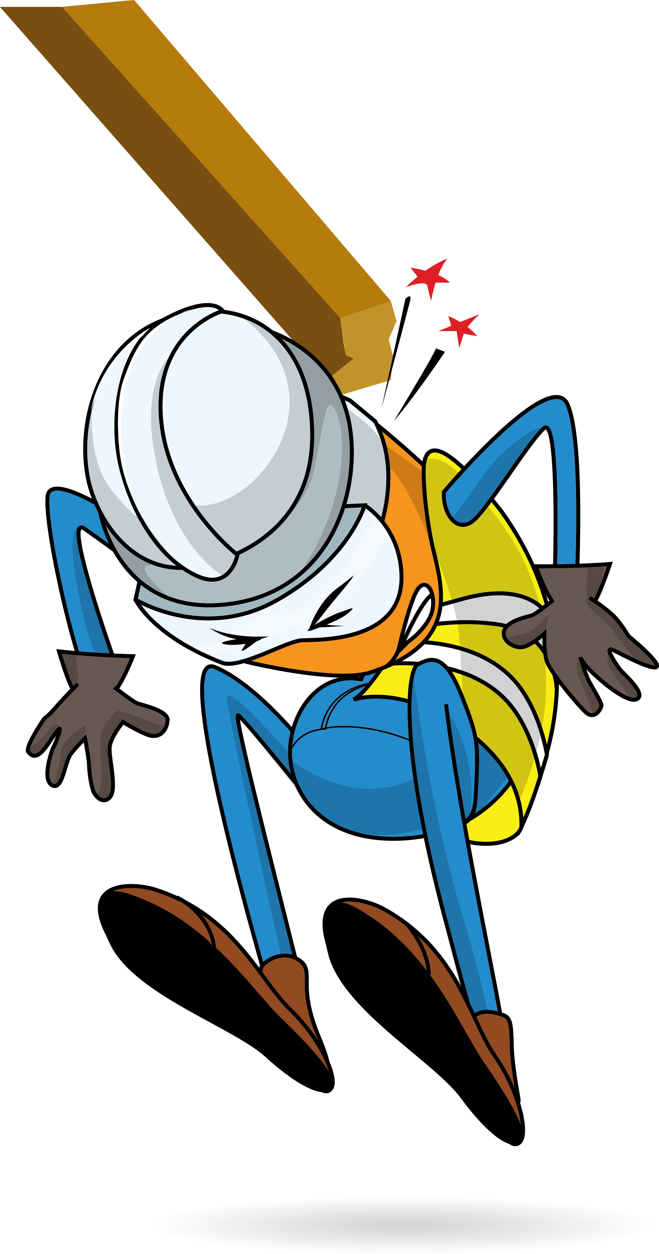
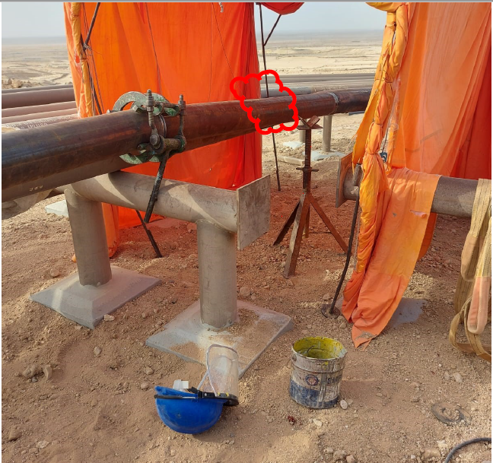
PDO Incident First Alert
Incident Type | LTI#20 | Pattern | Released Energy | In case of an emergency please call PDO Emergency Number (Toll Free): 2467-5555
Date / Time | 14.06.2022@16:30 hrs | Directorate
Location | Fahud D-station construction area | Dept
Target Audience: Well Engineering, Infrastructure, Operations, Engineering, Project Delivery & External Affairs
What happened
During the adjustment process for two flowline sections prior to welding activity, the new flowline moved toward existing flowline and hit the lower head and neck of the Grinder who was standing in between the flowlines causing injuries to his lower head and fracture to his neck. An X- ray revealed fracture to his neck and injury to his head.
Mr. Musleh asks the questions of can it happen to you?
Do you always ensure to stay away from “line of fire”?
Do you ensure you identify all hazards before starting a task?
Do you ensure adequate Supervision during task?
Do you intervene if you notice unsafe act/unsafe condition?
Please disseminate this LTI notification to your teams and use it in your tool box talks and HSE meetings and notice boards.

