Slide 1
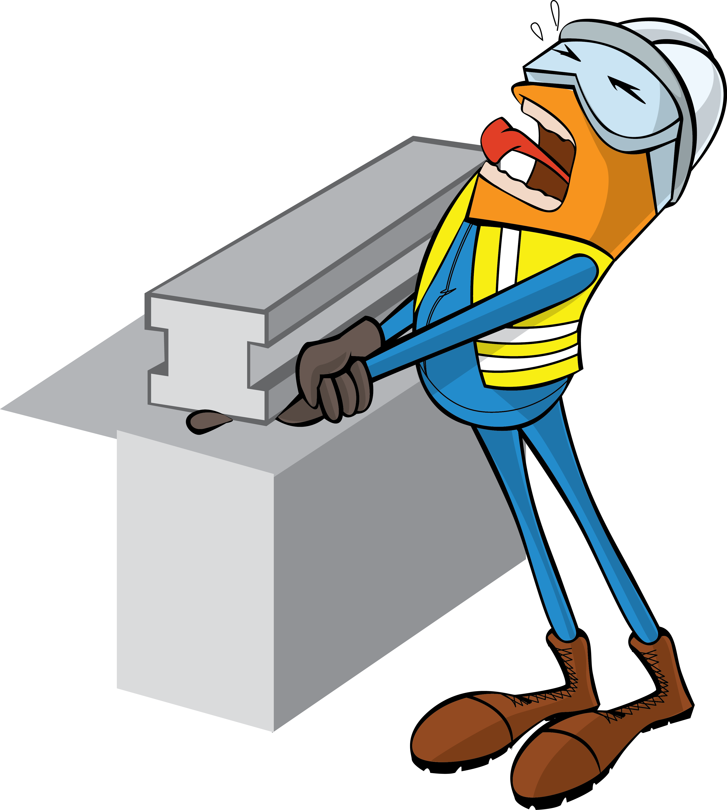

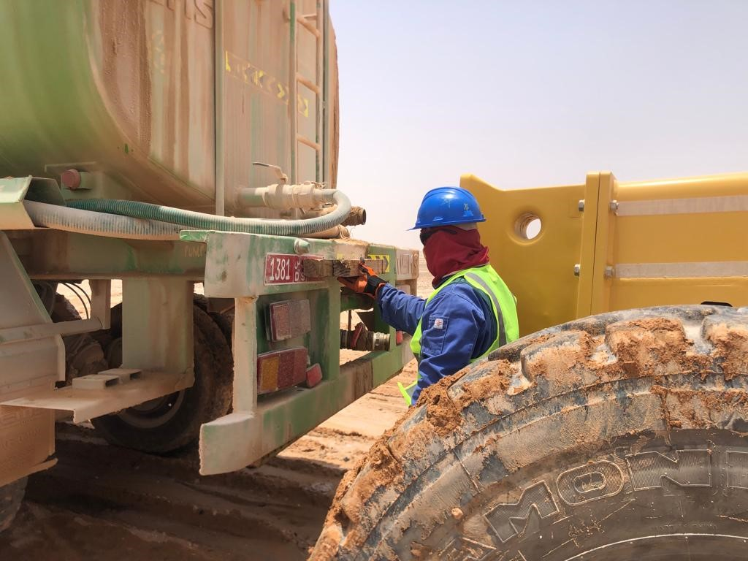


PDO Incident First Alert
Incident Type | LTI#24 | Pattern | Hands & Fingers | In case of an emergency please call PDO Emergency Number (Toll Free): 2467-5555
Date / Time | 19.06.2022@09:20 hrs | Directorate
Location | Yibal Al Huwaisah Field | Dept
Target Audience: Well Engineering, Infrastructure, Operations, Engineering, Project Delivery & External Affairs
What happened
While the Driver was placing two pieces of woods at the rear of the stuck water tanker to get it pushed out by the grader, his hand got trapped resulting in crush injury to his left hand’s index and middle fingers. An X- ray revealed fracture on both index and middle fingers.
Mr. Musleh asks the questions of can it happen to you?
Do you always ensure to place your body parts away from “line of fire”?
Do you ensure adequate Supervision during task?
Do you Stopped/intervened if you notice unsafe act/unsafe condition?
Do you ensure controls in place to manage out of sight location?
Please disseminate this LTI notification to your teams and use it in your tool box talks and HSE meetings and notice boards.

