Slide 1
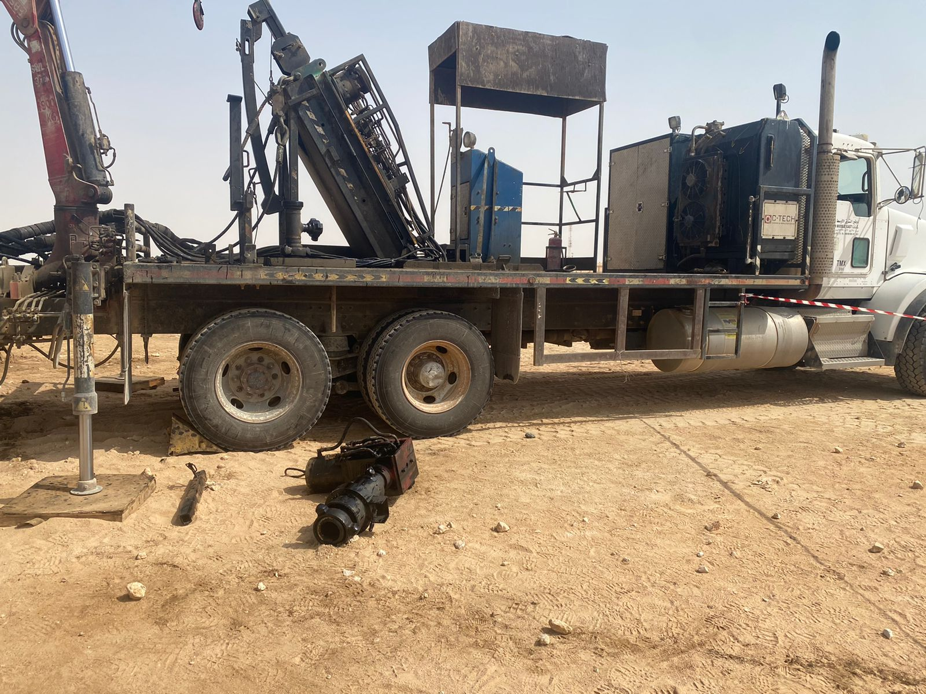
PDO Incident First Alert
Incident Type | LTI#28 | Pattern | DROPs | In case of an emergency please call PDO Emergency Number (Toll Free): 2467-5555
Date / Time | 13.07.2022@00:15 hrs | Directorate
Location | MARMUL – WPH78 | Dept
Target Audience: Infrastructure, Well Engineering, Operations, Engineering, Project Delivery & External Affairs
What happened
While the Assistant Operator was disconnecting the safety brake assembly located on the back of the trailer, the assembly fell from the trailer hitting Operator’s right foot resulting in compound fractured to his right foot.
Mr. Musleh asks the questions of can it happen to you?
Do you ensure you identify all hazards before starting a task including potential drop objects?
Do you ensure you keep your body parts away from Line Of Fire?
Do you ensure you have right procedure for the task and adhere to it?
Do you ensure to intervene when observe unsafe act/condition?
Do you ensure the management and supervision for the out of sight location?
Please disseminate this LTI notification to your teams and use it in your tool box talks and HSE meetings and notice boards.

