Slide 1
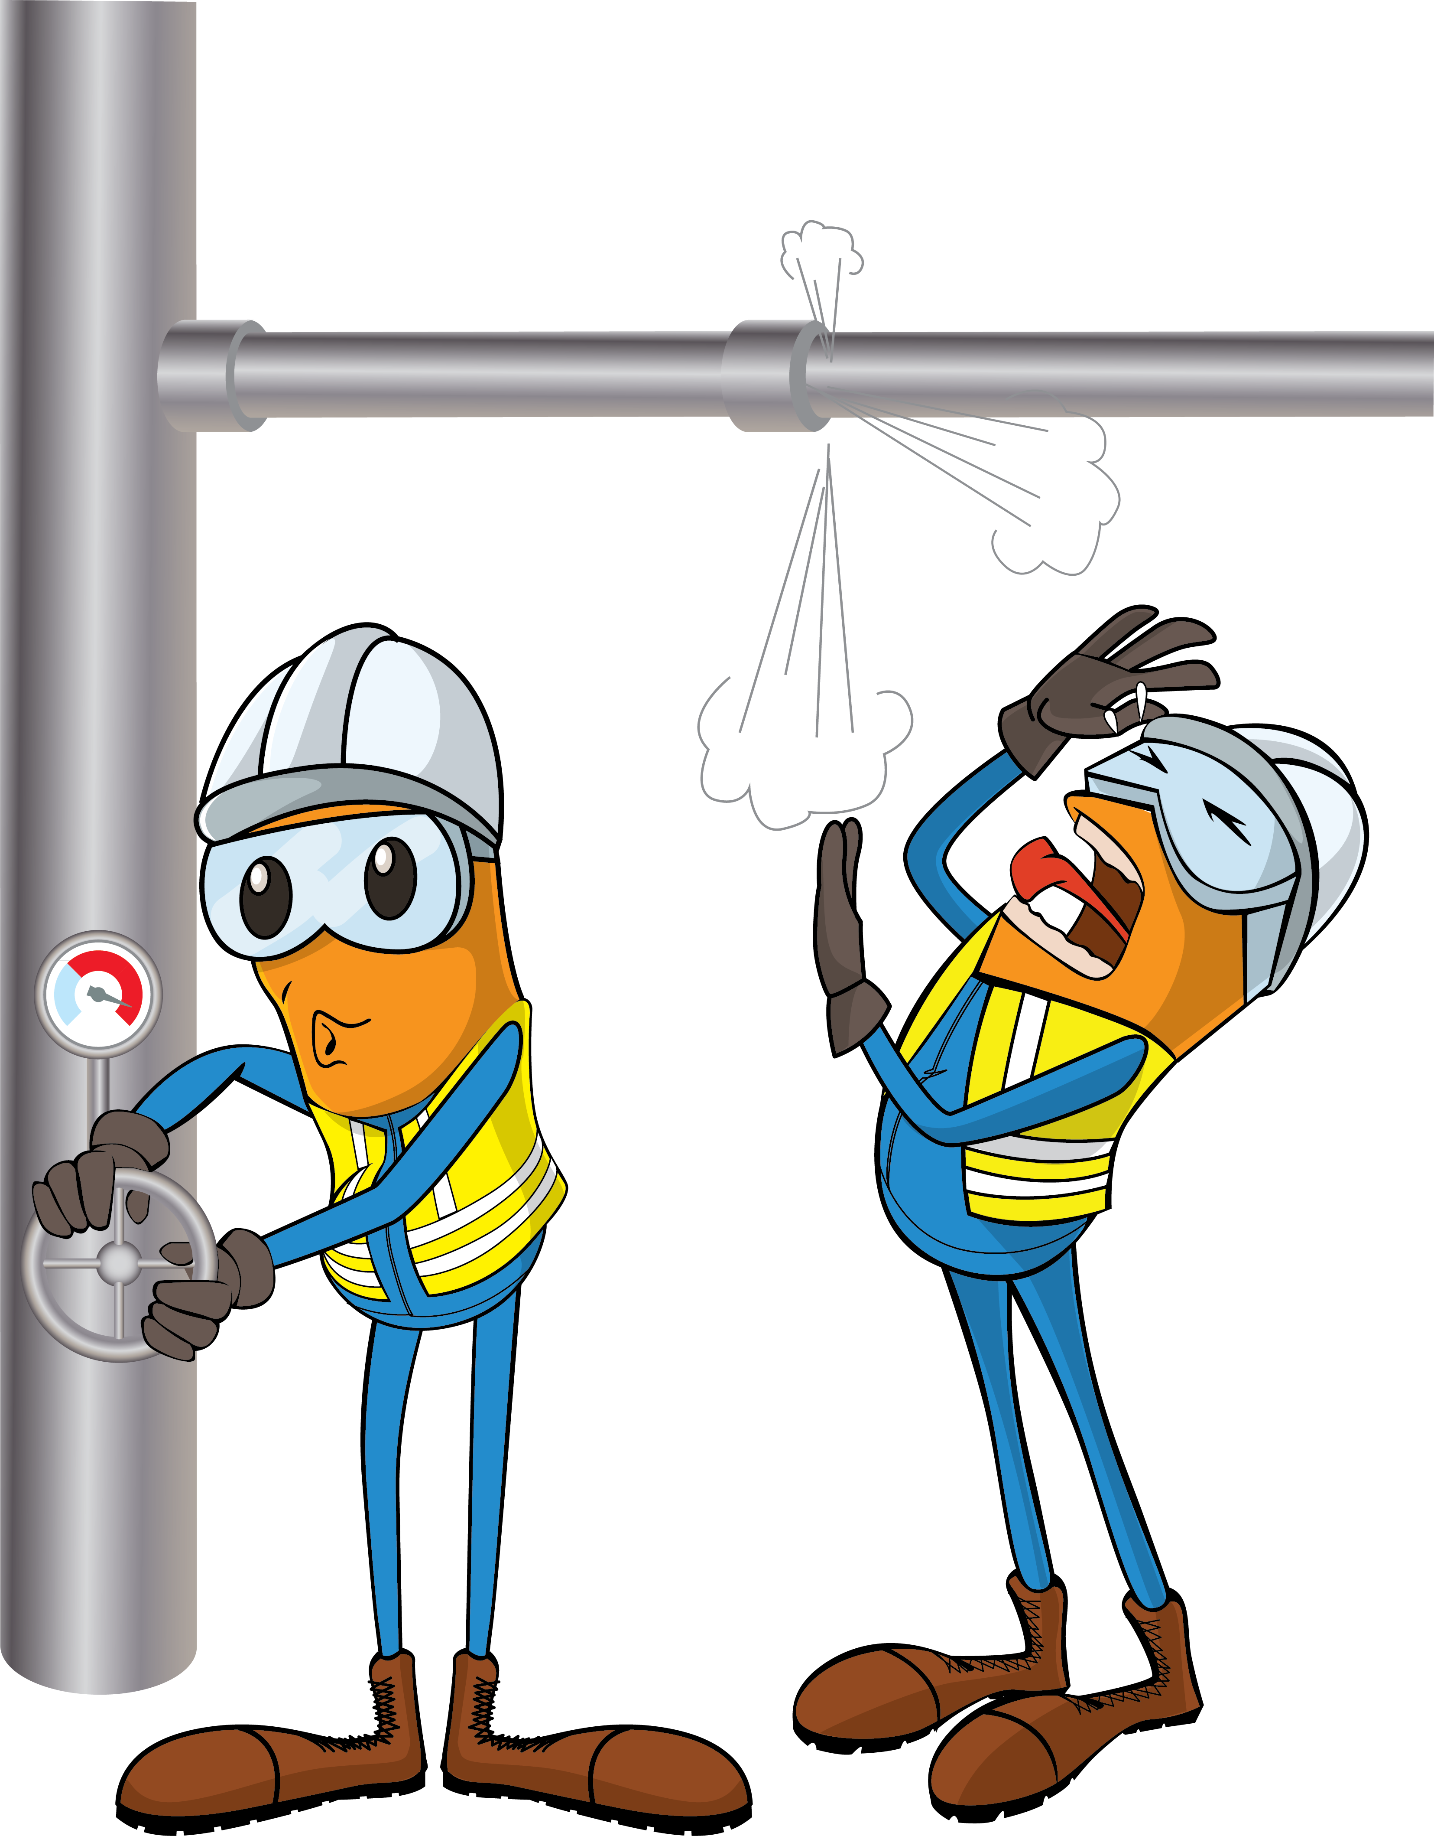
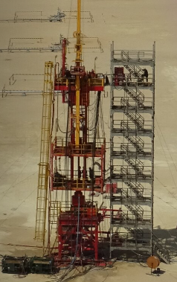
PDO Incident First Alert
Incident Type | LTI#29 | Pattern | Released Energy | In case of an emergency please call PDO Emergency Number (Toll Free): 2467-5555
Date / Time | 13.07.2022@09:05hrs | Directorate
Location | BRNW-41, Qarn Alam | Dept
Target Audience: Well Engineering, Infrastructure, Operations, Engineering, Project Delivery & External Affairs
What happened
While the Wellhead Engineer was involved in retrieving Tubing Hanger Pack off seal activity , a sudden pressure released resulting in fracture to the engineers’ Left Jaw.
Mr. Musleh asks the questions of can it happen to you?
Do you ensure that well barrier diagram is clear and understood before performing the task?
Do you always walk the line to identify the hazard/ risk of potential pressure release?
Do you ensure sub-surface uncertainties are known and discussed?
Do you ensure zone management is implemented and only required crew are in the working platform?
Do you ensure valid MOC in place if there is a deviation or variation from the standards and/or programs?
Please disseminate this LTI notification to your teams and use it in your tool box talks and HSE meetings and notice boards.

