Slide 1
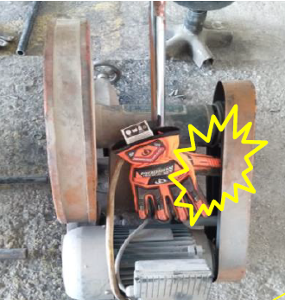
PDO Incident First Alert
Incident Type | LTI#34 | Pattern | Hands & Fingers | In case of an emergency please call PDO Emergency Number (Toll Free): 2467-5555
Date / Time | 16.09.2022@09:15hrs | Directorate
Location | BaOmar Workshop, Marmul | Department
Target Audience: Well Engineering, Infrastructure, Operations, Engineering, Project Delivery & External Affairs
What happened
While the Welder was attempting to switch off the pipe cutting machine, his right-hand thumb got crushed between the machine drive belt and the guard cover causing fracture of his right-hand thumb
Mr. Musleh asks the questions if it can happen to you?
Do you ensure you keep your hands and fingers away from pinch points?
Do you ensure you identify all hazards before starting a task?
Do you pay attention to the task in hand and the position of your body parts?
Do you ensure proper supervision during the task?
Please disseminate this LTI notification to your teams and use it in your tool box talks and HSE meetings and notice boards.

