Slide 1
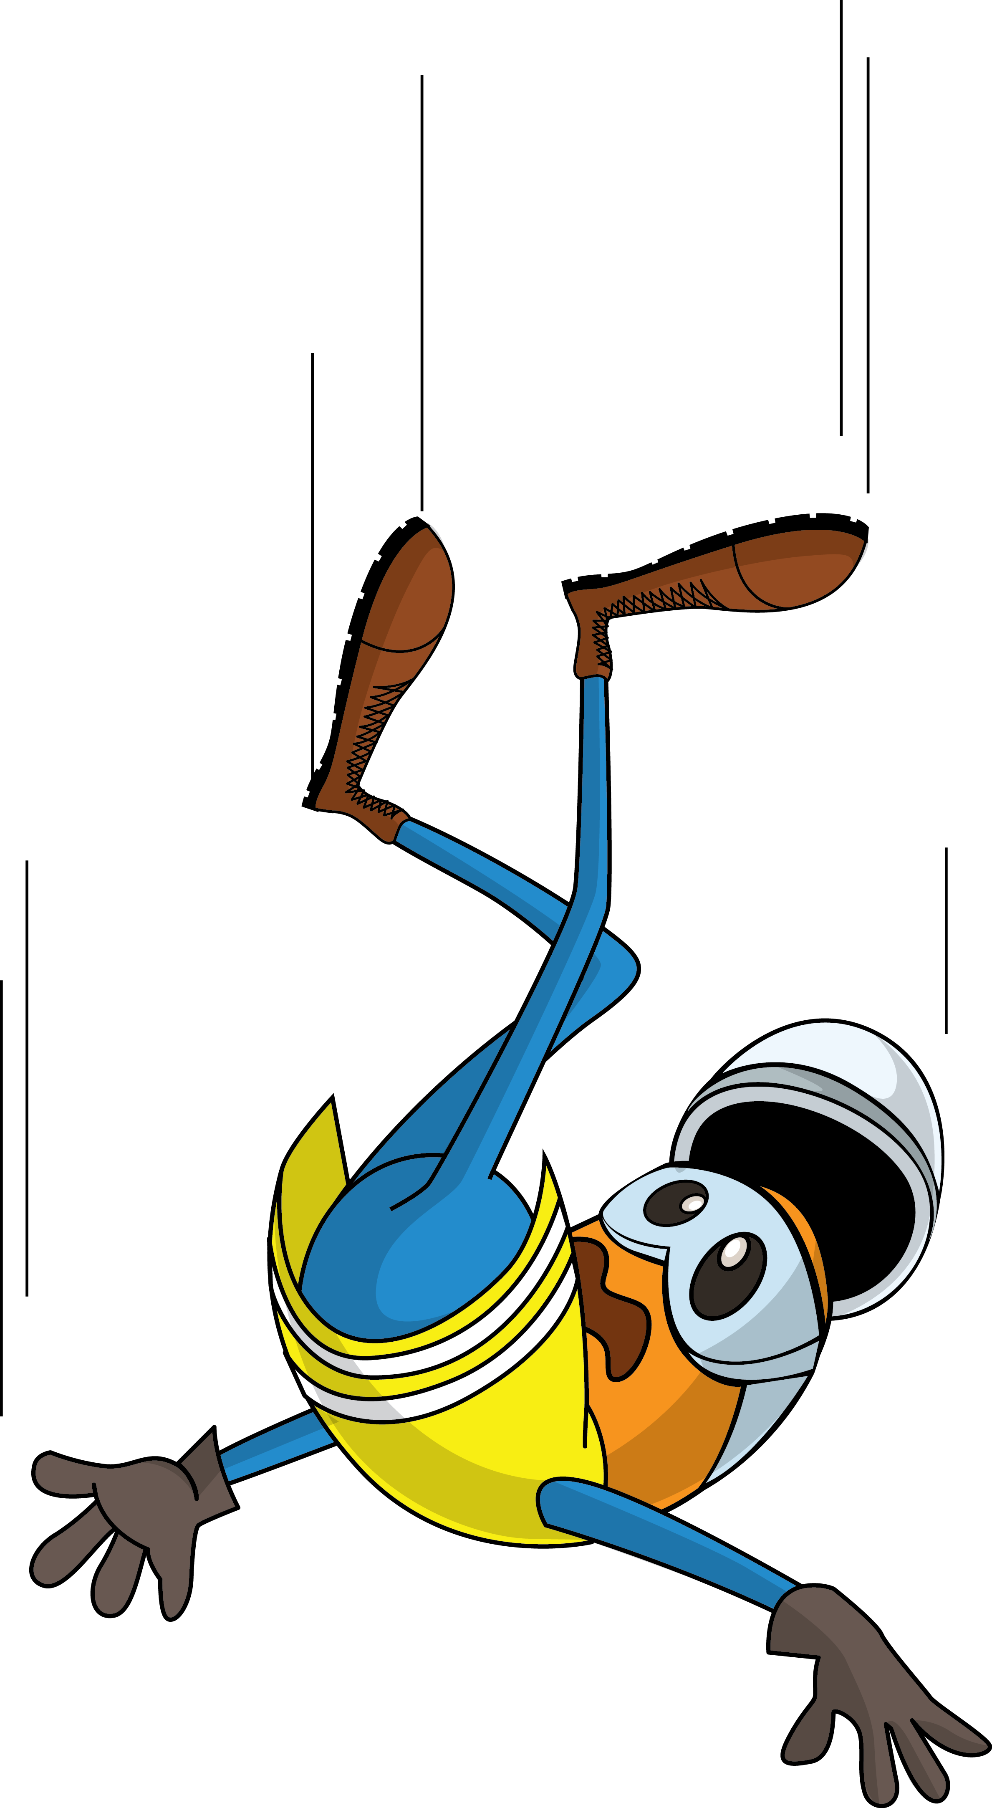
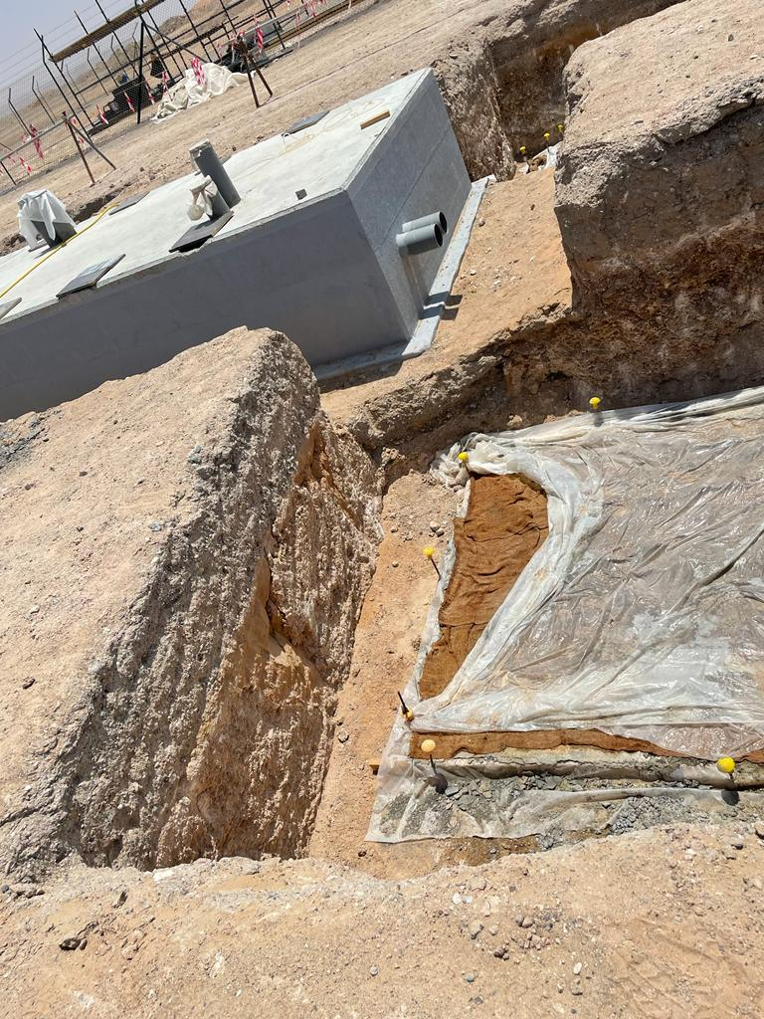
PDO Incident First Alert
Incident Type | LTI#11 | Pattern | Slip & fall | In case of an emergency please call PDO Emergency Number (Toll Free): 2467-5555
Date / Time | 09.04.2022@11:00hrs | Directorate
Location | Construction site, Lekhwair | Dept
Target Audience: Well Engineering, Infrastructure, Operations, Engineering, Project Delivery & External Affairs
What happened
Prior to offloading activity of the civil foundation and while the Carpenter was standing near to the foundation pit ,he stepped backward, lost balance and fell into the pet. His body hit a shuttering rebar and punctured his back.
Mr. Musleh asks the questions of can it happen to you?
Do you ensure you identify all surrounding hazards before starting a task?
Do you pay attention to where you stand?
Do you ensure proper supervision during the task?
Please disseminate this LTI notification to your teams and use it in your tool box talks and HSE meetings and notice boards.

