Slide 1
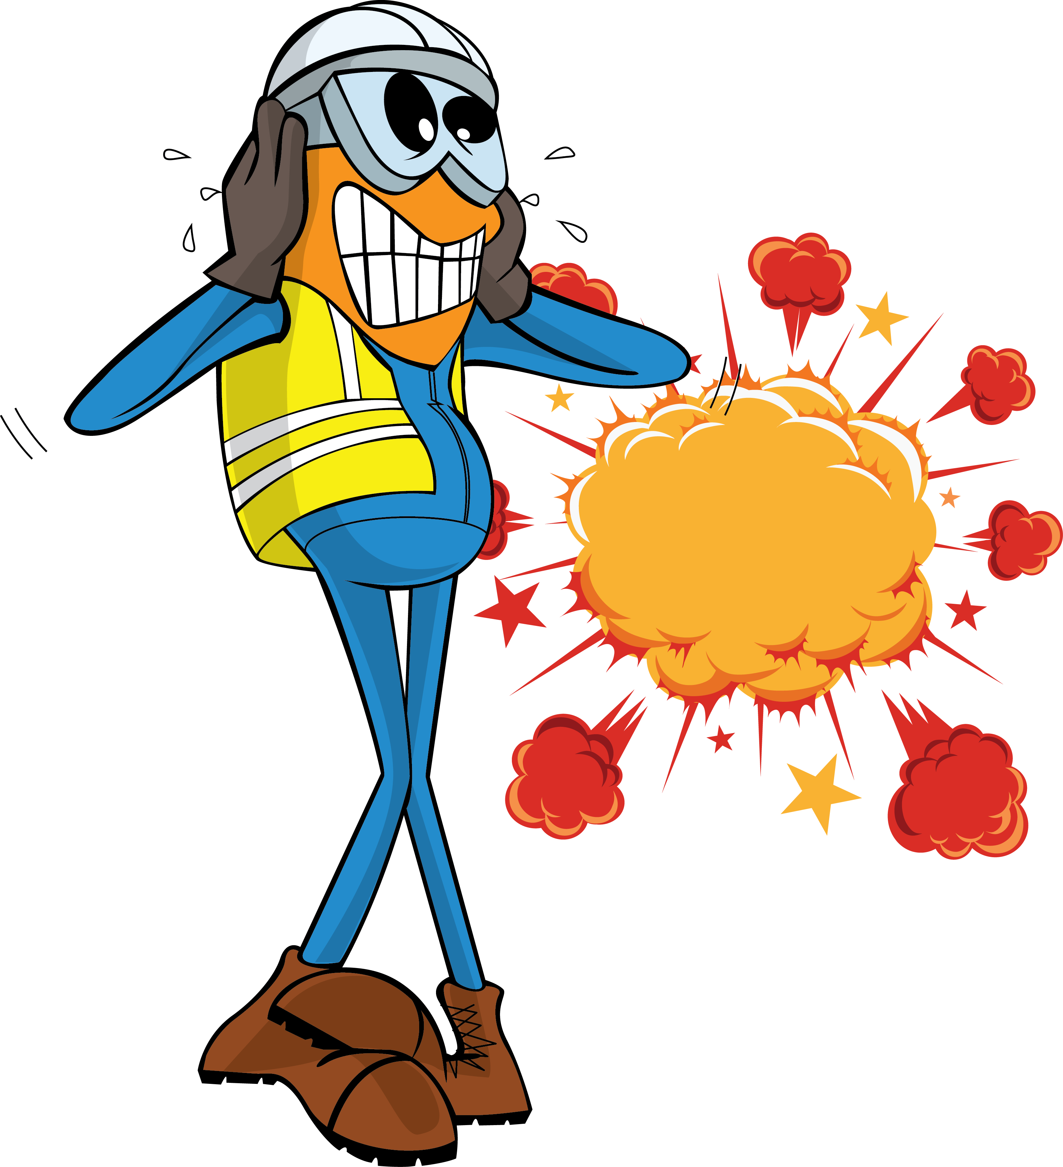
PDO Incident First Alert
Incident Type | LTI#12 &13 | Pattern | Fire & Explosion | In case of an emergency please call PDO Emergency Number (Toll Free): 2467-5555
Date / Time | 21.04.2022@17:20hrs | Directorate
Location | Rig-101, Nimr | Dept
Target Audience: Well Engineering, Infrastructure, Operations, Engineering, Project Delivery & External Affairs
What happened
During the process of MWD probe installation and while the engineers were attempting to latch the running tool to the fish neck of the probe, the lifting clamp accidentally opened and dropped on the rotary causing the probe to strike inside the NMDC (Non-Magnetic Drill Collar) and caused explosion of the lithium battery pack inside the probe which resulted in moderate burn injuries on right hand of both engineers and fracture of two fingers of one of the engineers.
Driller
Mr. Musleh asks the questions of can it happen to you?
Do you ensure you identify all hazards before starting a task?
Do you ensure proper supervision during the task?
Do you ensure you use the right tools before starting the task?
Do you ensure to intervene and correct unsafe act/condition?
MWD Eng
MWD Eng
Please disseminate this LTI notification to your teams and use it in your tool box talks and HSE meetings and notice boards.

