Slide 1
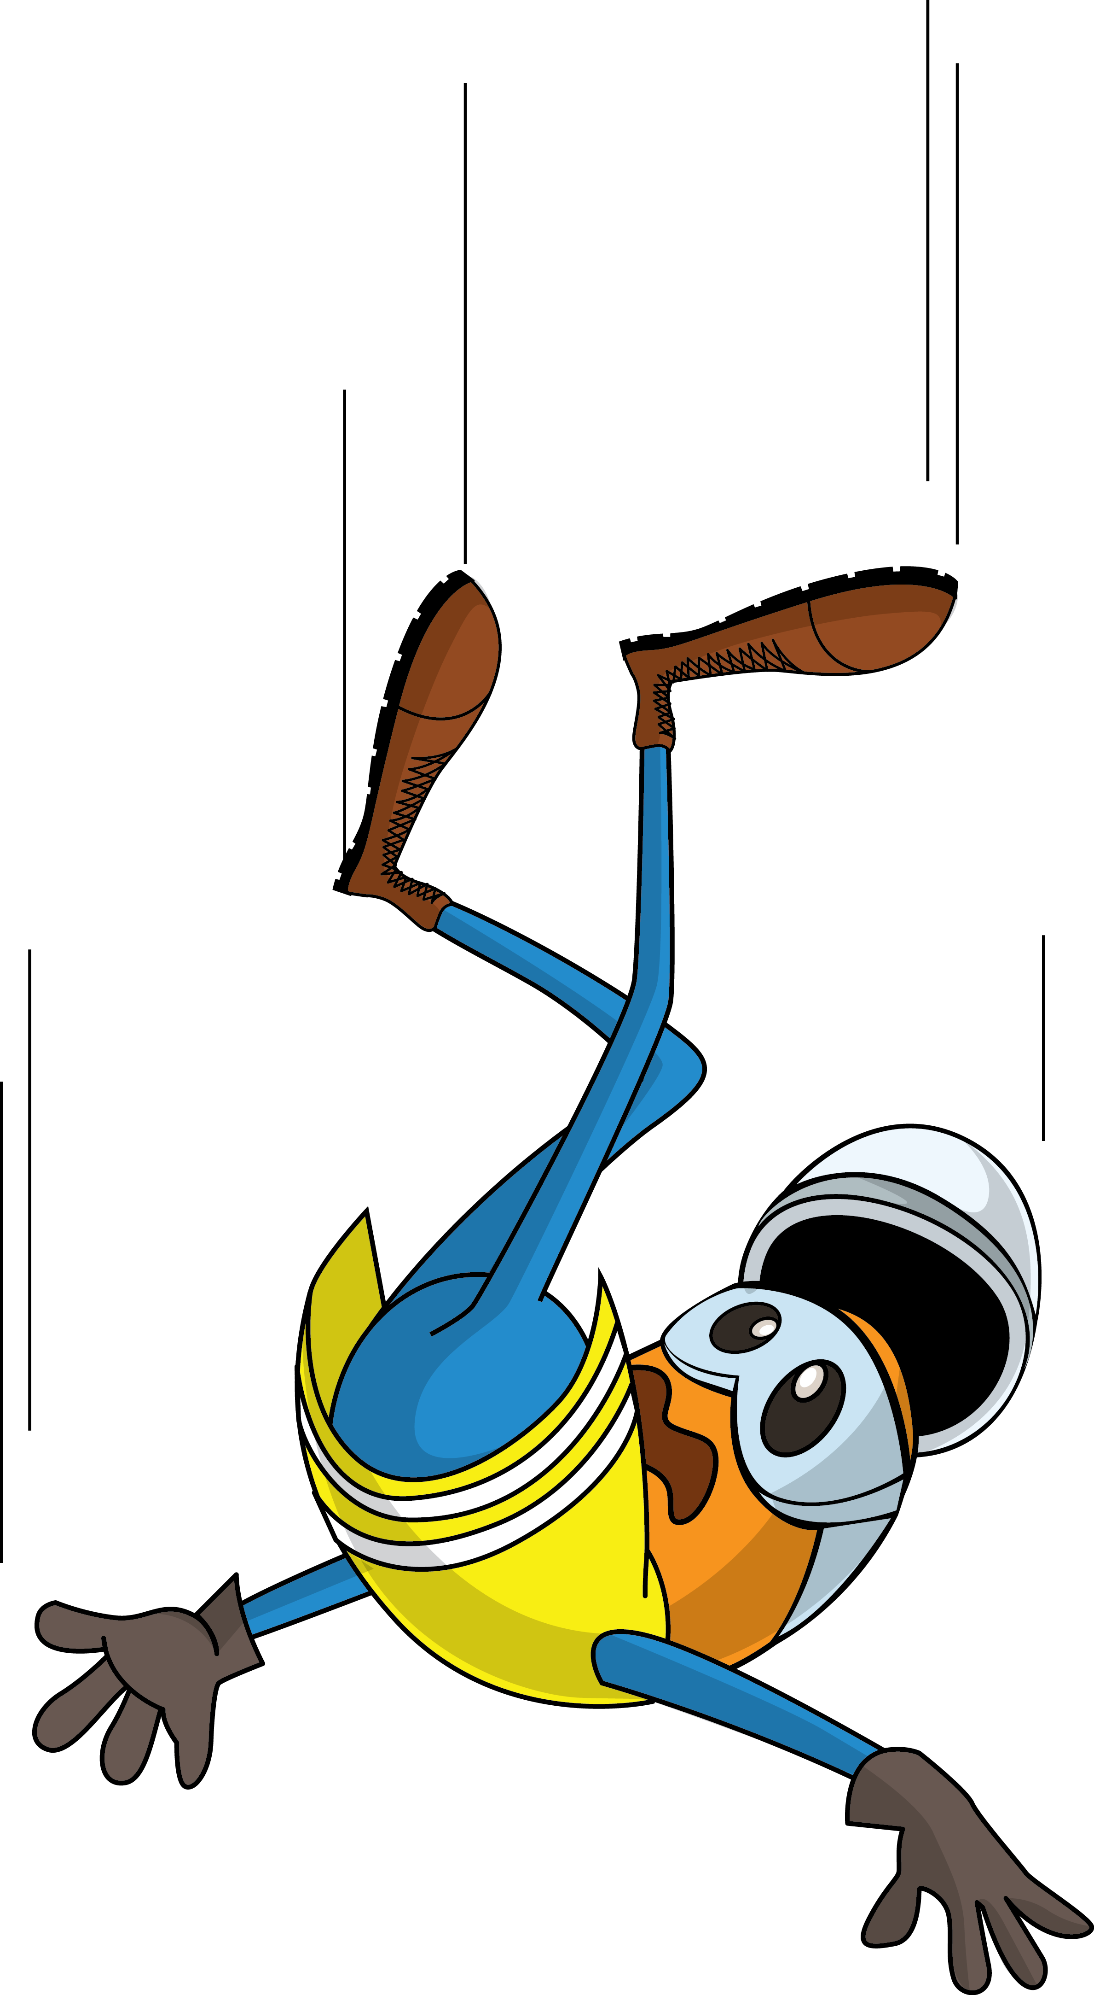
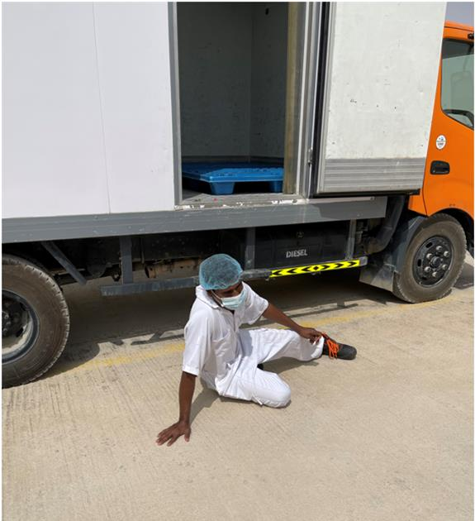
PDO Incident First Alert
Incident Type | LTI#14 | Pattern | Slip & fall | In case of an emergency please call PDO Emergency Number (Toll Free): 2467-5555
Date / Time | 01.05.2022@07:30hrs | Directorate
Location | ATE Camp, Nimr | Dept
Target Audience: Well Engineering, Infrastructure, Operations, Engineering, Project Delivery & External Affairs
What happened
While the catering staff was descending from the freezer truck cabin, he lost his balance and fell on the ground landing on his right hand and causing fracture to his right-hand wrist.
Mr. Musleh asks the questions of can it happen to you?
Do you ensure you identify all hazards around your working location?
Do always pay attention to where you are stepping?
Do you ensure you are wearing the correct type of footwear?
Do you ensure you have safe access and egress?
Do you always consider how you can fall from height?
Please disseminate this LTI notification to your teams and use it in your tool box talks and HSE meetings and notice boards.

