Slide 1
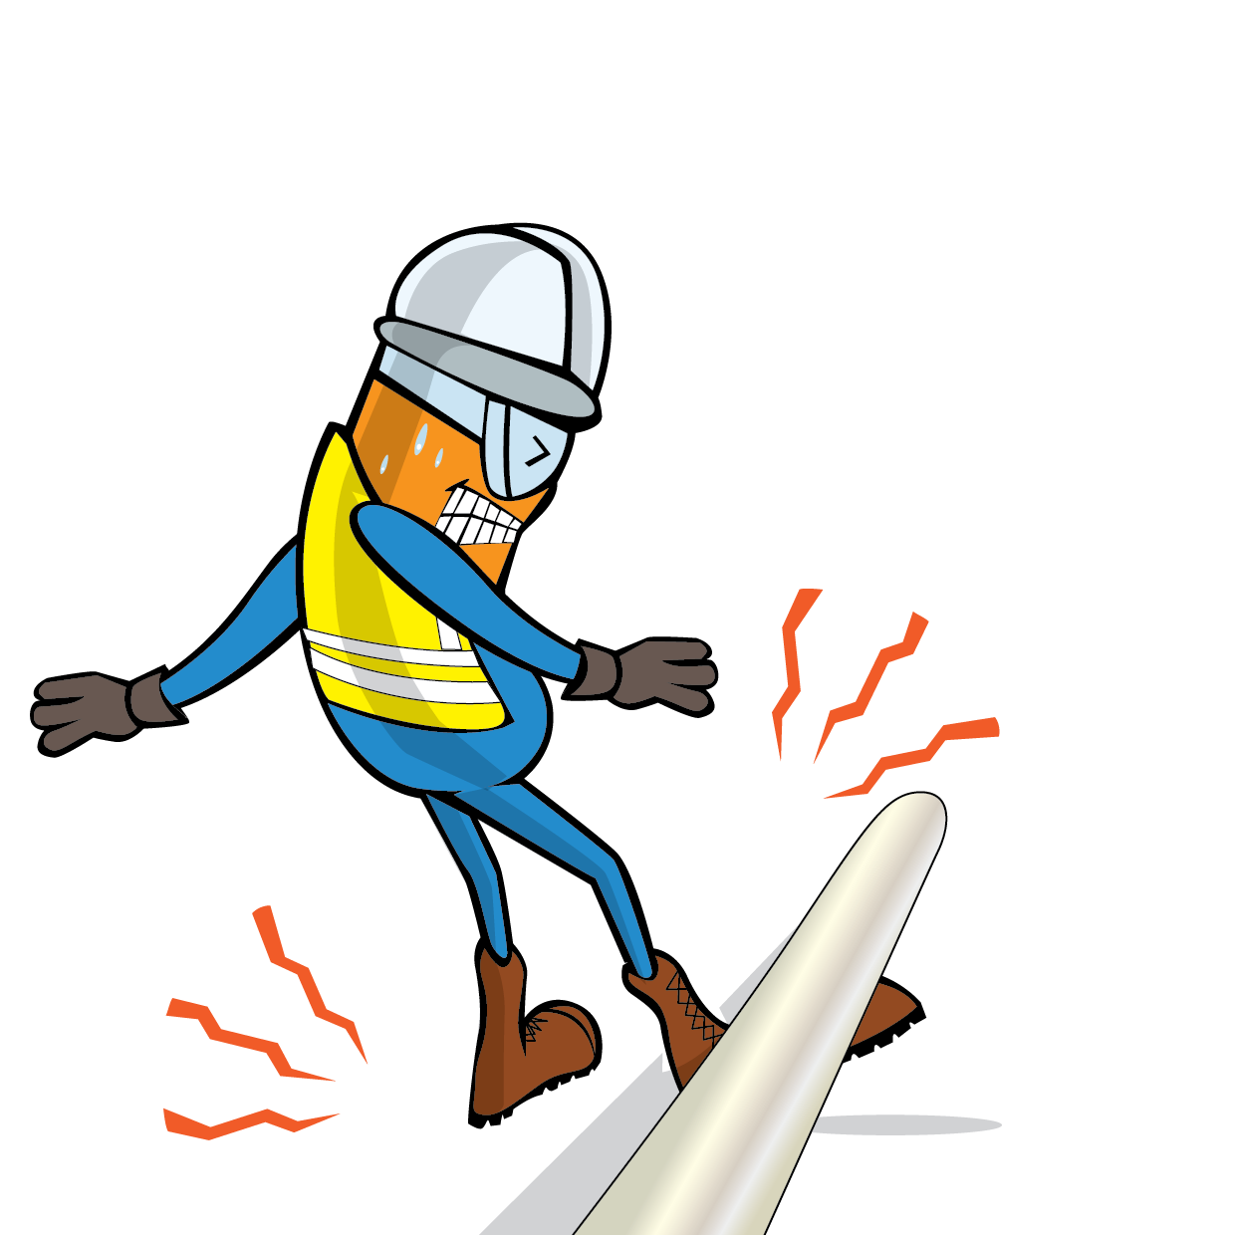
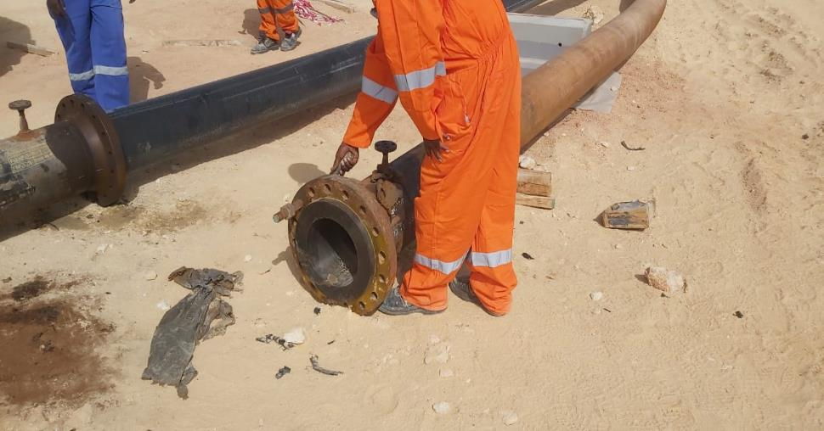
PDO Incident First Alert
Incident Type | LTI#15 | Pattern | Released Energy | In case of an emergency please call PDO Emergency Number (Toll Free): 2467-5555
Date / Time | 01.05.2022@ 13:30hrs | Directorate
Location | PL 07- Block 02 , Marmul | Dept
Target Audience: Well Engineering, Infrastructure, Operations, Engineering, Project Delivery & External Affairs
What happened
While the Rigger was attempting to release the stiffened bolt from the flange which was holding the 12-inch pipeline for PE liner activity using a hammer, suddenly the pipe shifted rapidly from the foundation and hit his left lower leg causing a fracture to his left lower leg.
Mr. Musleh asks the questions of can it happen to you?
Do you ensure to stay away from line of fire?
How do you ensure you identify all hazards before starting a task?
Do you ensure you follow the correct procedure?
Do you ensure proper supervision during the task?
Please disseminate this LTI notification to your teams and use it in your tool box talks and HSE meetings and notice boards.

