Slide 1
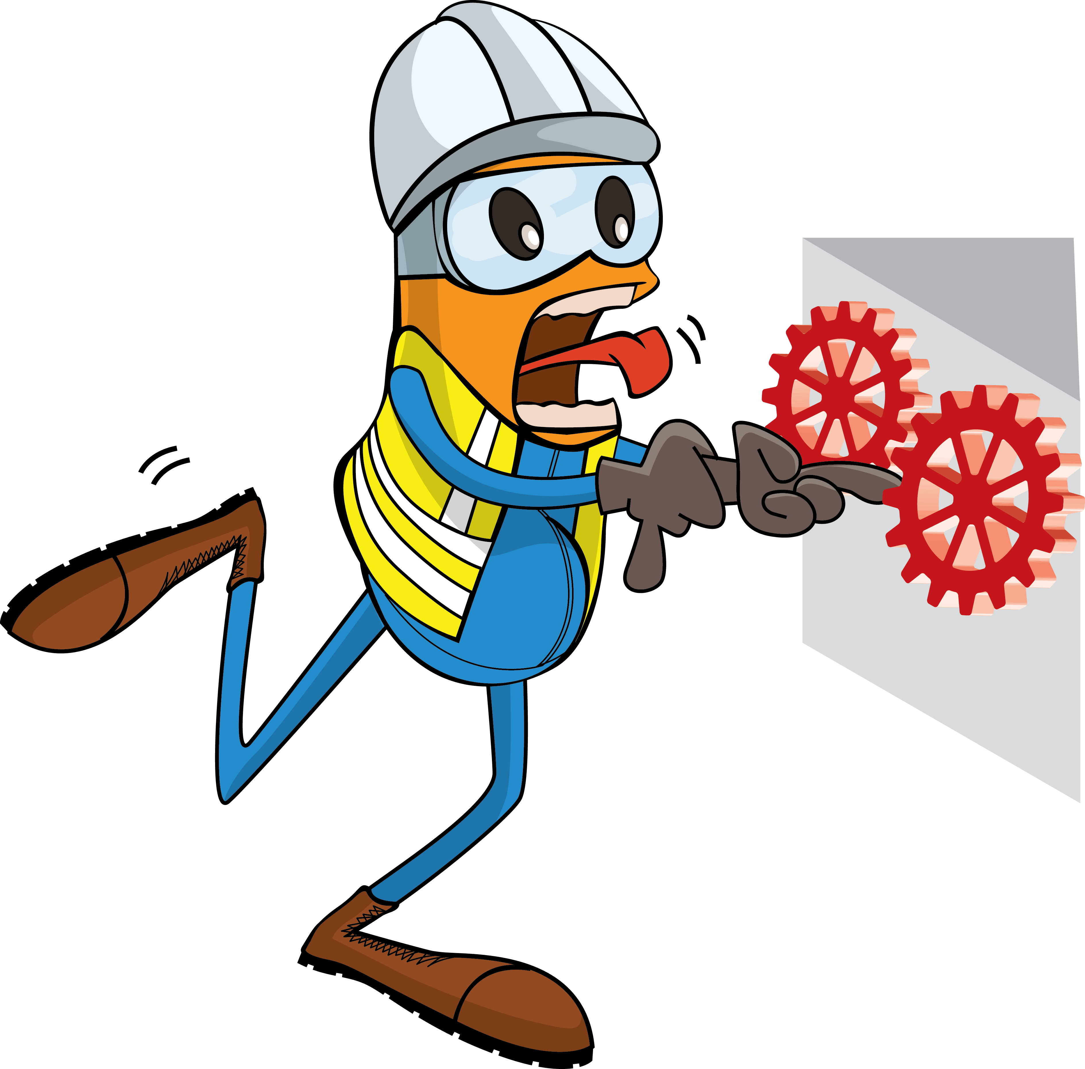
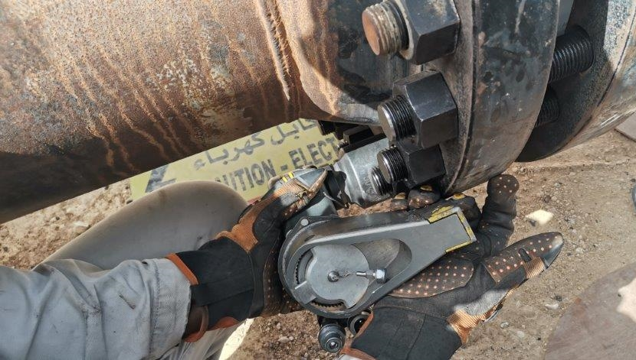
PDO Incident First Alert
Incident Type | LTI#16 | Pattern | Hands & Fingers | In case of an emergency please call PDO Emergency Number (Toll Free): 2467-5555
Date / Time | 05.05.2022@ 13:55 hrs | Directorate
Location | Rakid Area, Amal | Dept
Target Audience: Well Engineering, Infrastructure, Operations, Engineering, Project Delivery & External Affairs
What happened
While the Technician was performing hydraulic torqueing activity, his right-hand ring finger trapped in between the torqueing tool and the flange bolt resulting in fracture of his right-hand ring finger.
Mr. Musleh asks the questions of can it happen to you?
Do you ensure you identify all hazards before starting a task?
Do you ensure you keep your hands and fingers away from pinch points?
Do you ensure you follow the correct procedure?
Do you ensure to intervene when observe unsafe act/condition?
Please disseminate this LTI notification to your teams and use it in your tool box talks and HSE meetings and notice boards.

