Slide 1
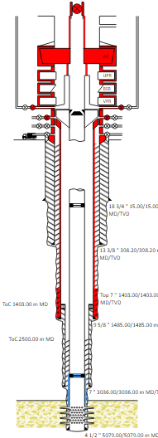
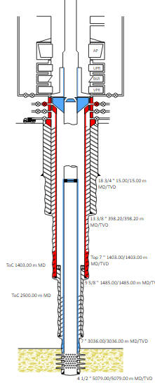
Learning From Incident Awareness Alert
Alert NO: PIM # | PDO_LFI_2607202200_Fatality 2 & 3 Initial 1141475 | Pattern: | AIPS- Released Energy
Date: | 13/07/2022 @ 09:15 hrs | Target Audience: | Planning & Operations Well Engineers. Site Supervisors
Tubing Hanger Ejected due to Well Pressure
Description of the incident:
During a well operation to restore Well Integrity of a gas production well, the Tubing Hanger ejected up through an open Blow Out Preventer (BOP) together with the a well plug followed by a large release of gas.
Above the BOP, two individuals were struck by the combination of ejected equipment combined with the force of gas being released resulting in their loss of life.
The well was immediately secured by closing the open BOP and Side Outlet Valves.
Why it happened/Finding :
The plug was set too shallow and assumed to have set correctly due to the fact that it had sealed pressure for a long period of time.
Part of the considered Secondary Barrier envelope (BOP) was open to prepare to remove the Tubing Hanger, hence considering it as part of a Barrier at this point in time was not valid until it is closed.
2x Qualified Barriers
Single Barrier
*Note – investigation on going
Notes:
Target audience for this alert
List the position names or roles that are the target audience for this alert. Wherever possible, the target audience should be limited to those in positions or roles or locations for which the lesson learnt are relevant, or who are required to take action upon receiving this Alert.
Position or role name
Position or role name
Description of the incident:
This should be free text writing and include the relevant facts explaining. what happened to all the relevant parties in a short sharp factual paragraph that describes the incident.
Without mentioning names of contractors or individuals. You should include, what happened, to who (by job title) and what injuries this resulted in. Nothing more
The description should be in sufficient detail to allow a person who does not know anything about the incident to imagine it.
It should only be about what happened and not why it happened.
DO NOT include investigation findings here, simply describe the incident as the investigation has shown it happened.
DO NOT give us a sequence of events here.

Slide 2
Learning From Incident Awareness Alert
Lessons learned:
All Well Barriers shall be formally qualified
Single Barrier Operations shall be only accepted under an Approved Deviation (Management of Change MOC)
All variations (Management of Change MOC) to a program shall be reported in writing and formally approved.
Having no pressure above a plug (well barrier) alone does not necessarily indicate the barrier is fully verified.
All Well Barriers shall be independent & Identified, Verified & Monitored.
Well Risk shall be captured within the handover from one team to another.
As a learning from this incident and ensure continual improvement all contract managers must review their HSE risk management against the questions asked below
Management Confirm the following:
Are Well Barriers visible and understood for every stage and every step of the operation?
Are Single Barrier Operations approved by the correct technical authority?
Is there clear evidence that the Well Risk is clearly understood by all parties?
* If the answer is NO to any of the above questions, please ensure you take action to correct this finding.
Notes:
Why it happened
Describe here the:
Immediate causes of the incident; and
Underlying causes of the incident
Lessons Learned: Four to five bullet points highlighting the main findings from the investigation. Remember the target audience is the front line staff so this should be written in simple terms in a way that everyone can understand.
Contract managers: Must review their risk assessment for this task capturing all points raised as a minimum and provide assurance to Contract Holders

