Slide 1
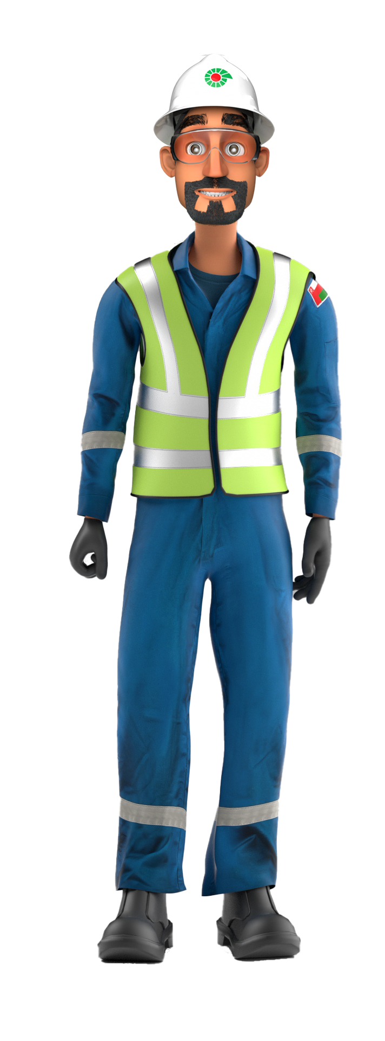
Mr. Musleh’s
Learnings from Incidents
Quarter One, 2023 Incidents

Slide 2
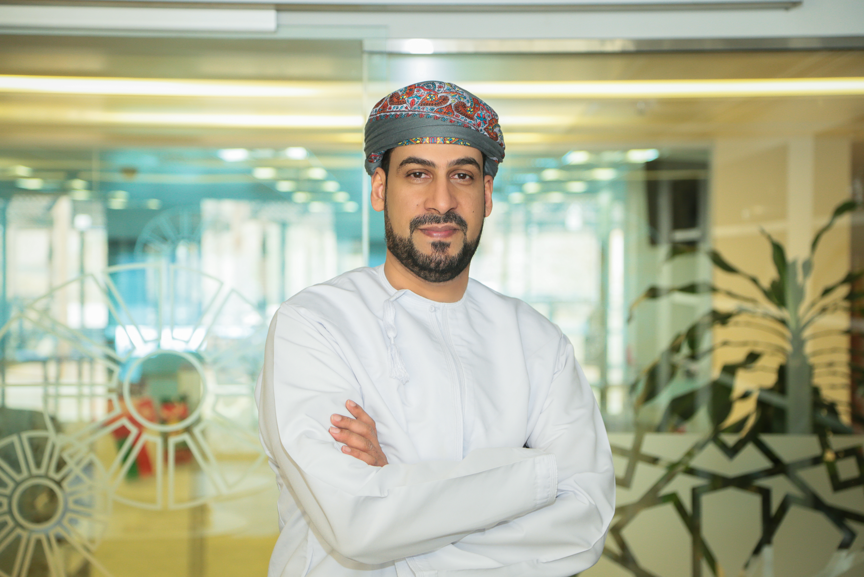
FOREWORD
Dear Colleagues,
Welcome to Mr. Musleh’s Newsletter, a ‘one stop shop’ communication highlighting the learnings from incidents in PDO.
Q1 2023 Mr. Musleh newsletter summarizes the learnings from incidents related to Lost Time Injuries (LTIs) and High Potential Incidents (HiPos).
DROPs & Lifting related incidents, followed with MVIs continues to be the main contributors to these serious incidents.
I would like to emphasize on the importance of going back to basics by compliance to:
PDO Golden rules
Life Saving Rules (with majorities falls under Line of Fire)
Addition to the above, we have included the learnings related to Non-Accidental Deaths (NADs).
We encourage you to discuss and reflect on the learnings from these incidents and utilize the information relevant to your activities in your engagement.
  Regards,
  Mahmoud Al Shukri (MSEM)
  Corporate Health Safety & Environment Manager

Slide 3

Contents
Chemical Burn:
1 LTI
Drops:
2 LTIs
3 HiPos
MVI:
4 HiPos
Released Energy:
1 HiPo
Hands & Fingers:
1 LTI
NAD:
3 NADs

Slide 4
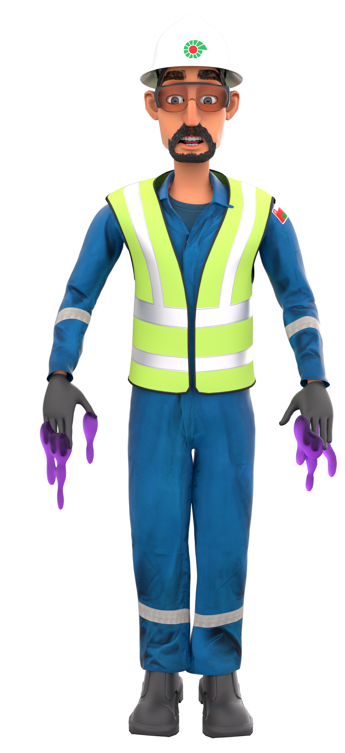
Chemical Burn
# | Short Description of Incidents (Hyperlinked) | Incident # | Activity | Actual Severity | Potential Severity
1 | Operator used his right foot to remove a build-up of Sulphur | LTI#01 | Sulphur pouring | LTI | C3P
Table of contents

Slide 5
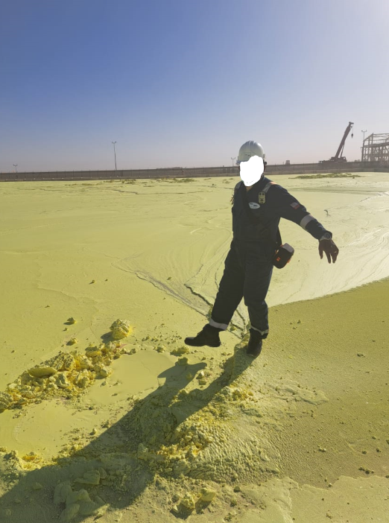
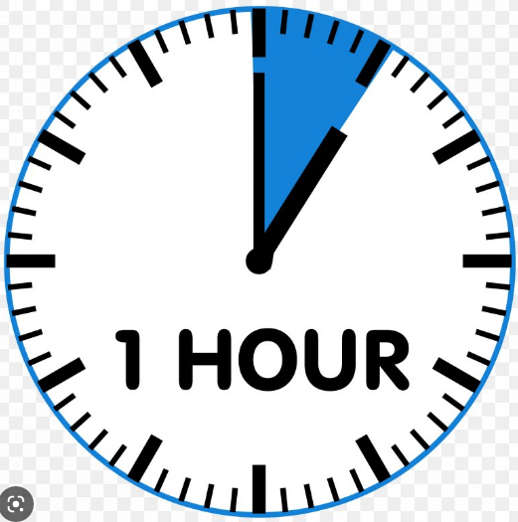
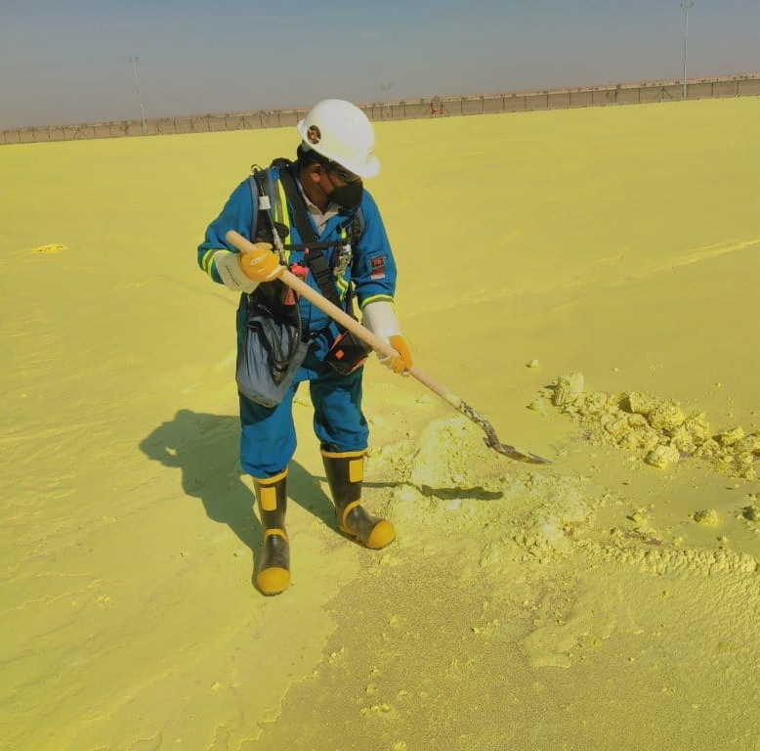
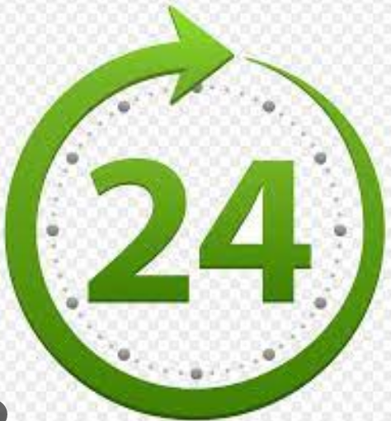
PDO Second Alert
Date:09/02/2023 Incident title: LTI#01: Liquid Sulphur burn to feet Pattern: Chemicals Potential severity: C3P Activity: Sulphur pouring
Target Audience: Drilling, Logistics, Operation & Construction
What happened?
While a Field Operator and his Supervisor were inside the boundary of the Sulphur blocking area, the Operator used his right foot to remove a build-up of Sulphur. At the same time, he was positioned on a thin crust of solid Sulphur which was covering liquid Sulphur at a temperature of 135c. The weight of the Operator fractured the crust and exposed his feet to the hot liquid underneath, resulting in 2nd degree burns to both feet. He was initially treated at PDO Yibal Clinic before being referred to Nizwa Hospital for further treatment.
Why it happened/Finding :
IP entered the area 1 hour after Sulphur pouring – the procedure highlights no one should enter area for a period of 24 hrs.
The correct specialist PPE was not worn as the operator and supervisor underestimated the risk of liquid Sulphur.
The Sulphur pouring arm had an oil leak which temporarily stopped the pouring process and allowed Sulphur to build up which required operator intervention.
Your learning from this incident..
Always follow the specific requirements of the procedure for your safe work (e.g. SOP, Method Statement, JSA).
Always wear the correct PPE required for specialist activities. If you don’t know what it is…..find out!
Always report equipment that is faulty or needs repairing – it could cause an incident.
Procedures have specific requirements within them – follow them to keep safe!
Notes:
Ensure all dates and titles are input
A short description should be provided without mentioning names of contractors or individuals. You should include, what happened, to who (by job title) and what injuries this resulted in. Nothing more!
Four to five bullet points highlighting the main findings from the investigation. Remember the target audience is the front line staff so this should be written in simple terms in a way that everyone can understand.
The strap line should be the main point you want to get across
The images should be self explanatory, what went wrong (if you create a reconstruction please ensure you do not put people at risk) and below how it should be done.

Slide 6
Management self audit
Date:09/02/2023 Incident title: LTI#01: Liquid Sulphur burn to feet Pattern: Chemicals Potential severity: C3P Activity: Sulphur pouring
As a learning from this incident and ensure continual improvement all contract managers must review their HSE risk management against the questions asked below
Confirm the following:
Do supervisors and staff have access to the correct procedure – is it effectively communicated to them?
In the event of equipment breakdown or recurring issues – does the workforce know how and who to report it to?
Does the induction/training provided to workers adequately cover the risks associated with their work to keep them safe?
Is the correct PPE available to all members of the workforce who need them?
Is access to you Site location adequately managed – how do you control the access arrangements?
* If the answer is NO to any of the above questions please ensure you take action to correct this finding
Notes:
Ensure all dates and titles are input
Make a list of closed questions (only ‘yes’ or ‘no’ as an answer) to ask others if they have the same issues based on the management or HSE-MS failings or shortfalls identified in the investigation.
Imagine you have to audit other companies to see if they could have the same issues.
These questions should start with: Do you ensure…………………?

Slide 7

Drops
# | Short Description of Incidents (Hyperlinked) | Incident # | Activity | Actual Severity | Potential Severity
1 | Complete slick line BOP tilted toward V-door side | HiPo#06 | Slickline | HiPo | C4P
2 | One of the acoustic panels fell from its installed position to the ground at BMF Atrium | HiPo#12 | installation of acoustic panels | HiPo | B4P
3 | While preparing the BOP to be repositioned It was found that the torque wrench was stuck | HiPo#13 | Rig Up HWO | HiPo | B4P
4 | Lifting bellow, the Centre of Gravity CoG | LTI#21 &LTI#38 | Lifting | LTI | D3P
Table of contents

Slide 8
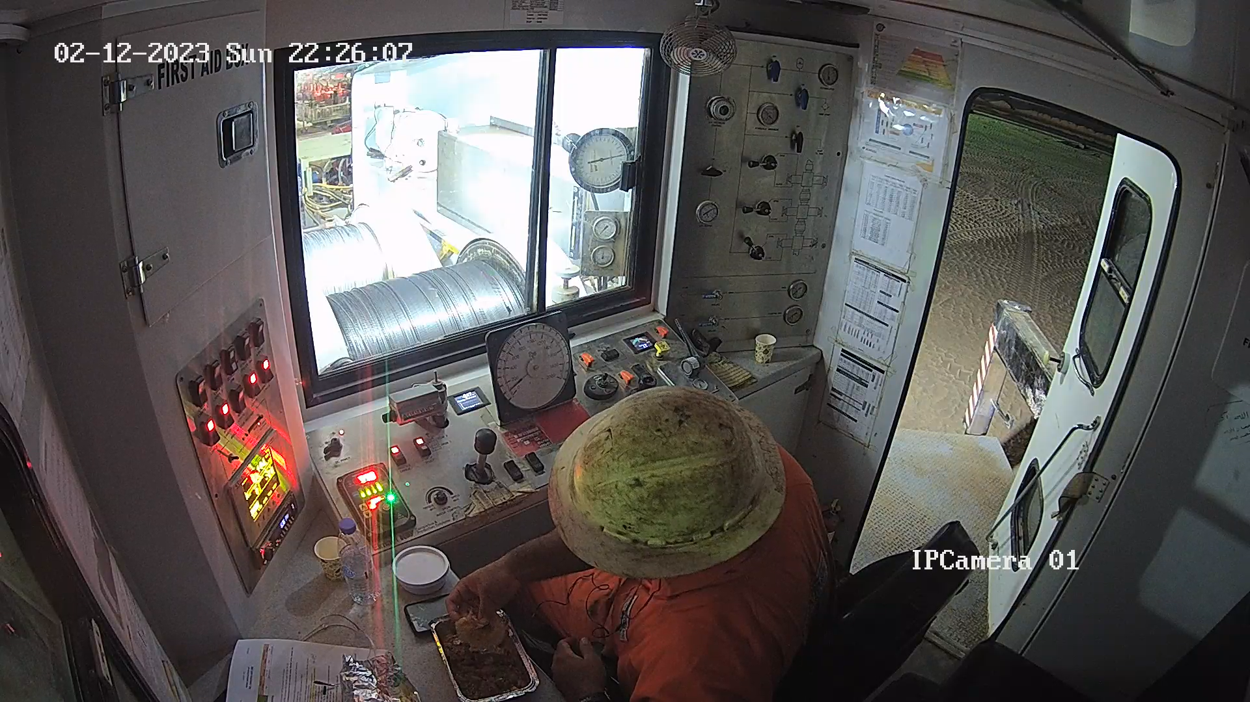
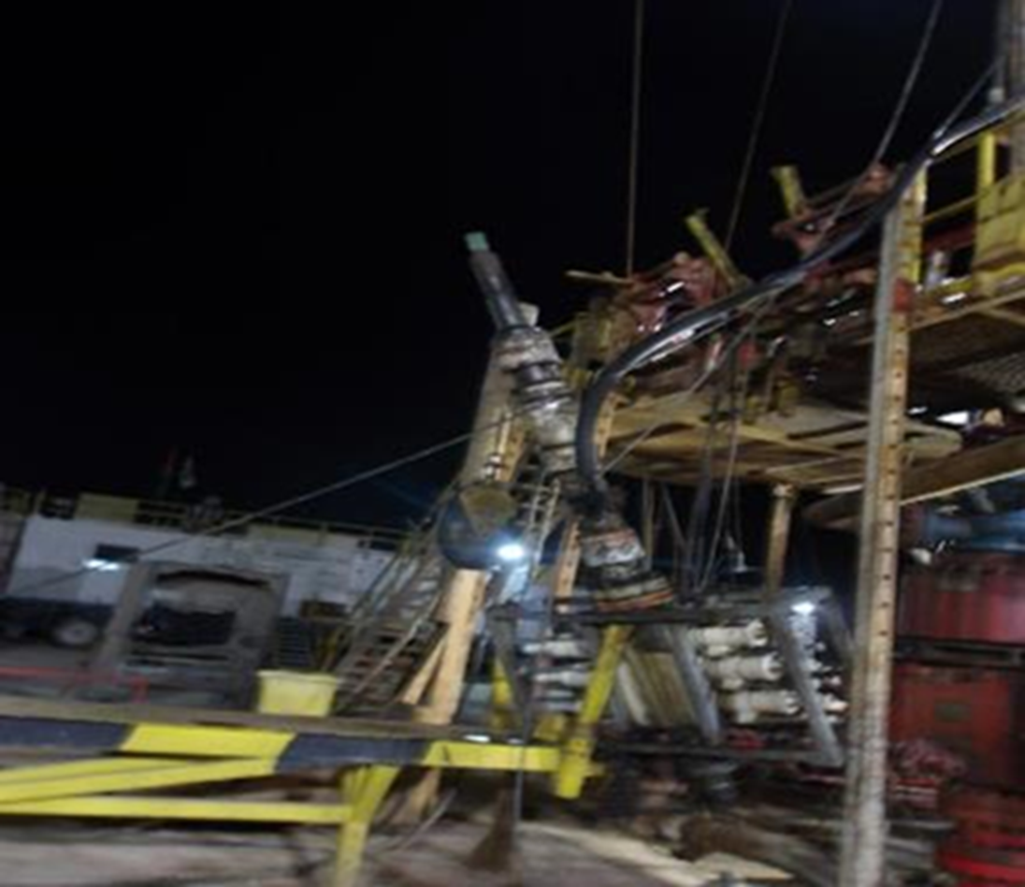

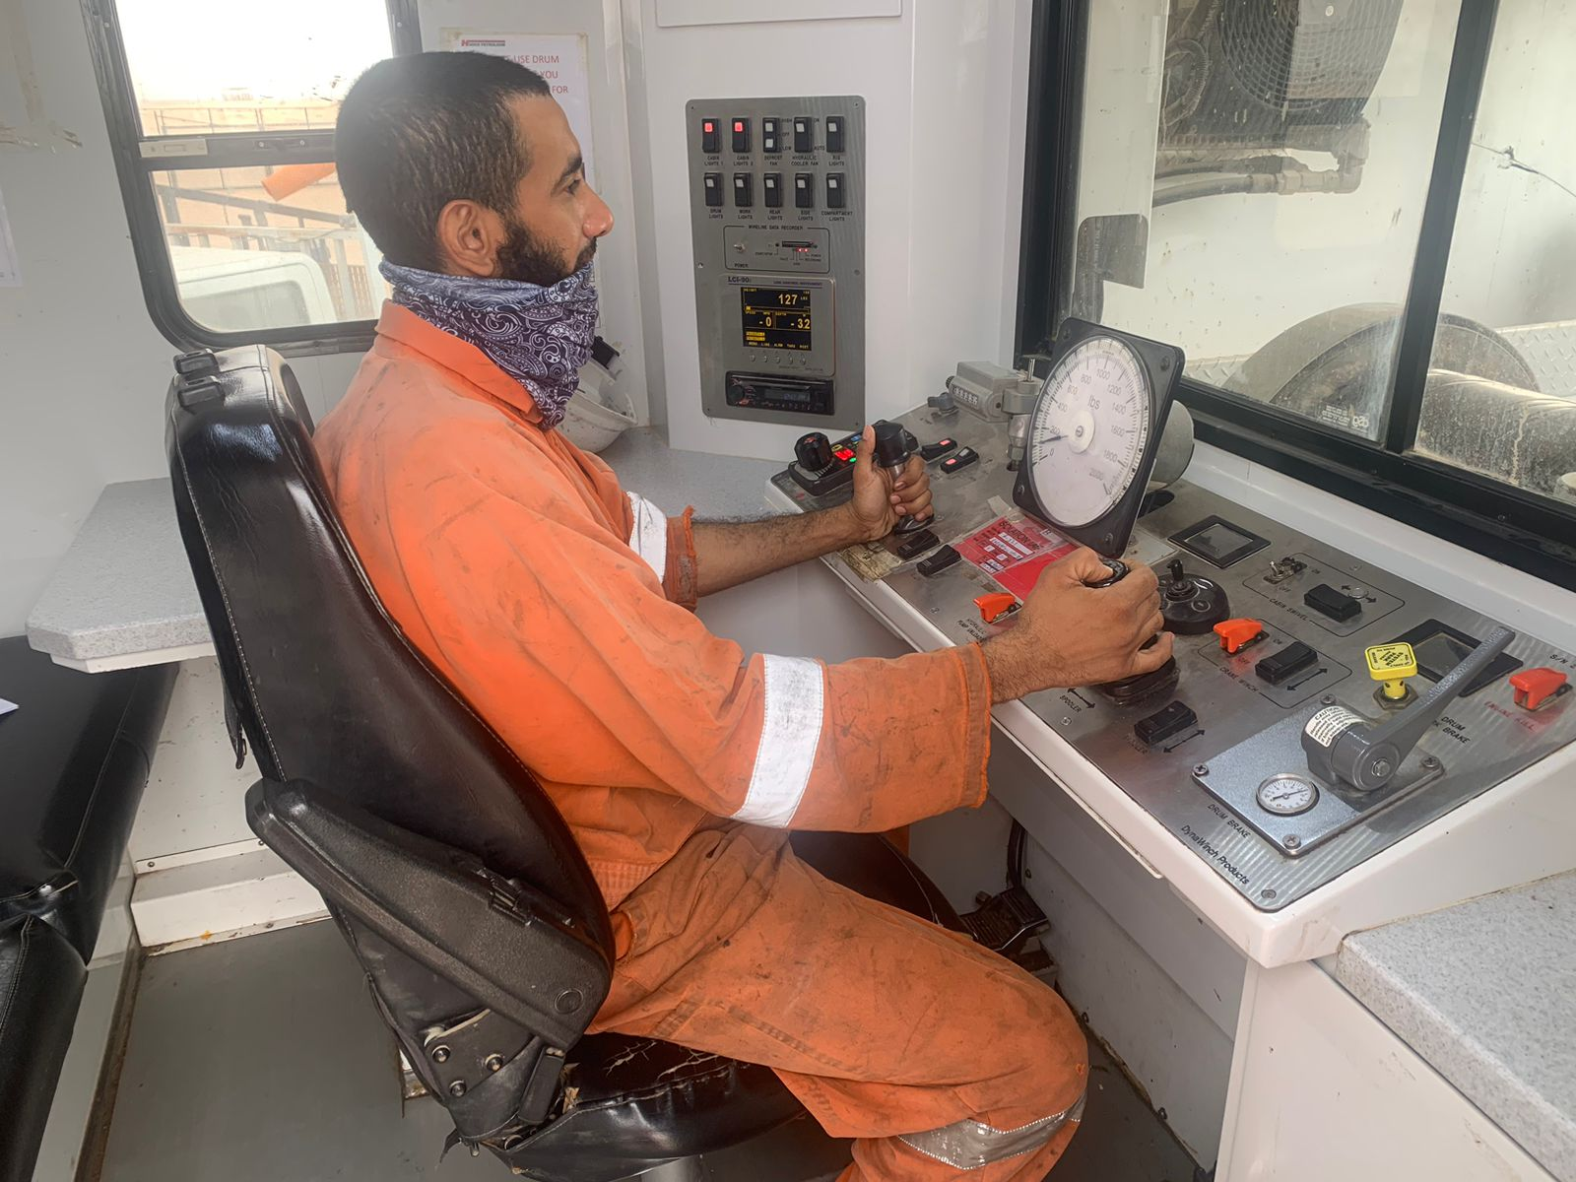

PDO Second Alert
Date: 12/02/2023 Incident title: HiPo# 06 Pattern: LOF/Drops Potential severity: C4P Activity: Slickline
Target Audience: Rigs & Hoists – Slick line contractors
What happened?
On 12th February 2023 at 22:30 hours, operation was shifting completion barriers by Hadco slick line. While preparing for fifth slick line run and while attempting to connect the lubricator to slick line BOP stack, suddenly the complete slick line BOP tilted toward V-door side. This has resulted in disconnection of 2”3/8 NU coupling and causing the complete slickline BOP to drop from rig floor and to rest on V-door frame from a height of 3m. At the same time, the slickline wire got parted resulting in the fall of slickline tool which penetrated through driller cabin top roof window. No injury was reported and minor equipment damage.
Why it happened/Findings:
TBT,PTW and generic JSA in place but without task-based risk assessment for the lubricator lift
SL BOP was pulled sideways with 1,000lbs unintended tension on the slickline during the lubricator lifting because SL Operator did not follow SOP to slack the wire before the lift
BOP assembly subsequently got disconnected from the threaded 2 3/8” tubing end due to the sideways wire tension
BOP fell to the V-door and the slickline tool dropped from the lubricator, landing on the roof of the driller cabin
SL Operator was not focused on his job, taking a meal break inside cabin while lifting was in progress
Slickline assistant who was on the BOP work platform at the time of incident was saved by the safety harness from falling from height
No further harm due to well managed No-Go zone with rigid barriers
Driller & AD were in driller’s cabin at the time of incident
Your learning from this incident.
Always use the correct size/capacity of equipment.
Always stay away from the line of fire.
Always follow SOP and maintain focus on the job at hand.
Always execute SWA for any unsafe act or unsafe condition.
Always stay away from the line of fire and stay focused on the job at hand.
Notes:
Ensure all dates and titles are input
A short description should be provided without mentioning names of contractors or individuals. You should include, what happened, to who (by job title) and what injuries this resulted in. Nothing more!
Four to five bullet points highlighting the main findings from the investigation. Remember the target audience is the front line staff so this should be written in simple terms in a way that everyone can understand.
The strap line should be the main point you want to get across
The images should be self explanatory, what went wrong (if you create a reconstruction please ensure you do not put people at risk) and below how it should be done.

Slide 9
Management self audit
Date: 12/02/2023 Incident title: HiPo# 06 Pattern: LOF/Drops Potential severity: C4P Activity: Slickline
As a learning from this incident and ensure continual improvement all contract managers must review their HSE risk management against the questions asked below
Confirm the following:
Do you ensure that site team adhere to zone management procedure
Do you ensure that your SOP and JSA cover all hazards and risks related to operation ?
Do you ensure that enough controls are in place prior to perform any critical task?
* If the answer is NO to any of the above questions please ensure you take action to correct this finding
Notes:
Ensure all dates and titles are input
Make a list of closed questions (only ‘yes’ or ‘no’ as an answer) to ask others if they have the same issues based on the management or HSE-MS failings or shortfalls identified in the investigation.
Imagine you have to audit other companies to see if they could have the same issues.
These questions should start with: Do you ensure…………………?

Slide 10
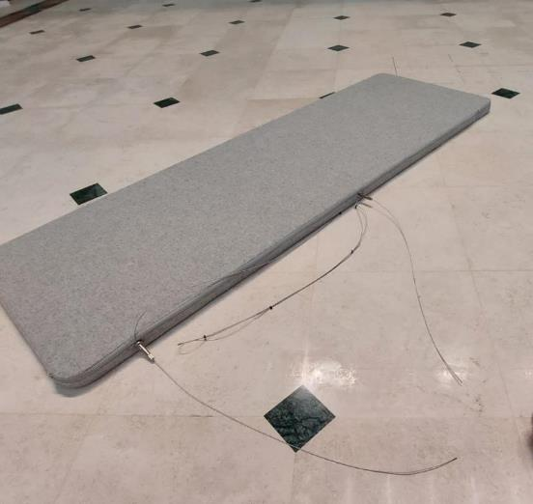
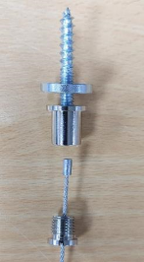
PDO Second Alert
Date:05/03/2023 Incident title: HiPo#12 Pattern: Drops. Potential severity: B4P Activity: installation of acoustic panels
Target Audience: Drilling, Logistics, Operation & Construction
What happened?
Why it happened/Finding :
OEM supplied wire hangers were not used.
Inappropriate QA/ QC checks carried out.
Your learning from this incident..
Only use the OEM supplied parts.
QA/QC checks to ensure correct materials are delivered and used.
QA/QC resource to be re-evaluated
Do not improvise to get the work completed.
Designer to be appointed to coordinate the design.
An enhancement was undertaken in the BMF atrium and part of this work was to install acoustic ceiling panels. On the 05.03.23 one of the acoustic panels, weighing approximately 4.5 Kg fell from its installed position (approximately 12. 5 meters height) to the ground at BMF Atrium. No people were injured. The fixing wire end cap / stopper failed at the point of connection to the ceiling fixing point due to poor quality of materials, causing the panel to fall to the ground
Quality - Do it right the first time
Notes:
Ensure all dates and titles are input
A short description should be provided without mentioning names of contractors or individuals. You should include, what happened, to who (by job title) and what injuries this resulted in. Nothing more!
Four to five bullet points highlighting the main findings from the investigation. Remember the target audience is the front line staff so this should be written in simple terms in a way that everyone can understand.
The strap line should be the main point you want to get across
The images should be self explanatory, what went wrong (if you create a reconstruction please ensure you do not put people at risk) and below how it should be done.

Slide 11
Management self audit
Date:05/03/2023 Incident title: HiPo#12 Pattern: Drops Potential severity: B4P Activity: installation of acoustic panels
As a learning from this incident and ensure continual improvement all contract managers must review their HSE risk management against the questions asked below
Confirm the following:
Do you ensure that the product and installation is a per design specification?
Do you ensure quality assurance check on your supplier's materials and work?
Do you ensure supplied products are OEM or to the same specification and used correctly?
Do you follow Management of change process and ensure the changes are correctly communicated ?
Do you ensure that the agreed ITP check sheets are completed by a competent person during your construction period?
* If the answer is NO to any of the above questions please ensure you take action to correct this finding
Notes:
Ensure all dates and titles are input
Make a list of closed questions (only ‘yes’ or ‘no’ as an answer) to ask others if they have the same issues based on the management or HSE-MS failings or shortfalls identified in the investigation.
Imagine you have to audit other companies to see if they could have the same issues.
These questions should start with: Do you ensure…………………?

Slide 12
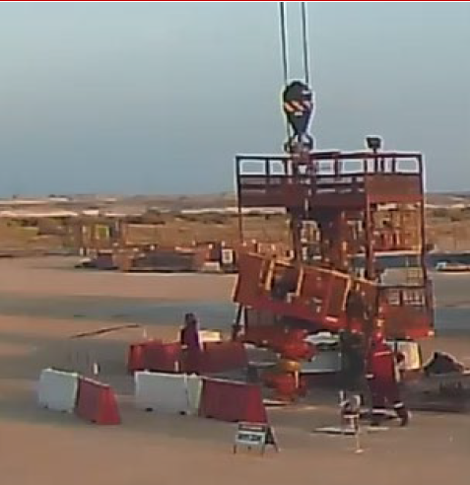
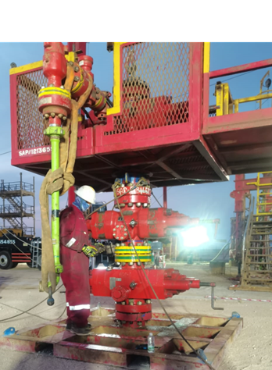
PDO Second Alert
Date:10/03/2023 Incident title: HiPo#13 Pattern: Drop Potential severity: B4P Activity: Rig Up HWO
Target Audience: Drilling, Logistics, Operation & Construction
What happened?
HWO rig up was in progress at well MAS-01 around 0500hrs crew picked up the stripping stack with the 130T crane and lifted the stripping stack on top of BOP#3. Day shift crew completed safety meetings and handover and jack operator identified that BOP#3 was only supported by a wooden plate, Stop Work Authority was used but not communicated with the supervisor, crew decided to move the BOP on to the correct BOP stand. While preparing the BOP to be repositioned It was found that the torque wrench was stuck on one of the nuts under the BOP. Lead hand went under to free the torque wrench and at that time the wooden plate broke causing the load weight to settle in the crane. Lead hand hit his hand on the XT while evacuating the area, Medic checked and found ok.
Halliburton Crew Stopped the operation and informed PDO DSV.
Why it happened/Finding :
Inefficient site supervision onsite.
Permit issued without walking the line / daily hazard hunt
Shortcut to not use the correct equipment
Ineffective use of Stop Work Authority
Your learning from this incident..
Always ensure to use the correct equipment for the task in hand.
Prior to issue Permit to Work site leader's are to walk the line and perform hazard hunt.
Any Stop Work Authority shall be communicated to the well site leaders.
Lift plans & JSA’s are to the relevant to the task in hand.
Always take the time on location to perform the correct job assessments for the task in hand.
Short cuts never save time
Notes:
Ensure all dates and titles are input
A short description should be provided without mentioning names of contractors or individuals. You should include, what happened, to who (by job title) and what injuries this resulted in. Nothing more!
Four to five bullet points highlighting the main findings from the investigation. Remember the target audience is the front line staff so this should be written in simple terms in a way that everyone can understand.
The strap line should be the main point you want to get across
The images should be self explanatory, what went wrong (if you create a reconstruction please ensure you do not put people at risk) and below how it should be done.

Slide 13
Management self audit
Date:10/03/2023 Incident title: HiPo#13 Pattern: Drop Potential severity: B4P Activity: Rig Up HWO
As a learning from this incident and ensure continual improvement all contract managers must review their HSE risk management against the questions asked below
Confirm the following:
- Do you ensure that the right equipment is used for task onsite.
- Do you ensure that effective supervision is available at all time onsite.
- Do you ensure that frequent discussions are held periodically with the team for every task.
- Do you ensure that lifting plans and Job Safety Analysis are the adequate for task in hand.
- Do you ensure that the implementation of Stop Work Authority is effective on your site location.
* If the answer is NO to any of the above questions please ensure you take action to correct this finding
Notes:
Ensure all dates and titles are input
Make a list of closed questions (only ‘yes’ or ‘no’ as an answer) to ask others if they have the same issues based on the management or HSE-MS failings or shortfalls identified in the investigation.
Imagine you have to audit other companies to see if they could have the same issues.
These questions should start with: Do you ensure…………………?

Slide 14
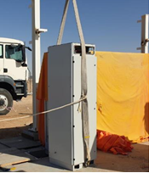
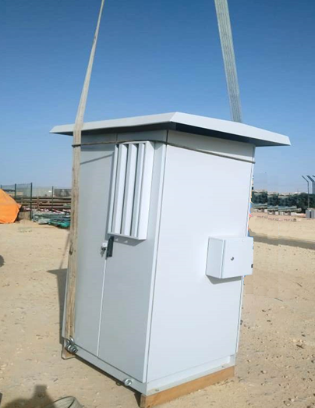

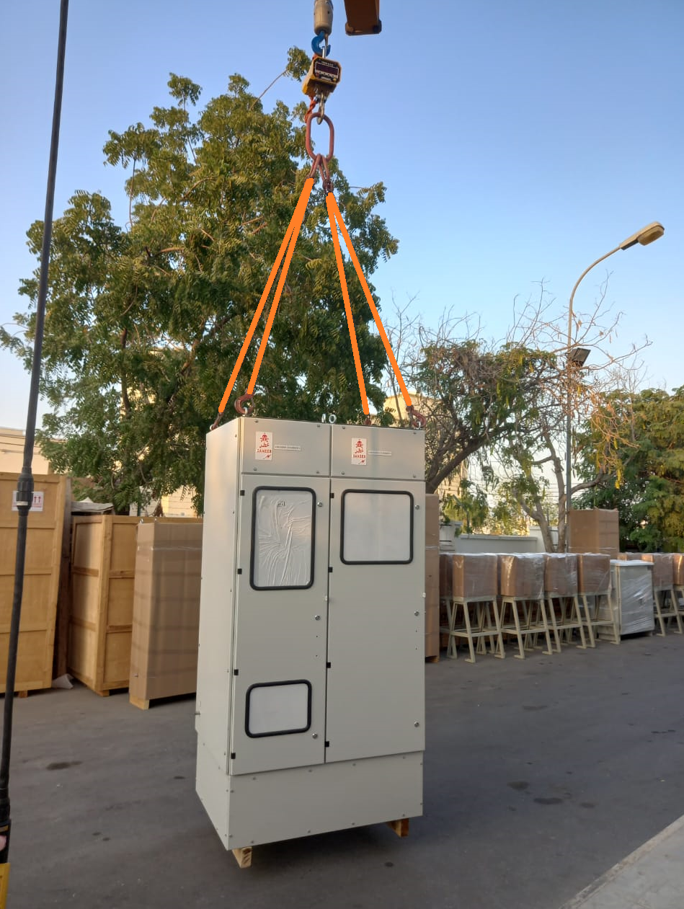

Learning From Incident
Awareness Alert
PIM# | 1129536 & 1145585 | Pattern: | LTI#21 (2021) & LTI# 38 (2022)
Date: | 22/09/2021 & 07/12/2022 | Target Audience: | Construction, Drilling, Operations ,Engineering, Exploration, Project and Logistic
Lifting bellow, the Center of Gravity CoG
Description of the incident (LTI#21):
An Electrician suffered injury while engaged in VFD (Variable Frequency Drive) panel replacement activity as the lifted VFD panel toppled over him.
The panel brought from the supplier yard to site was unloaded to the ground from the canter using a crane, and was again lifted a feet above ground to remove the wooden base (shipping skid). The Electrician was hammering the wooden base to dislodge it when the panel lost balance and toppled over.
Description of the incident (LTI#38):
A Rigger was engaged in lifting and placing single cubicle panel on to the foundation for final alignment. The panel had two eye bolts on either side of the panel at the bottom on which the lifting belt was secured and lifted. At a height of 20cm from ground the panel lost its balance and toppled. At the time the rigger was holding the tagline who tried to escape backwards but he got tripped and fell backwards. The panel landed on his legs resulting in injury.
Why it happened/Finding :
  Incorrect rigging method, suspend a load under center of gravity (CoG)
  Tagline connected wrongly to the lifting slings.
Notes:
Target audience for this alert
List the position names or roles that are the target audience for this alert. Wherever possible, the target audience should be limited to those in positions or roles or locations for which the lesson learnt are relevant, or who are required to take action upon receiving this Alert.
Position or role name
Position or role name
Description of the incident:
This should be free text writing and include the relevant facts explaining. what happened to all the relevant parties in a short sharp factual paragraph that describes the incident.
Without mentioning names of contractors or individuals. You should include, what happened, to who (by job title) and what injuries this resulted in. Nothing more
The description should be in sufficient detail to allow a person who does not know anything about the incident to imagine it.
It should only be about what happened and not why it happened.
DO NOT include investigation findings here, simply describe the incident as the investigation has shown it happened.
DO NOT give us a sequence of events here.

Slide 15
Learning From Incident
Awareness Alert
Lessons learned:
Ensure that lift plan and specific risk assessment are developed and approved prior any lifting
Ensure that lifting points are above the Center of Gravity and OEM instruction are followed
Ensure that tag line is connected directly to the load.
As a learning from this incident and ensure continual improvement all contract managers must review their HSE risk management against the questions asked below
Management Confirm the following:
Do you ensure that lift plan and risk assessment are developed and being approved prior any lift?
Do you ensure manufacturer instructions are followed for the load to be lifted?
Do you ensure the right equipment and best method of lifting are available?
Do you ensure lift area is clear and personnel are kept away from the line of fire?
Do your ensure personnel are aware of their empowerment to stop unsafe work/condition?
* If the answer is NO to any of the above questions, please ensure you take action to correct this finding.
**As a learning from this incident and ensure continual improvement review risk management ( HEMP) against the questions
Notes:
Why it happened
Describe here the:
Immediate causes of the incident; and
Underlying causes of the incident
Lessons Learned: Four to five bullet points highlighting the main findings from the investigation. Remember the target audience is the front line staff so this should be written in simple terms in a way that everyone can understand.
Contract managers: Must review their risk assessment for this task capturing all points raised as a minimum and provide assurance to Contract Holders

Slide 16
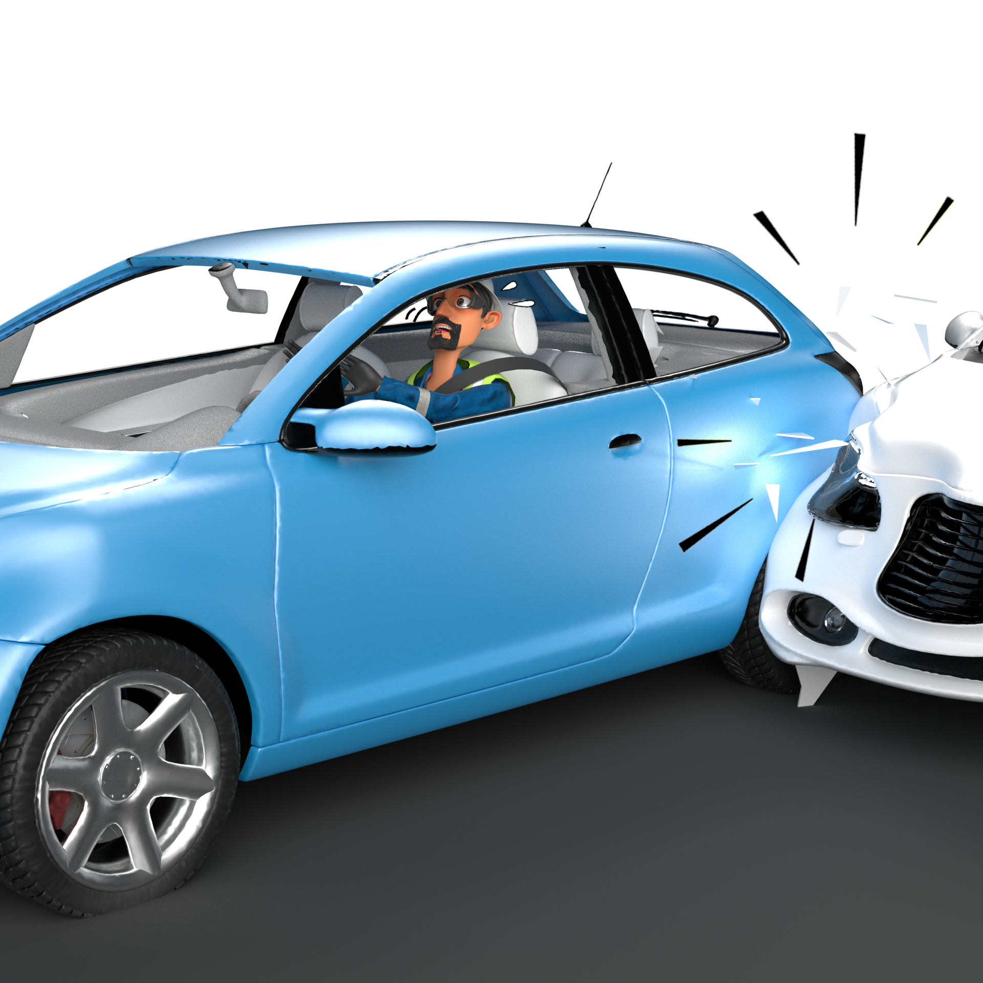
Motor Vehicle Incident
# | Short Description of Incidents (Hyperlinked) | Incident # | Activity | Actual Severity | Potential Severity
1 | A telehandler was carrying a bundle of 6 numbers of 3 inches 12 meters CS pipes | HiPo#79 | Flowline construction | HiPo | C3A
2 | A subcontractor 10-ton truck was on the way from Abraj Adam Base | HiPo#82 | Rollover | HiPo | C4P
3 | A water tanker was travelling to deliver the remainder of water at the Rig camp | HiPo#01 | Rollover | HiPo | D4P
4 | OTO driver was on route to Marmul to deliver High Density Polyethylene Duct | HiPo#10 | MVI | HiPo | C5P
Table of contents

Slide 17
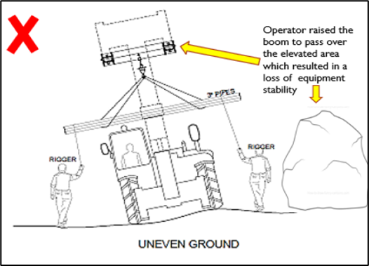
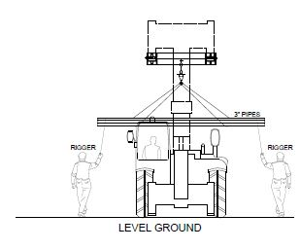
PDO Second Alert
Date:29/11/2022 Incident title: HiPo#79 Pattern: Rollover Potential severity: C3A Activity: Flowline construction
Target Audience: Drilling, Logistics, Operation & Construction
What happened?
On November 29, 2022, at approximately 09:50 Hrs., a telehandler was carrying a bundle of 6 numbers of 3 inches 12 meters CS pipes for construction of new flowline near Fahud C station F-532. When the telehandler turned from the graded road to the uneven road parallel to the existing flowlines, it tipped over to its left and the suspened pipe bundle made slight contact with the nearby live lines. The telehandler sustained minor damages but there were no injuries to the operator and no damage to the live lines.
Why it happened/Finding :
The road was uneven and congested due to hilly area on one side
Line walk through was not conducted by PTWA and PTWH to identify the road condition
The planned work location was changed due to an oil leak, but no MOC or risk assessment was conducted to manage the change.
The crew signaler and operator decided to raise the boom without considering the uneven ground, which resulted in a loss of stability and caused the telehandler to tip over to the left.
Ineffective supervision and hazard/Dynamic risk identification
Your learning from this incident..
Always conduct site walk through to identify site related hazards before starting the job
Ensure road conditions are even and without obstructions before starting lifting/shifting activity.
Equipment movement area to be assessed by the lifting supervisor /operator before starting any shifting/lifting activity
Identify all hazards/dynamic risk and ensure appropriate controls throughout the job
Intervene if you notice unsafe act/unsafe condition..
Store the materials/pipes close to the work /safe location as much as possible.
Do you Identify all the hazards before starting the task
Notes:
Ensure all dates and titles are input
A short description should be provided without mentioning names of contractors or individuals. You should include, what happened, to who (by job title) and what injuries this resulted in. Nothing more!
Four to five bullet points highlighting the main findings from the investigation. Remember the target audience is the front line staff so this should be written in simple terms in a way that everyone can understand.
The strap line should be the main point you want to get across
The images should be self explanatory, what went wrong (if you create a reconstruction please ensure you do not put people at risk) and below how it should be done.

Slide 18
Management self audit
Date:29/11/2022 Incident title: HiPo#79 Pattern: Rollover Potential severity: C3A Activity: Flowline construction
As a learning from this incident and ensure continual improvement all contract managers must review their HSE risk management against the questions asked below
Confirm the following:
Do you ensure that all hazards have been identified prior to start of activity?
Do you have a risk register covering difficult terrains in the construction field?
* If the answer is NO to any of the above questions please ensure you take action to correct this finding
Notes:
Ensure all dates and titles are input
Make a list of closed questions (only ‘yes’ or ‘no’ as an answer) to ask others if they have the same issues based on the management or HSE-MS failings or shortfalls identified in the investigation.
Imagine you have to audit other companies to see if they could have the same issues.
These questions should start with: Do you ensure…………………?

Slide 19
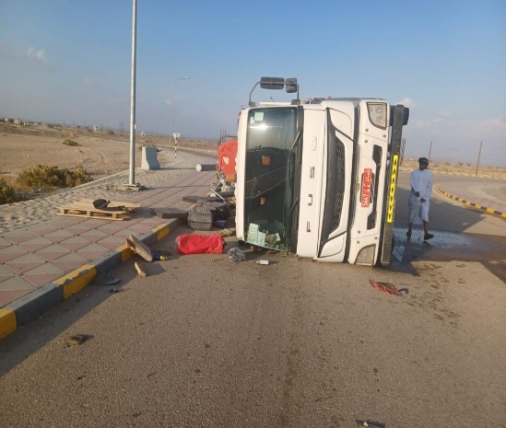

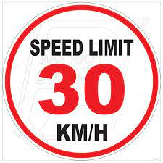
PDO Second Alert
Date:10/12/2022 Incident title: HiPo#82 Pattern: MVI Potential severity: C4P Activity: Driving
Target Audience: Drivers, Journey Managers
What happened?
On 10-12-2022 @ 13:40 hours, a subcontractor 10-ton truck # 5447 MK was on the way from Abraj Adam Base to deliver an IFS Skid and other tools to FRAC location. While passing through a roundabout, the driver lost control resulting in the truck to tip over to the right side. Driver did not sustain any injury, however, there were some minor damages to the truck.
Why it happened/Finding:
Speed at the time of the incident was 54 km/hour (at the roundabout)
Load weight is approximately 4 tons and was inadequately secured using 2 securing belts.
IVMS installed in the vehicle but roundabout over speed buzzer was not functional
Journey plan issued for the journey. TBT meeting with Driver was not documented
Driver has valid ROP and defensive driving permit
Your learning from this incident.
Driver should always drive according to road conditions. Speed limit at the roundabout is 30 km/hour
Unit & Journey Manager shall always ensure that all drivers are aware of the roundabout speed limit.
Supervisors to always ensure that loads are properly secured and weight is equally distributed as per SP 2001 requirements.
Unit Manager and Journey Manager shall always ensure that all functions of IVMS are in working condition
Drive shall always report any defect in the vehicle to journey manager
Drivers to always ensure to reduce speed limit at roundabout to 30km/hour
Notes:
Ensure all dates and titles are input
A short description should be provided without mentioning names of contractors or individuals. You should include, what happened, to who (by job title) and what injuries this resulted in. Nothing more!
Four to five bullet points highlighting the main findings from the investigation. Remember the target audience is the front line staff so this should be written in simple terms in a way that everyone can understand.
The strap line should be the main point you want to get across
The images should be self explanatory, what went wrong (if you create a reconstruction please ensure you do not put people at risk) and below how it should be done.

Slide 20
Management self audit
Date:10/12/2022 Incident title: HiPo#82 Pattern: MVI Potential severity: C4P Activity: Driving
As a learning from this incident and ensure continual improvement all contract managers must review their HSE risk management against the questions asked below
Confirm the following:
Do you ensure that drivers are reducing speed in the roundabouts?
Do you ensure the driver and supervisor are aware of the right load securement as per SP 2001 requirements?
Do you ensure that all functions of IVMS are active?
Do you ensure that Driver always report any defect in the vehicle to Journey manager?
* If the answer is NO to any of the above questions please ensure you take action to correct this finding
Notes:
Ensure all dates and titles are input
Make a list of closed questions (only ‘yes’ or ‘no’ as an answer) to ask others if they have the same issues based on the management or HSE-MS failings or shortfalls identified in the investigation.
Imagine you have to audit other companies to see if they could have the same issues.
These questions should start with: Do you ensure…………………?

Slide 21
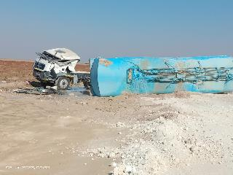

PDO Second Alert
Date: 06/01/2023 Incident title: HiPo#01 Pattern: MVI Rollover Potential severity:D4P Activity: Driving
Target Audience: Drivers, Journey Managers, Supervisors
What happened?
After delivering a part load of water at a Rig, a water tanker was travelling to deliver the remainder of water at the Rig camp. Whilst negotiating a left bend on the graded road, the driver lost control of the vehicles and swerved off the road where the vehicle rolled over. The Driver and helper escaped through passenger side door window. Employees from the Rig 49 camp witnessed the incident and came to their aid in a pick up vehicle. The driver and helper received first aid treatment before being sent to Yibal Clinic then Nizwa hospital before being discharged with minor injuries.
Why it happened/Finding :
The driver was not driving as per the road condition
TBT’s not being conducted with all drivers
Inadequate road warning signs (Slippery Road & Speed Limit) and road maintenance
Driver feedback was not escalated to the concerned parties
Your learning from this incident..
Always ensure you follow your defensive driver training
Always ensure you drive at a speed according to the road condition
Always ensure you report road hazard and escalate to concerned parties.
Always ensure you use empowerment to stop if feels unsafe.
Adjust your speed to the road conditions and type of load
Notes:
Ensure all dates and titles are input
A short description should be provided without mentioning names of contractors or individuals. You should include, what happened, to who (by job title) and what injuries this resulted in. Nothing more!
Four to five bullet points highlighting the main findings from the investigation. Remember the target audience is the front line staff so this should be written in simple terms in a way that everyone can understand.
The strap line should be the main point you want to get across
The images should be self explanatory, what went wrong (if you create a reconstruction please ensure you do not put people at risk) and below how it should be done.

Slide 22
Management self audit
Date: 06/01/2023 Incident title: HiPo#01 Pattern: MVI Rollover Potential severity:D4P Activity: Driving
As a learning from this incident and ensure continual improvement all contract managers must review their HSE risk management against the questions asked below
Confirm the following:
Do you ensure your drivers are regularly briefed on following defensive driving techniques?
Do you ensure the proper reporting and escalation system on road hazards is followed?
Do you ensure empowerment to stop system in place when it feels unsafe?
Do you ensure all employees are involved in TBT’s/safety briefings?
Do you ensure your journey managers are proactively analyzing IVMS data to learn drivers behaviours?
* If the answer is NO to any of the above questions please ensure you take action to correct this finding
Notes:
Ensure all dates and titles are input
Make a list of closed questions (only ‘yes’ or ‘no’ as an answer) to ask others if they have the same issues based on the management or HSE-MS failings or shortfalls identified in the investigation.
Imagine you have to audit other companies to see if they could have the same issues.
These questions should start with: Do you ensure…………………?

Slide 23
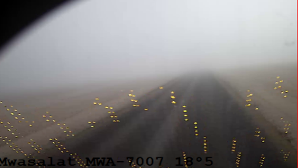

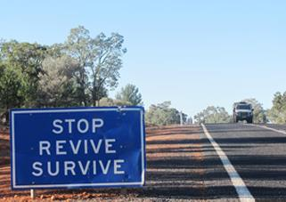
PDO Second Alert
Date:01/03/2023 Incident title: HiPo#10 Pattern: MVI Potential severity: C5P Activity: Driving
Target Audience: Drilling, Logistics, Operation & Construction
What happened?
On 1st March at 8.15am, an HGV driver was on route to Marmul to deliver High Density Polyethylene Duct, the driver started his journey from Haima at 6.01am, three kilometers before Rima roundabout on a straight blacktop road, the OTO driver attempted to overtake another 3rd party truck whilst the 3rd party bus approaching from the oncoming lane, due to heavy fog in the area both drivers were unable to avoid the collision. The 2 vehicles impacted at an angle with the right side of the prime mover striking the right front corner of the bus in a glancing blow before the bus collided with the trailer headboard centre windscreen and both vehicles came to a stop at the right-hand side of the road in the northern direction lane. Consequently, 5 passengers in the bus sustained injuries.
Why it happened/Finding :
Overtaking and failing to apply defensive driving techniques in low visibility foggy road conditions.
Driver fatigue.
Your learning from this incident..
Always drive defensively and avoid overtaking when visibility is limited on the road (e.g. fog conditions).
Always assess the road conditions prior to the start of your journey.
Always inform your journey manager of road hazards that could help others drive safely.
Always ensure you have enough rest prior to driving.
Always ensure your DFMS camera is aligned to your face and report any misalignment immediately.
Overtaking in low visibility, is like driving blindfolded
Notes:
Ensure all dates and titles are input
A short description should be provided without mentioning names of contractors or individuals. You should include, what happened, to who (by job title) and what injuries this resulted in. Nothing more!
Four to five bullet points highlighting the main findings from the investigation. Remember the target audience is the front line staff so this should be written in simple terms in a way that everyone can understand.
The strap line should be the main point you want to get across
The images should be self explanatory, what went wrong (if you create a reconstruction please ensure you do not put people at risk) and below how it should be done.

Slide 24
Management self audit
Date:01/03/2023 Incident title: HiPo#10 Pattern: MVI Potential severity: C5P Activity: Driving
As a learning from this incident and ensure continual improvement all contract managers must review their HSE risk management against the questions asked below
Confirm the following:
Do you ensure your journey planners are taking mitigating actions during adverse weather?
Do you ensure your safe journey management procedure is compliant and proactive?
Do you ensure your fatigue monitoring system alerts are being actioned upon?
Do you ensure your drivers are having sufficient rest?
Do you ensure drivers are learning from previous incidents?
* If the answer is NO to any of the above questions please ensure you take action to correct this finding
Notes:
Ensure all dates and titles are input
Make a list of closed questions (only ‘yes’ or ‘no’ as an answer) to ask others if they have the same issues based on the management or HSE-MS failings or shortfalls identified in the investigation.
Imagine you have to audit other companies to see if they could have the same issues.
These questions should start with: Do you ensure…………………?

Slide 25
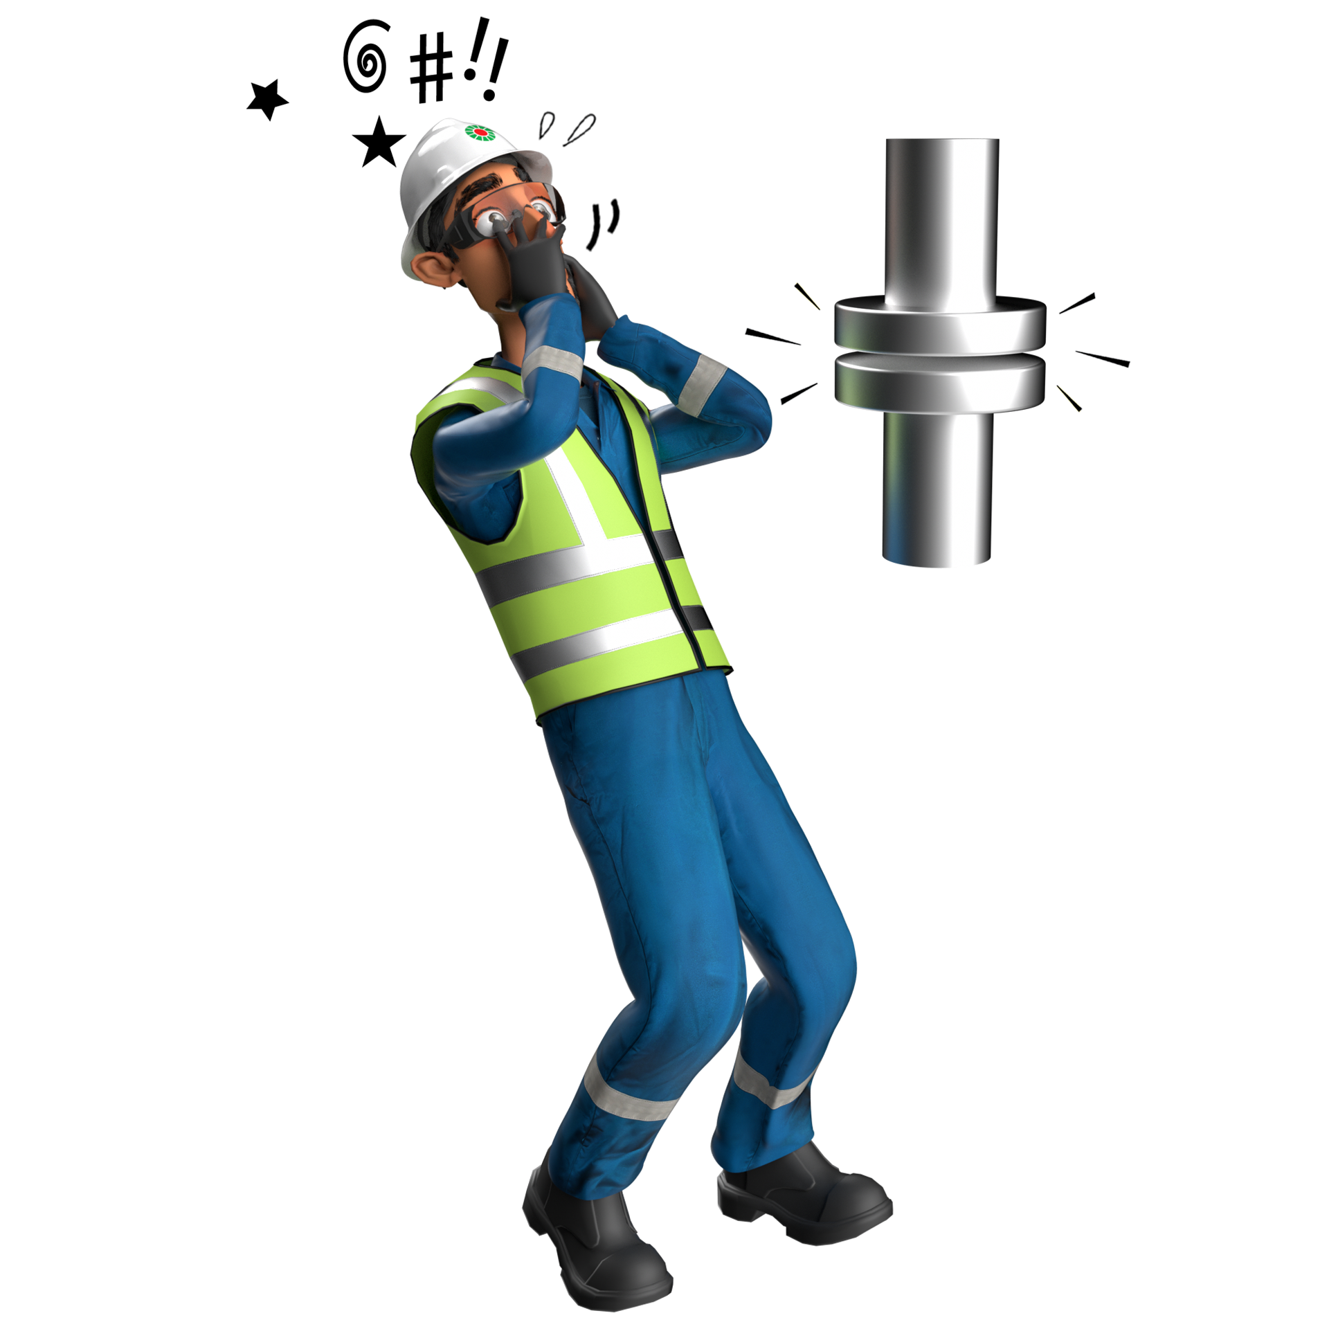
Released Energy
# | Short Description of Incidents (Hyperlinked) | Incident # | Activity | Actual Severity | Potential Severity
1 | The incident involved a firefighter sustaining an injury to his stomach whilst demonstrating | HiPo#03 | Training | HiPo | B4P
Table of contents

Slide 26
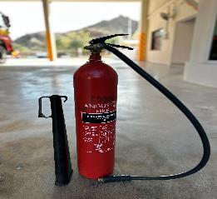

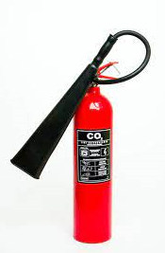
PDO Second Alert
Date: 08/01/2023 Incident title: HiPo#3 Pattern: Released Energy Potential severity: B4P Activity: Fire Warden Training
Target Audience: Drilling, Logistics, Operation & Construction
What happened?
That an accident had occurred at the Mina Al Fahal (MAF) Fire Station. The incident involved a firefighter sustaining an injury to his stomach whilst demonstrating the use of an extinguisher whilst participating in a Fire Warden Training Session. The 5kg Carbon Dioxide extinguisher plastic horn detached violently from the extinguisher supply hose. The pressurized hose connection recoiled causing the injury.
Why it happened/Finding :
Cracked horn connection to the extinguisher supply hose.
No pre inspection of the extinguisher or oversight checks being carried out
You're learning from this incident..
Ensure fire extinguishers are visually inspect prior use to identify defect and replaced as required.
Damaged extinguisher clearly labelled and put into quarantine.
A full oversight of the third-party maintenance, testing and inspections are to be carried
Check all your equipment before use
Notes:
Ensure all dates and titles are input
A short description should be provided without mentioning names of contractors or individuals. You should include, what happened, to who (by job title) and what injuries this resulted in. Nothing more!
Four to five bullet points highlighting the main findings from the investigation. Remember the target audience is the front line staff so this should be written in simple terms in a way that everyone can understand.
The strap line should be the main point you want to get across
The images should be self explanatory, what went wrong (if you create a reconstruction please ensure you do not put people at risk) and below how it should be done.

Slide 27
Management self audit
Date: 08/01/2023 Incident title: HiPo#3 Pattern: Released Energy Potential severity: B4P Activity: Fire Warden Training
As a learning from this incident and ensure continual improvement all contract managers must review their HSE risk management against the questions asked below
Confirm the following:
Do you ensure that the proper inspection and maintenance programs in place and carried our regularly?
Do you ensure that all fire team are aware that extinguishers should be visually checked prior to their use?
Do you ensure that fire extinguishers on all sites have records of their extinguisher locations and up to date inventories of numbers and types?
* If the answer is NO to any of the above questions please ensure you take action to correct this finding
Notes:
Ensure all dates and titles are input
Make a list of closed questions (only ‘yes’ or ‘no’ as an answer) to ask others if they have the same issues based on the management or HSE-MS failings or shortfalls identified in the investigation.
Imagine you have to audit other companies to see if they could have the same issues.
These questions should start with: Do you ensure…………………?

Slide 28
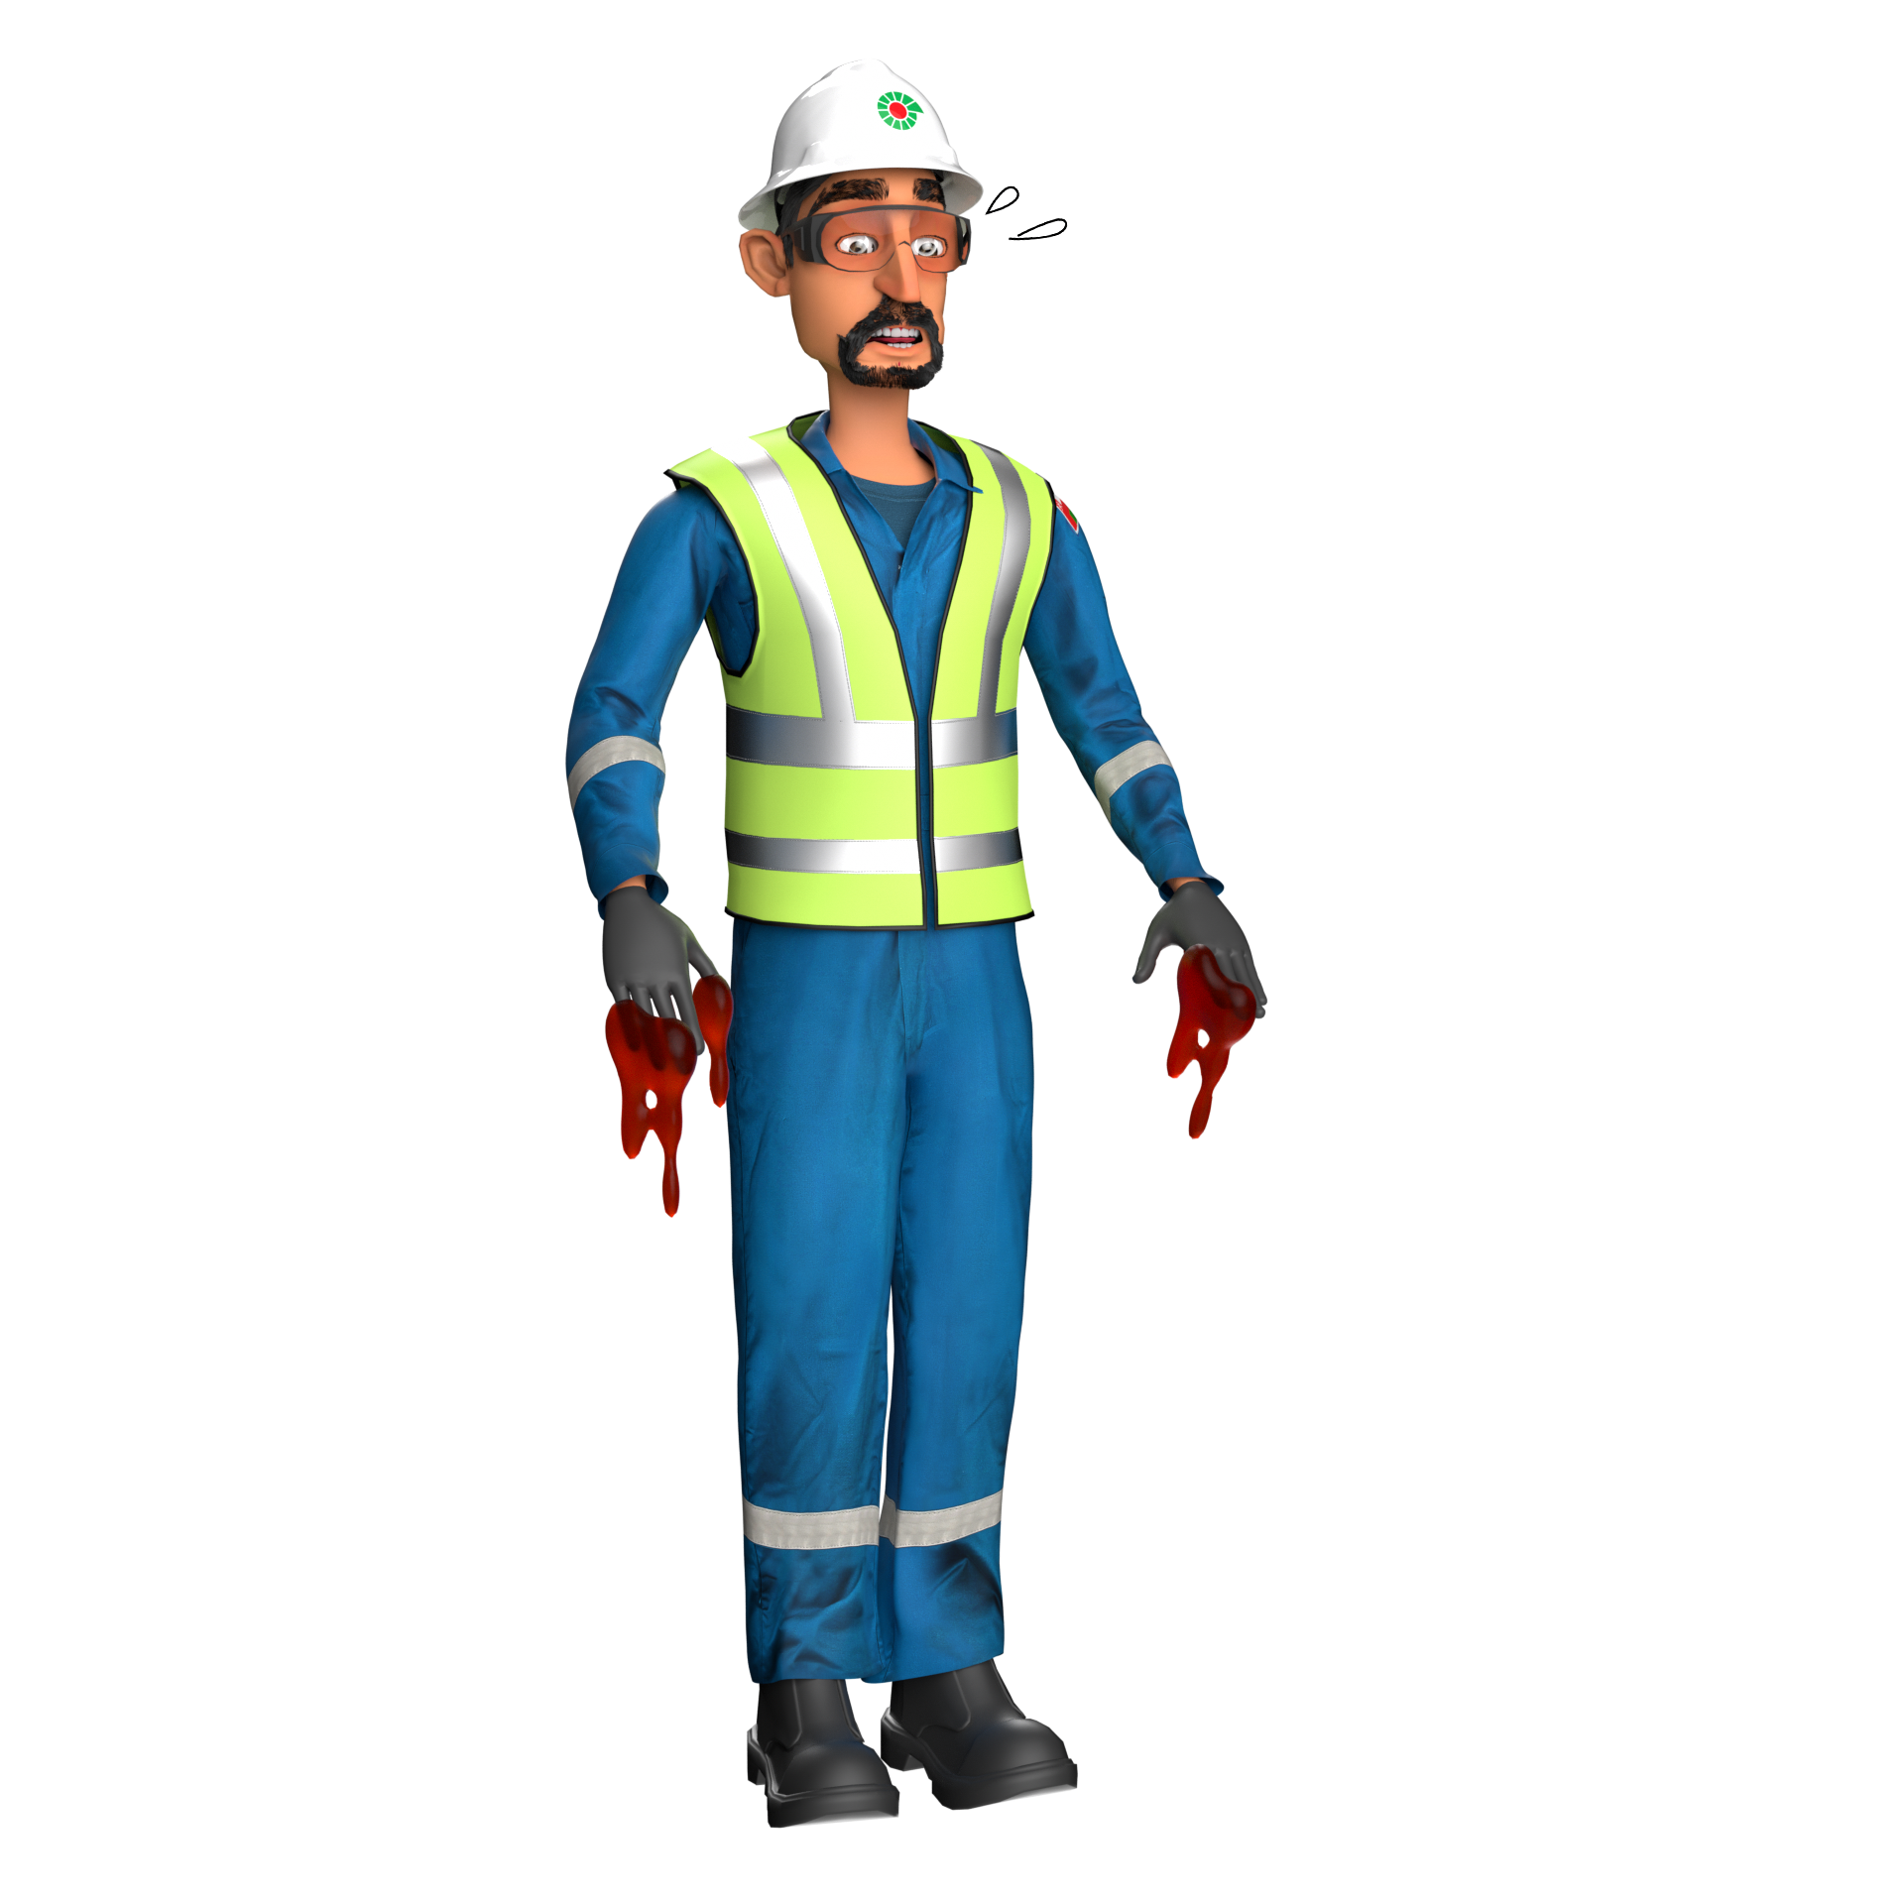
Hands & Fingers
# | Short Description of Incidents (Hyperlinked) | Incident # | Activity | Actual Severity | Potential Severity
1 | the rear door dislodged and fell on his arm | LTI#35 | unlock the side door | LTI | C3P
Table of contents
Notes:
Ensure all dates and titles are input
A short description should be provided without mentioning names of contractors or individuals. You should include, what happened, to who (by job title) and what injuries this resulted in. Nothing more!
Four to five bullet points highlighting the main findings from the investigation. Remember the target audience is the front line staff so this should be written in simple terms in a way that everyone can understand.
The strap line should be the main point you want to get across
The images should be self explanatory, what went wrong (if you create a reconstruction please ensure you do not put people at risk) and below how it should be done.

Slide 29
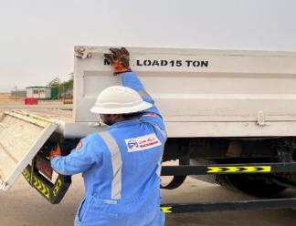
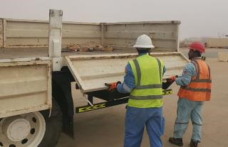
PDO Second Alert
Date: 17/09/2022 Incident title: LTI#35 Pattern: Hands & Fingers Potential severity: C3P Activity: Offloading
Target Audience: Drilling, Logistics, Operation & Construction.
What happened?
While the driver was attempting to unlock the side door of Hiab, the rear door dislodged and fell on his arm causing fracture to his left forearm. The driver was given first aid by the warehouse supervisor and then moved to PDO clinic at Harweel with Warehouse supervisor in his vehicle. The driver was later referred to Salalah for further diagnostics where it was found that he suffered from fracture on distal ends of both bones on the left forearm.
Why it happened/Finding :
Inadequate supervision
Safety briefing or induction was not given to the driver.
The driver placed his hand on the line of fire
The driver did not make sure the left side door was locked by the helpers as requested prior to open the right-side door.
No intervention has been made by everyone at site
Your learning from this incident..
Always ensure adequate supervision
Always ensure you place your body parts away from line of fire
Always communicate properly before performing any task with other colleague
Always ensure you intervene upon seeing any unsafe act or unsafe condition
Always ensure you follow the correct sequence when dismantling interrelated parts/doors
Keep your ARM out of HARM
Notes:
Ensure all dates and titles are input
A short description should be provided without mentioning names of contractors or individuals. You should include, what happened, to who (by job title) and what injuries this resulted in. Nothing more!
Four to five bullet points highlighting the main findings from the investigation. Remember the target audience is the front line staff so this should be written in simple terms in a way that everyone can understand.
The strap line should be the main point you want to get across
The images should be self explanatory, what went wrong (if you create a reconstruction please ensure you do not put people at risk) and below how it should be done.

Slide 30
Management self audit
Date: 17/09/2022 Incident title: LTI#35 Pattern: Hands & Fingers Potential severity: C3P Activity: Offloading
As a learning from this incident and ensure continual improvement all contract managers must review their HSE risk management against the questions asked below
Confirm the following:
Do you ensure all activities performed are included in HEMP and SOP ?
Do you ensure adequate supervision by competent personnel is at site?
Do you ensure regular communication related to the pinch points risks?
Do you ensure your workforce are empowered to STOP any unsafe act?
Do you ensure you have the correct level of resources to carry out the task?
Do you ensure Management of Change and risk mitigation is conducted?
* If the answer is NO to any of the above questions please ensure you take action to correct this finding
Notes:
Ensure all dates and titles are input
Make a list of closed questions (only ‘yes’ or ‘no’ as an answer) to ask others if they have the same issues based on the management or HSE-MS failings or shortfalls identified in the investigation.
Imagine you have to audit other companies to see if they could have the same issues.
These questions should start with: Do you ensure…………………?

Slide 31
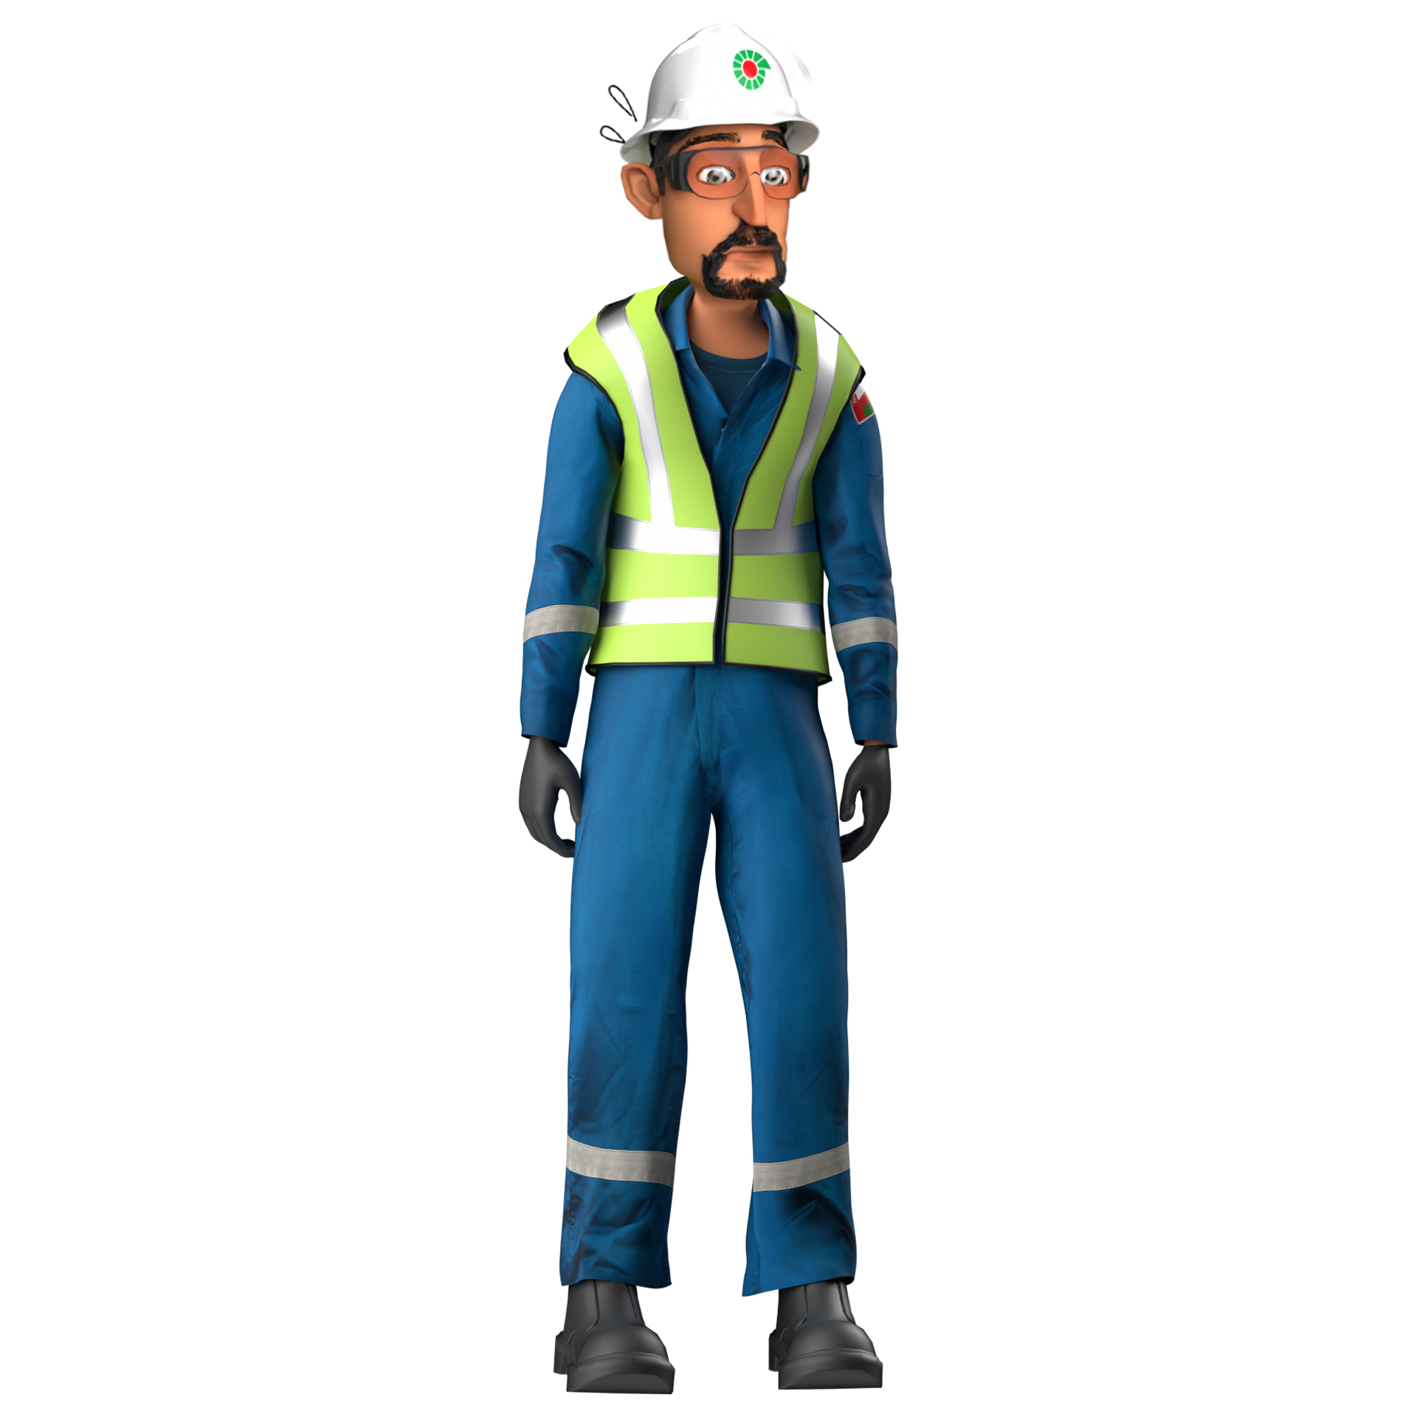
NAD
# | Short Description of Incidents (Hyperlinked) | Incident # | Actual Severity | Potential Severity
1 | Heavy duty driver collapsed while being examined in the PAC clinic | NAD#12 | NAD | 4P
2 | Driver was found unresponsive in front of hir room doorstep | NAD#01 | NAD | 4P
3 | Helper was sitting in front of his room door complaining of chest pain, suddenly collapsed and passed away | NAD#02 | NAD | 4P
Table of contents
Notes:
Ensure all dates and titles are input
A short description should be provided without mentioning names of contractors or individuals. You should include, what happened, to who (by job title) and what injuries this resulted in. Nothing more!
Four to five bullet points highlighting the main findings from the investigation. Remember the target audience is the front line staff so this should be written in simple terms in a way that everyone can understand.
The strap line should be the main point you want to get across
The images should be self explanatory, what went wrong (if you create a reconstruction please ensure you do not put people at risk) and below how it should be done.

Slide 32
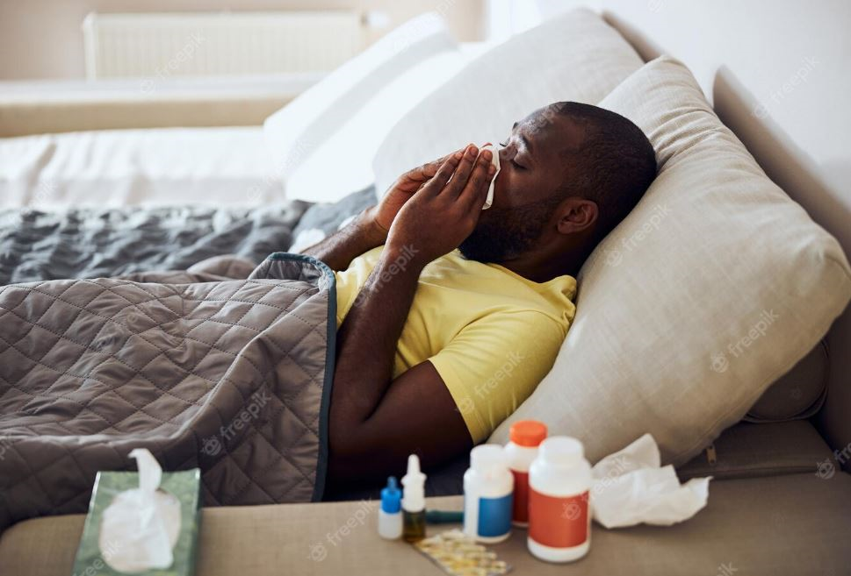
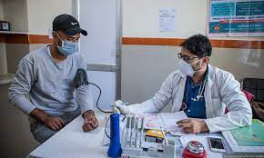
PDO Second Alert
Date: 31 Dec 2022 Incident title: NAD#12
What happened?
On 31 Dec 2022, at about 07:35 hrs a 45 yrs old Heavy Duty Driver reported to Tawoos PAC Doctor with complaints of difficulty in passing urine along with nausea and vomiting. PAC Doctor immediately attended him. During the initial treatment, his condition got deteriorated hence Doctor decided to shift him to Salalah Hospital in ambulance for further medical attention. After been moved into the ambulance, deceased got collapsed and Immediate revival protocols were initiated by medical team. The PAC Doctor and medical team administered CPR and AED attached. After consulting with PDO Doctor decided to transfer him to Shaleem hospital. Upon arrival, the deceased was unresponsive and got shifted from ambulance to emergency room. CPR continued by hospital staff. Unfortunately, he was declared as brought dead by Shaleem Doctor at 11:40 hrs.
Your learning from this incident..
Always disclose your medical conditions to the company Doctor/Medic and Site Clinic Doctor.
Always report to clinic if you feel any discomfort, without any delay.
Always ensure that follow ups on medical condition/referrals are performed.
Ensure to update site clinic health care provider about any changes in health condition or whenever new medical condition arise.
Sharing your health condition with medical team helps them to support you better during your illness !!
Notes:
No names or detail of company to link this to any recent specific incident

Slide 33


PDO Second Alert
Date: 04.01.2023 Incident title: NAD#01
What happened?
On 04 Jan 2023 at about 08:13 hrs, a 42 years old employee, was found in his room unresponsive by room boy. The room boy immediately informed the catering camp boss who in return informed the rig manager. Rig manager informed the PDO Emergency Number and to Sahara PAC Doctor . Catering Camp boss examined his condition and immediately went to PDO MAC2 (1 min from Al baraka camp to MAC2 camp). MAC2 medic was on the scene within 4 minutes and resuscitation was given for 45 mint. Later, Sahara PAC Doctor joined the scene, checked and declared him dead at 09:00 am. ROP was informed by Rig manager. The deceased was transferred to Sahara Clinic Nimr, before being shifted to Haima hospital.
Your learning from this incident..
Incase of emergency, always ensure to covey proper information (exact location, details of incident ) when 5555 is called.
Always ensure to add area code number (2438 / 2467-5555 From GSM) while calling 5555
Ensure to carryout refreshment courses and drills on First Aid.
Always remember to take your medication at as prescribed by the doctor and follow up chronic medical condition as per the Doctors prescription.
Always maintaining of healthy ( Healthy diet, avoid smoking & alcohol, ensure regular exercises).
Always maintain a healthy lifestyle and diet.
Notes:
No names or detail of company to link this to any recent specific incident

Slide 34
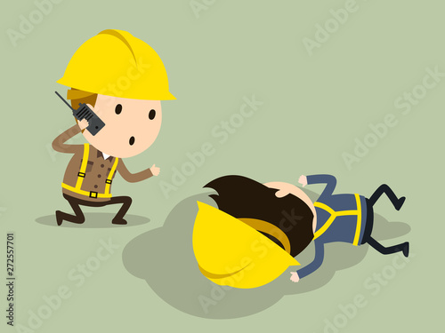

PDO Second Alert
Date: 08.01.2023 Incident title: NAD#02
What happened?
On 8th January 2023 at 08:40Hrs the SAS TAC Camp laundry man noticed that the deceased was sitting at his room's doorstep and approached him. The deceased complained of abdominal pain with vomiting sensation and asked for some water . The laundry man rushed to get him water and when he returned to him at 08:47 Hrs, he found the deceased collapsed at the doorsteps and shouted for help. A carpenter who was nearby, heard him and reached the scene. After seeing the deceased had collapsed, he rushed and informed SAS Camp boss. SAS camp boss immediately informed the SAS PAC admin, who then contacted PAC clinic for emergency medical support at 08:49Hrs. The PAC medical team arrived at 09.00 Hrs and shifted the deceased via PDO Ambulance. CPR was initiated in the ambulance by PAC medic.
After reaching the clinic, PAC Doctor and the medic team continued performing resuscitation. Approximately 40mins later at around 09:40 Hrs., the deceased was declared dead by the PAC doctor.
Your learning from this incident..
Ensure to call PDO emergency number 24385555 immediately for emergency assistance.
Ensure to conduct medical emergency drill as per HSE Plan by involving PDO medical team to evaluate the effectiveness of emergency response.
Ensure conducting frequent refresher trainings to educate First Aiders about their responsibilities.
Educate employees to report immediately in case of any illness or discomfort.
Encourage all employees to maintain a healthy lifestyle (E.g., healthy diet, exercise)
??
??
??
DURING EMERGENCY CALL 24385555 IMMEDIATELY !
Do not ignore any signs of discomfort. Report to clinic immediately
Notes:
No names or detail of company to link this to any recent specific incident

