Slide 1
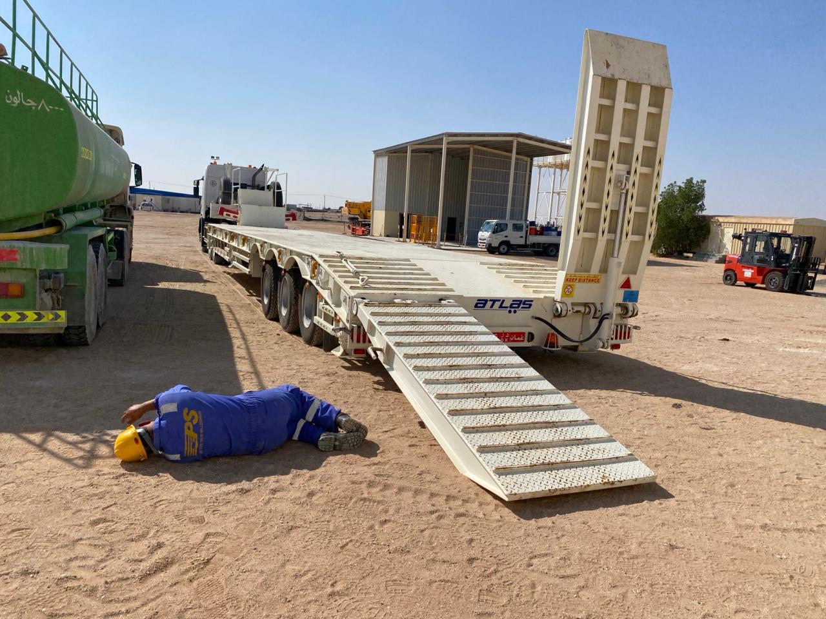
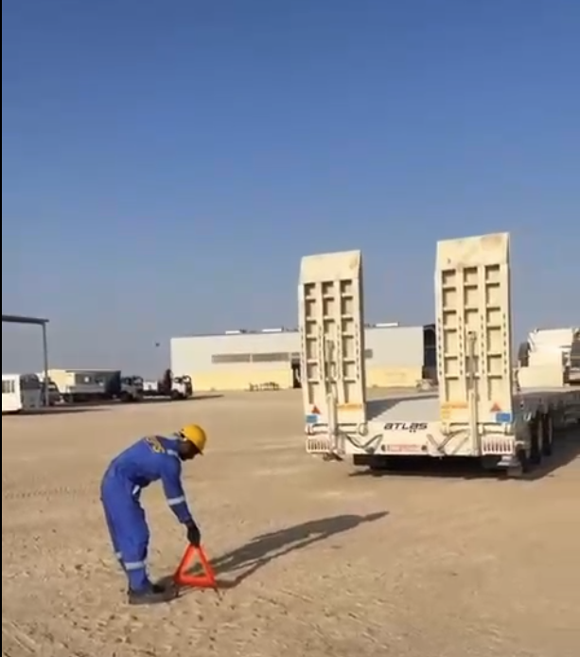
PDO Second Alert
Date: Time: | 25/09/2024 06:50 PM | Incident title: PIM# | LTI#17 1170747 | Risk Category: Injury / Asset Damaged: | Released Energy Leg Injury | Actual Severity: Potential severity: | 3P C4P | Activity: Location: | Rig Move HARWEEL
Target Audience: Drilling, Logistics, Operation & Construction
Photo explaining what was done wrong
What happened?
On 25 September 2024 at 09:30, while preparing to unload the bulldozer from a low-bed trailer, the Driver began to open the trailer ramps. During this process one of the ramps remained stuck. As he went to inspect the stuck ramp, it suddenly began to descend. While the Driver was trying to escape a direct impact from the ramp, he fell and twisted his left foot, resulting in a fracture.
He was initially taken to Yibal PDO clinic before being transferred to Badr Al Samaa hospital, where x-ray revealed a fracture on his left foot.
Why it happened/Finding :
Driver had deactivated the safety lock on both ramps.
One of the ramps started to descend before the Driver activated the drop lever.
The Driver’s safety shoes were partially tied and unable to fully bear his weight when he fell.
Your learning from this incident:
How do you identify and mark out Line Of Fire zone during unloading of trailers
Do you ensure you release Safety locks according to the procedure?
Do you ensure your PPE is correctly worn?
Photo explaining how it should be done right
ALWAYS identify the line of fire risks and avoid them!
Notes:
Ensure all dates and titles are input
A short description should be provided without mentioning names of contractors or individuals. You should include, what happened, to who (by job title) and what injuries this resulted in. Nothing more!
Four to five bullet points highlighting the main findings from the investigation. Remember the target audience is the front line staff so this should be written in simple terms in a way that everyone can understand.
The strap line should be the main point you want to get across
The images should be self explanatory, what went wrong (if you create a reconstruction please ensure you do not put people at risk) and below how it should be done.

Slide 2
Management self-audit
Date: Time: | 25/09/2024 06:50 PM | Incident title: PIM# | LTI#17/HiPo#33 1170747 | Risk Category: Injury / Asset Damaged: | Released Energy Sever vehicle damage | Actual Severity: Potential severity: | 3P C4P | Activity: Location: | Rig Move HARWEEL
As a learning from this incident and to ensure continual improvement, all contract managers must review their HSE risk management against the questions asked below
Confirm the following:
Do you ensure that the method statements/SOPs cover all aspects of the task including risk involved and safety mitigations?
Do you ensure that your employees understand the Line of Fire hazards associated with their work?
Do you ensure that competency level of your employees is maintained?
Do you ensure that your employees are aware of the emergency protocol?
Do you ensure that the workers are aware of their authority to stop unsafe work practices?
* If the answer is NO to any of the above questions please ensure you take action to correct this finding
Notes:
Ensure all dates and titles are input
Make a list of closed questions (only ‘yes’ or ‘no’ as an answer) to ask others if they have the same issues based on the management or HSE-MS failings or shortfalls identified in the investigation.
Imagine you have to audit other companies to see if they could have the same issues.
These questions should start with: Do you ensure…………………?

