Slide 1
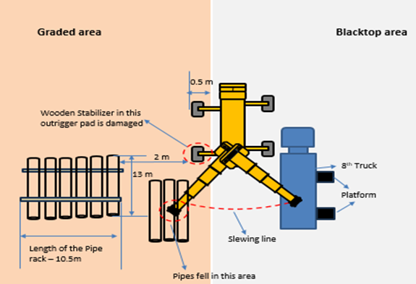
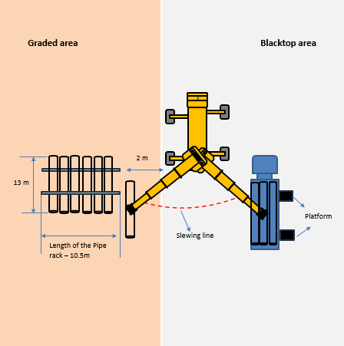
PDO Second Alert
Date: Time: | 09/02/2025 10:45 AM | Incident title: PIM# | HiPo#06 1174975 | Risk Category: Injury / Asset Damaged: | Drop/Lift No damage | Actual Severity: Potential severity: | 0P C5P | Activity: Location: | Lifting Fahud
Target Audience: Lifting operation and Lifting Team
Photo explaining what was done wrong
What happened?
On 9-Feb-2025, An incident occurred while lifting three 30-inch casing pipes, each weighing 4.5T. During the process, the crane tilted forward, prompting the crane operator to drop the load on the ground. No injury or asset damages were sustained during the incident.
Why it happened/Finding :
The incident was not reported timely by the lifting crew and the third-party driver at location.
The lifting crew deviated from the approved lift plan.
No one from the crew utilized empowerment to stop to intervene and stop the unsafe lifting.
CAT report from Duqm was not shared and thus there was a lack of proper planning.
There was rush in the yard as 10 trucks came for offloading at the same time.
The lift plan was not reviewed after the previous crane was swapped with another crane.
The crane outrigger was placed in (home mad pad) unstable surface.
No damage or injuries sustained during this incident.
Your learning from this incident..
Ensure that all incidents and events are reported immediately ?
Ensure that your lifting team follow the lift plan?
Ensure that everyone is utilizing their empowerment to stop unsafe acts?
Ensure that proper planning is in place for all the yard activities?
Ensure that you review your lift plan when the lifting equipment is swapped?
Ensure that the crane outriggers are placed in a stable ground (standard manufacturer recommend out rigger pad) ?
Photo explaining how it should be done right
Ensure to follow approved lifting plan, crane outrigger is extended and placed in a stable surface
Notes:
Ensure all dates and titles are input
A short description should be provided without mentioning names of contractors or individuals. You should include, what happened, to who (by job title) and what injuries this resulted in. Nothing more!
Four to five bullet points highlighting the main findings from the investigation. Remember the target audience is the front line staff so this should be written in simple terms in a way that everyone can understand.
The strap line should be the main point you want to get across
The images should be self explanatory, what went wrong (if you create a reconstruction please ensure you do not put people at risk) and below how it should be done.

Slide 2
Management Reflective Questions
As a learning from this incident and to ensure continual improvement, all contract managers must review their HSE risk management against the questions asked below
Confirm the following:
Do you ensure lift plan is approved and being adhered?
Do you ensure that lifting crew complies with 10 Q’s of safe lift?
Do you ensure all risk has been assessed, mitigated and controlled?
Do you ensure that the lifting crew is competent and fully aware about the lifting plan?
Do you encourage your team to report all events / incidents?
Do you ensure the person in charge of operation have sufficient support and is not rushed?
Do you empower your crew to intervene any unsafe acts/practices and unsafe condition that will compromise safety?
Do you ensure appropriate tools & equipment and other relevant resources are provided and available?
* If the answer is NO to any of the above questions please ensure you take action to correct this finding
Please refer to the notes section for guidance
Notes:
Make a list of closed questions (only ‘yes’ or ‘no’ as an answer) to ask others if they have the same issues based on the management or HSE-MS failings or shortfalls identified in the investigation.
Imagine you have to audit other companies to see if they could have the same issues.
These questions should start with: Do you ensure…………………?

