Slide 1
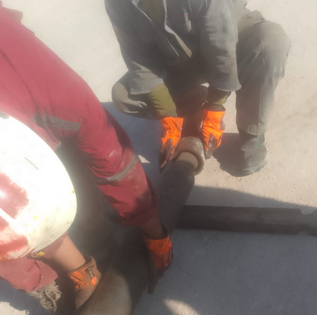
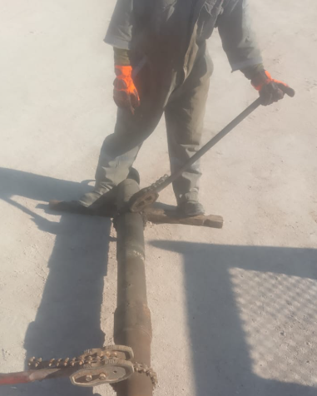
PDO Second Alert
Date: Time: | 17/01/2025 10:30 AM | Incident title: PIM# | HiPo#02 1174068 | Risk Category: Injury / Asset Damaged: | Drop/Lift No damage | Actual Severity: Potential severity: | 1P C4P | Activity: Location: | Lifting Marmul
Target Audience: Hoisting Crew, third party access to Rig floor
Photo explaining what was done wrong
What happened?
A circulation sub with a plug valve became unconnected and fell from a height of 8 meters from the top of a landing joint during the assembly of a tubing hanger. The falling object made contact with the floorman's right arm, causing slight injury.
Why it happened/Finding :.
Risk normalization and poor supervision while making up of the connection
Improper tool selection:Toolbox talk done, the SOP for installation of hanger available yet plug valve was used instead of BPV
Circulating head was not properly torqued into landing joint box connection
Failure to notice plug valve stuck between links & connection to landing joint getting screwed
Reflective Question..
How do you verify that all connections are properly torqued according to the Program and SOP before proceeding with operations?
Are you consistently using the correct tools as specified in the SOP for each operation, and how do you ensure proper tool selection?
What steps do you take to confirm that all crew members are fully aware of the Procedures, JSA, and risk assessments before starting a task?
How do you actively perform dynamic risk assessments during operations, and what methods do you use to monitor tasks efficiently in real time?
Photo explaining how it should be done right
Always ensure to follow the SOP and comply with Work authorizations
Notes:
Ensure all dates and titles are input
A short description should be provided without mentioning names of contractors or individuals. You should include, what happened, to who (by job title) and what injuries this resulted in. Nothing more!
Four to five bullet points highlighting the main findings from the investigation. Remember the target audience is the front line staff so this should be written in simple terms in a way that everyone can understand.
The strap line should be the main point you want to get across
The images should be self explanatory, what went wrong (if you create a reconstruction please ensure you do not put people at risk) and below how it should be done.

Slide 2
Effective Learning
To make sure learning is translated to the site day to day activities , please answer the below questions :-
How learning can be implemented at site ?
Follow the SOP for selecting the correct tools for the task.
Ensuring the site leadership is supervising critical activities.
How can you sustain the action ?
Ensure routine follow up by operations for upcoming critical operations reviewing the SOP with RM & NTP.
Ensuring appropriate tools are available and maintained.
Continue educating employees on SOP’s & risk assessments.
Routine L3 & L2 audits.
Notes:
Guideline for Effective Learning & Sustainability
•Can be replicated across similar contractor / activities
•Shall be SMART- Specific ,Measurable , Achievable ,Realistic & Timebound
•Can be implemented in a months' time

