Slide 1
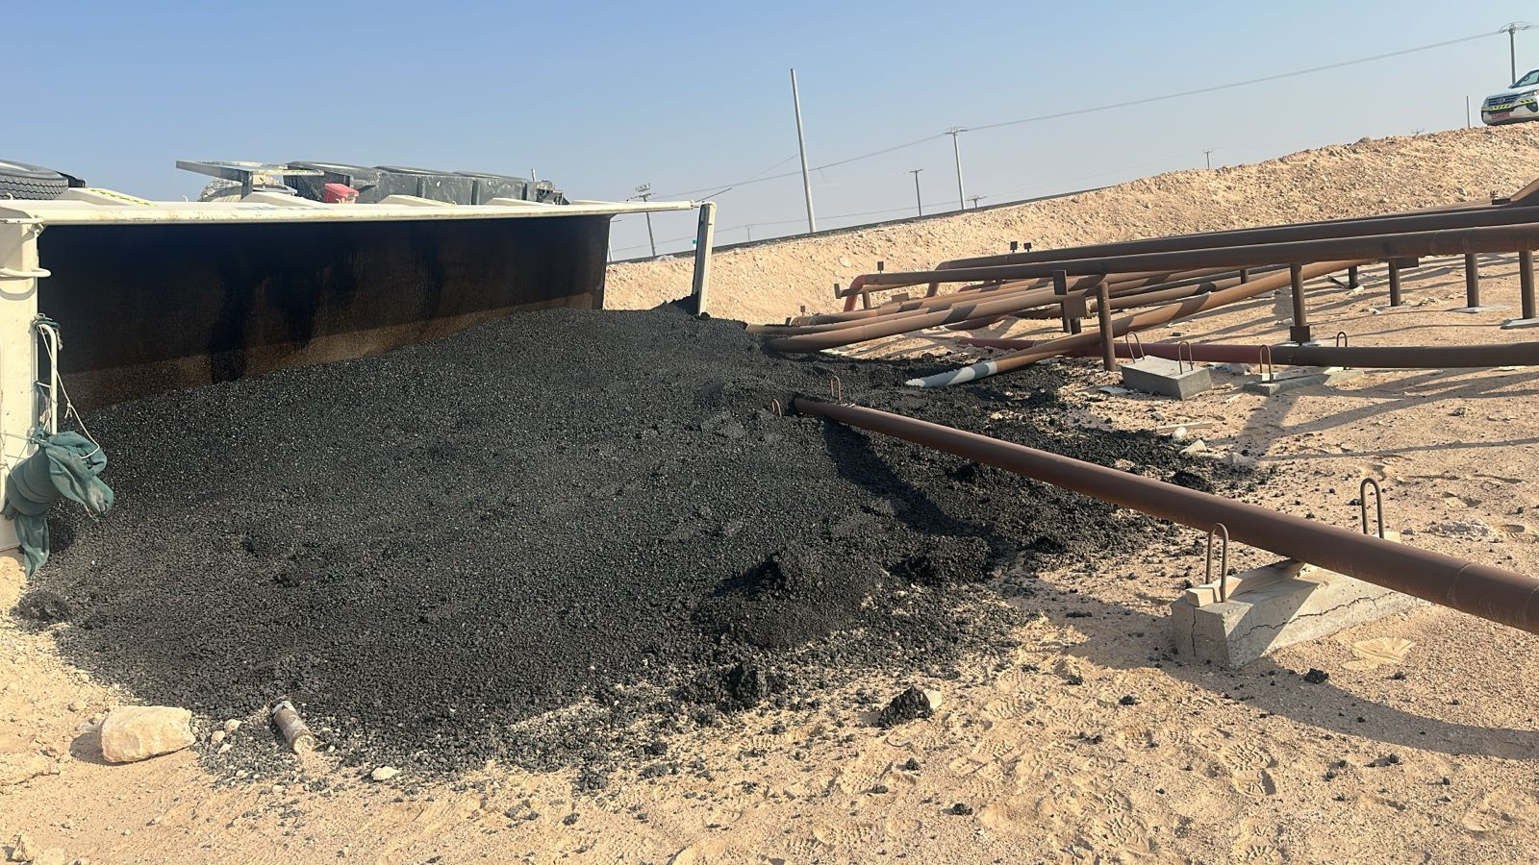
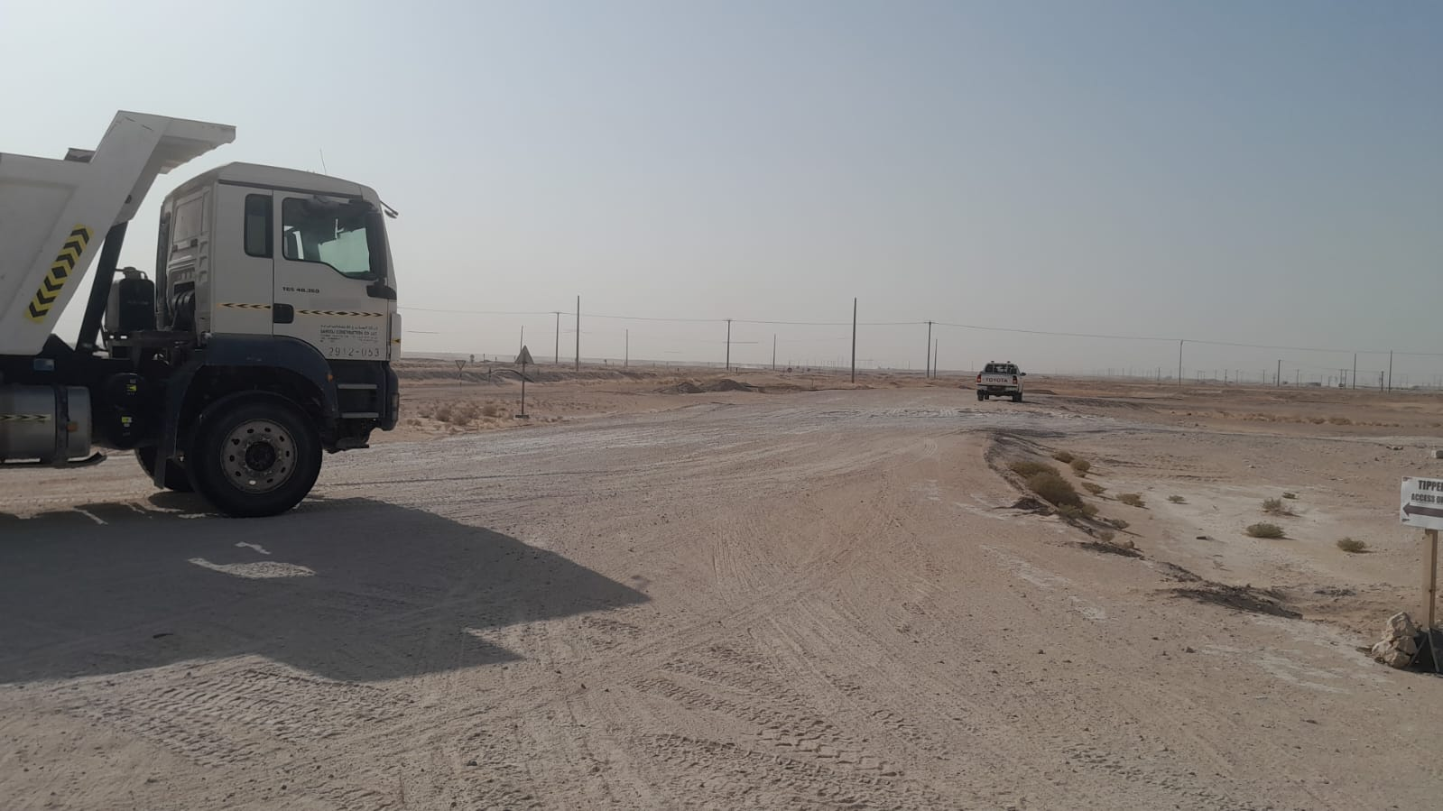
Date: Time: | 31/01/2025 03:04 | Incident title: PIM# | HiPo#3 MVI 1174456 | Risk Category: Injury / Asset Damaged: | MVI Rollover Minor vehicle damage | Actual Severity: Potential severity: | 2A 3A4P | Activity: Location: | Driving Chainage 39+372 (Saih Rawl Lot 3)
PDO Second Alert
PDO Second Alert
Date: Time: | 31/01/2025 08:07 AM | Incident title: PIM# | HiPo#03 1174456 | Risk Category: Injury / Asset Damaged: | MVI Minor Damage | Actual Severity: Potential severity: | 2A C4P | Activity: Location: | Driving Saih Rawl
Target Audience: Logistics, Operation & Construction
Photo explaining what was done wrong
What happened?
The subcontractor was engaged in transporting asphalt materials to the worksite. During operations, the tipper trailer driver lost control of the vehicle near to the flow line area due to unstable soil conditions, resulting in the overturning of the trailer. The driver successfully self-extricated from the vehicle without requiring external assistance.
Why it happened/Findings:
Management of change: Straying away from the norm to practice substandard SSOW to improve work efficiency.
Broken Chain of Communication: Transfer of key information was reliant on weak system of communication.
Assumption and lack of verification: The driver assumed the task details without verifying the information.
Delegation of Safety Responsibility: Supervisor delegated safety responsibility.
Ineffective scheduling: The work schedule relied on a flawed communication system with significant safety gaps
Reflective Questions
When you make changes to your procedures or standard way of working, how do you assess the potential impact of these changes into your operations?
How do you ensure direct effective communication between supervisor, team and crew are taking place when they are geographically apart (large distance)?
How do you ensure the competency of Drivers and Journey Managers before they start work?
When making changes to planning and scheduling of activities, how do you communicate these changes to affected parties before the changes are implemented?
Ensure regular scheduled audits of systems take place to identify any changes to key systems that might affect safety.
Photo explaining how it should be done right
Always follow signage to diversions
Ensure channels of communications are well established between teams
Notes:
Ensure all dates and titles are input
A short description should be provided without mentioning names of contractors or individuals. You should include, what happened, to who (by job title) and what injuries this resulted in. Nothing more!
Four to five bullet points highlighting the main findings from the investigation. Remember the target audience is the front line staff so this should be written in simple terms in a way that everyone can understand.
The strap line should be the main point you want to get across
The images should be self explanatory, what went wrong (if you create a reconstruction please ensure you do not put people at risk) and below how it should be done.

Slide 2
Management Reflective Questions
PDO Second Alert
As a learning from this incident and ensure continual improvement all contract managers must review their HSE risk management against the questions asked below
Confirm the following:
How do you ensure the crew has understood your instructions by receiving their acknowledgment directly?
How do you ensure the route to be followed is without obstruction and obstacles?
How do you ensure that communication channels are without interruptions?
How do you ensure competency of employees against their specific jobs and roles?
How do you ensure effective toolbox talks wherein the crew have understood and acknowledged – all hazards and their respective control measures?
Notes:
Ensure all dates and titles are input
Make a list of closed questions (only ‘yes’ or ‘no’ as an answer) to ask others if they have the same issues based on the management or HSE-MS failings or shortfalls identified in the investigation.
Imagine you have to audit other companies to see if they could have the same issues.
These questions should start with: Do you ensure…………………?

