Slide 1
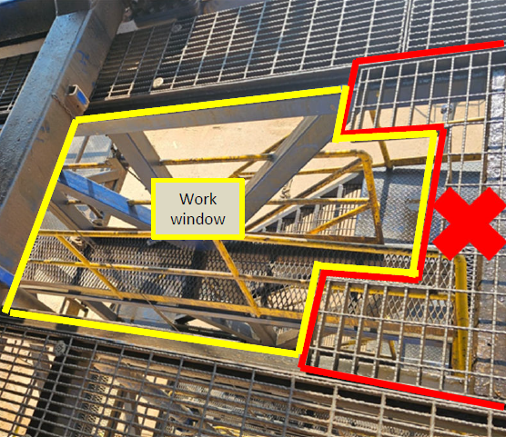
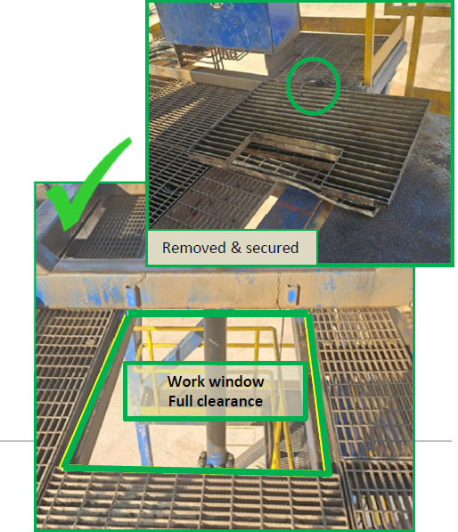
PDO Second Alert
Date: Time: | 06-02-2025 09:26 AM | Incident title: PIM# | HiPo#05 1174694 | Risk Category: Injury / Asset Damaged: | Drop Minor damage | Actual Severity: Potential severity: | 1A C4P | Activity: Location: | Lifting Activities Saih Rawl
Target Audience: Drilling, Logistics, Operation & Construction
Photo explaining what was done wrong
What happened?
On 6-Feb-2025, during a day shift operation, a third-party slickline (SLK) crew was lifting the lubricator into the wellhead through the coil tubing (CT) tower (yellow area). While doing so, a D-shackle—part of the lifting accessories—contacted a removable grating (red highlighted) from the top section of the CT tower, causing it to fall. At the time of the incident, a banksman was standing on the scaffolding below the tower, near the line of fire. Fortunately, no injuries were reported.
Why it happened/Finding :
• Improper behavior & Inadequate Lifting supervision
• Lack of control and verification before approving a PTW.
• XOM SLK JSA didn’t specify the requirements for running the lubricator through CT Tower
• The XOM SLK Lifting Plan was generic and wasn’t job-specific.
• No lifting supervisor nor dedicated Banksman in place.
• The job was considered routine.
• No 3rd party checklist verification was conducted.
Your learning from this incident..
• Lifting supervisor should always ensure supervision in the crucial lifting activity.
• Ensure always the interface with a third party to be fully access and adequate control to be in place.
• Ensure always continuous improvement and revalidation of SOP & JSA and equipment requirement considering new practices
Photo explaining how it should be done right
Ensure supervision during lifts , eliminate any potential drops, and remove people from Red Zone
Notes:
Ensure all dates and titles are input
A short description should be provided without mentioning names of contractors or individuals. You should include, what happened, to who (by job title) and what injuries this resulted in. Nothing more!
Four to five bullet points highlighting the main findings from the investigation. Remember the target audience is the front line staff so this should be written in simple terms in a way that everyone can understand.
The strap line should be the main point you want to get across
The images should be self explanatory, what went wrong (if you create a reconstruction please ensure you do not put people at risk) and below how it should be done.

Slide 2
Effective Learning
To make sure learning is translated to the site day to day activities , please answer the below questions :-
How learning can be implemented at site ?
Stand down & Alerts
Drills and TBT with management participation engaging field team
How can you sustain the action ?
Leadership and awareness sessions
Proper RACI and clear R&R for all personnel
Audits and Management visits
Implement a HSE Calander to tackle risk normalization
Notes:
Guideline for Effective Learning & Sustainability
•Can be replicated across similar contractor / activities
•Shall be SMART- Specific ,Measurable , Achievable ,Realistic & Timebound
•Can be implemented in a months' time

