Slide 1
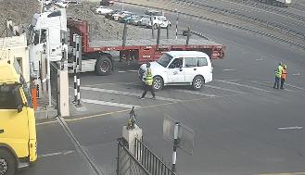
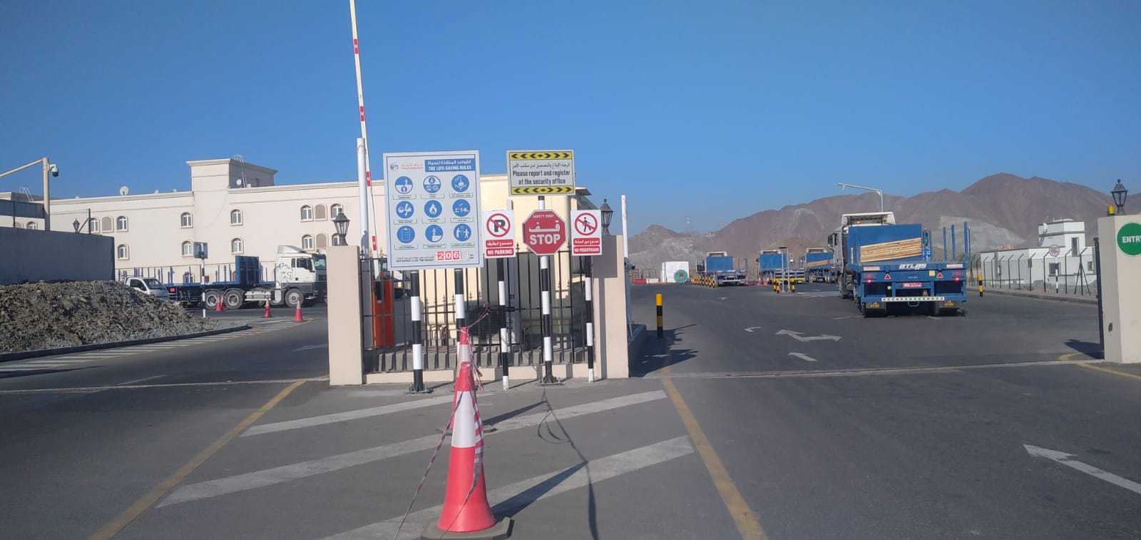
PDO Second Alert
Date: Time: | 10/02/2025 09:45 AM | Incident title: PIM# | HiPo#07 1174793 | Risk Category: Injury / Asset Damaged: | MVI Wrist fracture | Actual Severity: Potential severity: | 3P C4P | Activity: Location: | Main entrance area MAF
Target Audience: Lifting operation and Lifting Team
Photo explaining what was done wrong
What happened?
On February 10, 2025, at 09:45 AM, an incident occurred outside the contractor logistics yard in Muscat near the entrance and exit gate chevron area involving a contractor driver along with PDO vendor representative and helper. The light duty driver stopped at the gate area within the chevroned area while at the same time two 3rd party pedestrians were stood behind, also within the chevroned area. The light duty driver concluded his conversation with security and began reversing hitting both pedestrians, as a result one 3rd party helper fell to the ground fracturing his arm.
Both 3rd party personnel were transported to SQU hospital for further medical evaluation and checkup.
Why it happened/Finding :
The LDD had parked the vehicle in a non-designated area.
Security personnel did not intervene – in relation to the vehicle and in relation to the pedestrians.
Reflective Questions:
How do you identify, evaluate & control the hazards involved at the entrance to your site?
Do you ensure that site induction is done for all site users?
Do you ensure that everyone is utilizing Empowerment to STOP if any unsafe act/condition?
Do you ensure that you control the vehicle parking at the entrance to your site?
Do you ensure you conduct 360 degree checks before maneuvering and reversing ?
Do you ensure that adequate hazard identifications are placed such as signage, warning chevrons etc.?
Photo explaining how it should be done right
Ensure to conduct 360 degree check before reversing or maneuvering the vehicle
Notes:
Ensure all dates and titles are input
A short description should be provided without mentioning names of contractors or individuals. You should include, what happened, to who (by job title) and what injuries this resulted in. Nothing more!
Four to five bullet points highlighting the main findings from the investigation. Remember the target audience is the front line staff so this should be written in simple terms in a way that everyone can understand.
The strap line should be the main point you want to get across
The images should be self explanatory, what went wrong (if you create a reconstruction please ensure you do not put people at risk) and below how it should be done.

Slide 2
Management Reflective Questions
As a learning from this incident and to ensure continual improvement, all contract managers must review their HSE risk management against the questions asked below
Confirm the following:
Do you ensure that all visitors are inducted prior to entry into your facility?
Do you ensure that vehicles are not parking in no parking areas?
Do you ensure that ‘Empowerment To STOP’ is communicated to workforce & visitors?
Do you ensure that pedestrian movement in high-risk areas is restricted and mitigated?
Do you ensure that there is a designated pedestrian area in your facility?
* If the answer is NO to any of the above questions please ensure you take action to correct this finding
Please refer to the notes section for guidance
Notes:
Make a list of closed questions (only ‘yes’ or ‘no’ as an answer) to ask others if they have the same issues based on the management or HSE-MS failings or shortfalls identified in the investigation.
Imagine you have to audit other companies to see if they could have the same issues.
These questions should start with: Do you ensure…………………?

