Slide 1
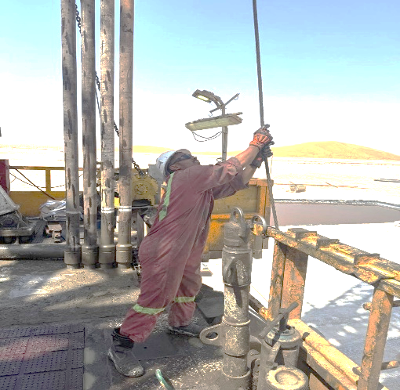
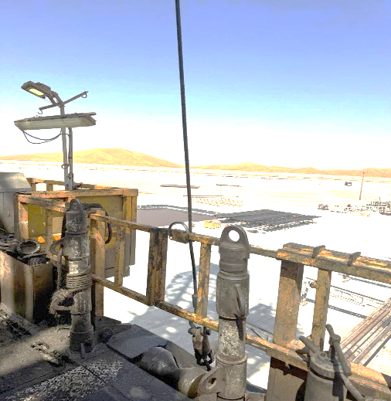
PDO Second Alert
Date: Time: | 04-03-2025 02:15 AM | Incident title: PIM# | HiPo#10 1175476 | Risk Category: Injury / Asset Damaged: | Slip, Trip, Fall First Aid Case | Actual Severity: Potential severity: | 1P C4P | Activity: Location: | Laydown the Jar Lekhwair
Target Audience: Floormen, Assistant Drillers,Drillrers, Rig Mangers and Night Tool Pushers
What happened?
During the Running in Hole (RIH) of the 8-1/2” BHA, the crew used the power catwalk skate and winch line to place the drilling jar in the
mousehole. The floor man noticed the winch line was snagged on the monkey-board finger. To free the line, the floor man slacked the winch
line, allowing the floor man to attempt removal, but without success. The driller then tried to lower the drilling jar back to the catwalk. As he
moved the power catwalk skate, slack in the winch line caused the jar to shift toward the driller side of the V-door. When the winch line
Tightened, the floor man, still holding the line, experienced a sharp jerk, causing Him to lose balance and slide down on the V-door to the catwalk
Why it happened/Finding :
The floorman attempted to free the snagged winch line from the monkey board finger.
Winch line entangled in monkey-board finger; risk not reassessed.
The floorman was positioned close to the V-door, which constituted a line of fire.
Communication gaps: Catwalk was operated without confirming the area was clear, leading to a sudden line tension that caused a floorman to lose balance and fall.
Stop work authority was not utilized; no one intervened when they observed the floor man near the V-door.
There was insufficient supervision.
Reflective Questions.
What should you do when a task changes unexpectedly?
Why is it critical to close the V-door before handling winch lines?
How can we prevent complacency during repetitive tasks?
What steps ensure effective communication?
How do you apply Stop Work Authority when you see unsafe Acts/conditions?
How do you ensure effective supervision during critical activity?
Always ensure Stop and reassess any dynamic risk
Notes:
Ensure all dates and titles are input
A short description should be provided without mentioning names of contractors or individuals. You should include, what happened, to who (by job title) and what injuries this resulted in. Nothing more!
Four to five bullet points highlighting the main findings from the investigation. Remember the target audience is the front line staff so this should be written in simple terms in a way that everyone can understand.
The strap line should be the main point you want to get across
The images should be self explanatory, what went wrong (if you create a reconstruction please ensure you do not put people at risk) and below how it should be done.

Slide 2
Effective Learning
To make sure learning is translated to the site day to day activities , please answer the below questions :-
How can learning be implemented at the site?
Supervisor-Led Coaching – Have Night Tool pushers and Drillers lead pre-job talks and deliver immediate coaching during operational changes. Update Toolbox Talks with real incident examples and require a new TBT if tasks deviate from the plan.
Live Observations & Feedback – Conduct random spot-checks and audits by HSE and Operations teams on high-risk tasks, providing instant feedback to reinforce safe practices.
Clear SOPs & Accessible Guidance – Keep updated SOPs, quick guides, and risk prompts in key spots (drillers’ cabins, doghouse, Tool pushers’ office) for easy, on-the-spot reference.
How can you sustain the action?
Supervisor Accountability Verification – Use CCTV reviews, check-ins, and spot audits to confirm supervisors are present and actively leading during critical operations.
Leadership Engagement & Oversight – Ensure Rig Managers and Superintendents regularly engage with crews to monitor compliance, gather feedback, and drive sustained improvements.
KPI Monitoring & Incident Integration – Track adherence to dynamic risk assessments (e.g., updated TBTs) and proper winch use through post-task reviews and incident investigations.
Notes:
Guideline for Effective Learning & Sustainability
•Can be replicated across similar contractor / activities
•Shall be SMART- Specific ,Measurable , Achievable ,Realistic & Timebound
•Can be implemented in a months' time

