Slide 1
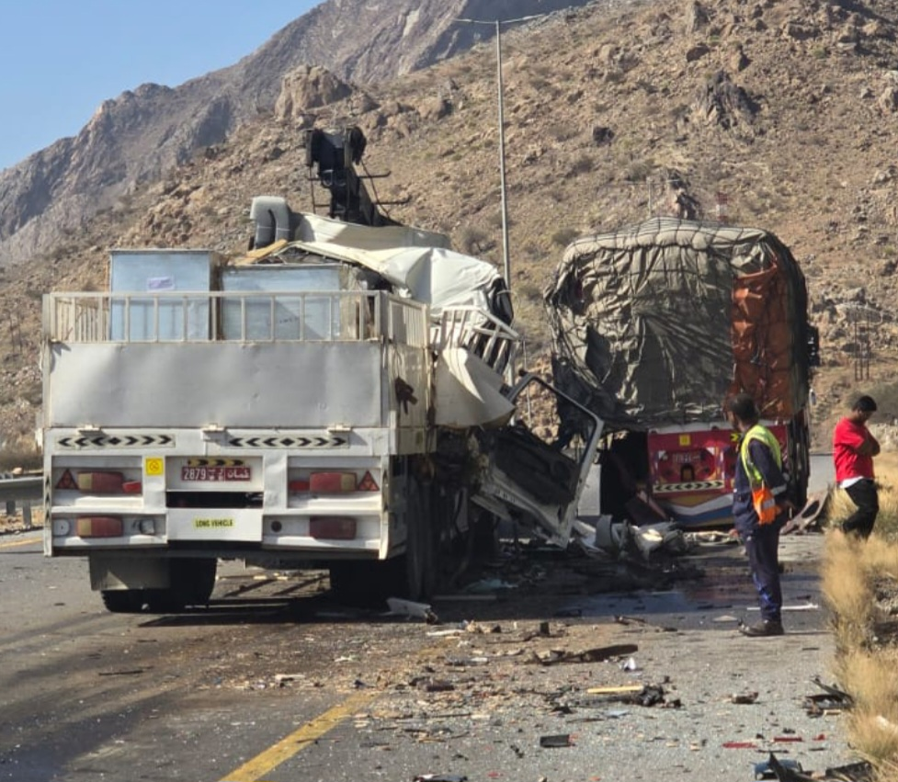
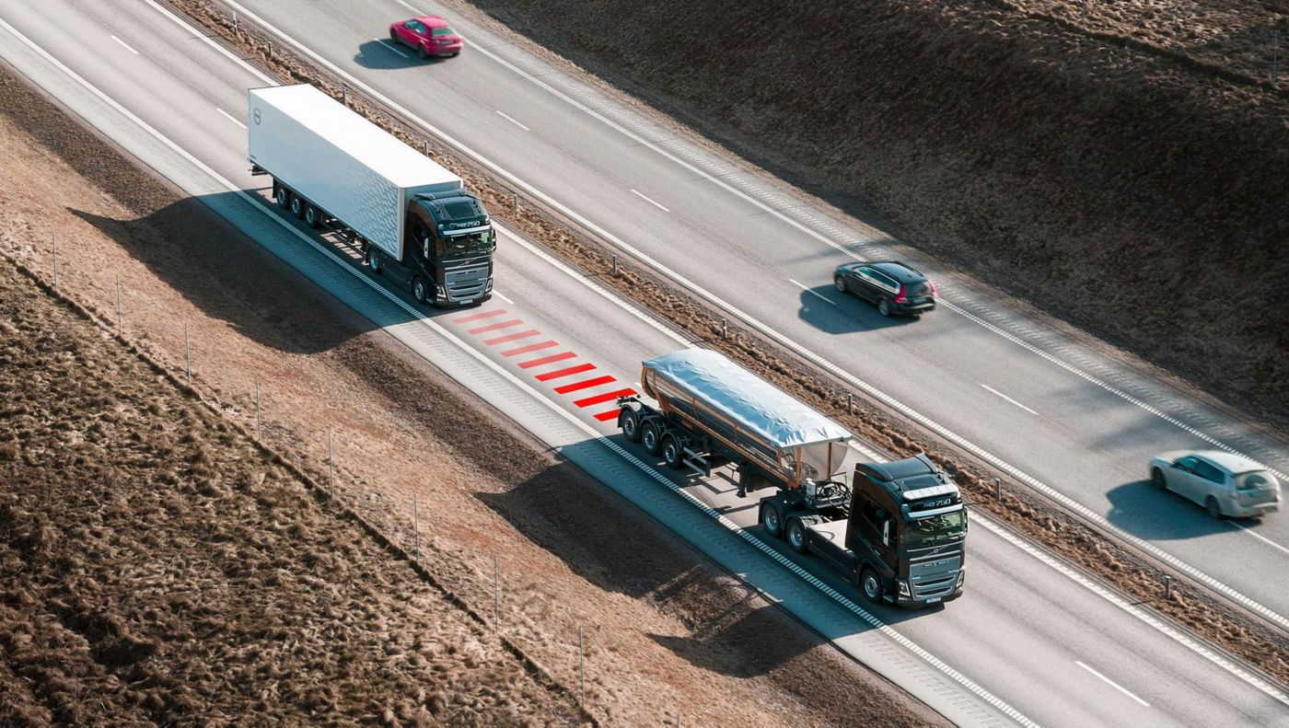
PDO Second Alert
Date: Time: | 26/03/2025 07:28 | Incident title: PIM# | HiPo#12 1176285 | Risk Category: Injury / Asset Damaged: | MVI Vehicle damage | Actual Severity: Potential severity: | 3A D4P | Activity: Location: | Driving Main Road
Target Audience: Operations Managers, Well Engineers, Assurance team, Hoist Supervisors
What happened?
Motor Vehicle Incident (MVI) occurred on the Muscat–Nizwa dual carriageway near Samail. A prime mover with a 40ft trailer transporting HVAC equipment (payload 2.6 tons) attempted to overtake a slow-moving third-party truck on an uphill stretch. While overtaking at 85 km/h, a civilian car approached in the fast lane and sounded its horn. The prime mover driver reacted by steering back into the second lane, causing the vehicle to collide with the rear left side of the third-party trailer. The prime mover was a total loss, and the trailer sustained major damage. No injuries were reported.
Why it happened/Finding:
Unsafe Speed: Driver maintained 85 km/h despite uphill gradient and slow-moving traffic.
Overtaking without fully scanning surrounding traffic conditions.
Fatigue Risk: Incident occurred during Ramadan; possible inadequate rest.
Lack of Road Signage: No warning signs for uphill climb or slow-moving trucks for 4 km before the location.
Driver Behavior: Haste to complete delivery and return same day.
Reflective Questions :
How do you ensure safe speed and braking distance on uphill roads?
What should you do before overtaking on multi-lane highways?
Why is it critical to plan journeys realistically instead of rushing?
How can fatigue impact decision-making during long-haul trips?
What role does proactive communication play in preventing such incidents?
Always ensure its safe and clear before deciding to overtake
Notes:
Ensure all dates and titles are input
A short description should be provided without mentioning names of contractors or individuals. You should include, what happened, to who (by job title) and what injuries this resulted in. Nothing more!
Four to five bullet points highlighting the main findings from the investigation. Remember the target audience is the front line staff so this should be written in simple terms in a way that everyone can understand.
The strap line should be the main point you want to get across
The images should be self explanatory, what went wrong (if you create a reconstruction please ensure you do not put people at risk) and below how it should be done.

Slide 2
Management Reflective Questions
As a learning from this incident and to ensure continual improvement, all contract managers must review their HSE risk management against the questions asked below
Confirm the following:
Do you ensure that your drivers apply defensive driving techniques (in particular, maintain safe speed taking into account surrounding traffic conditions)?
Do you ensure adequate briefing on 3rd party risks in your operations?
Do you ensure proactive monitoring of journeys by your journey managers?
Do you ensure that fatigue can be recognized by your journey managers and your drivers?
* If the answer is NO to any of the above questions please ensure you take action to correct this finding
Please refer to the notes section for guidance
Notes:
Make a list of closed questions (only ‘yes’ or ‘no’ as an answer) to ask others if they have the same issues based on the management or HSE-MS failings or shortfalls identified in the investigation.
Imagine you have to audit other companies to see if they could have the same issues.
These questions should start with: Do you ensure…………………?

