Slide 1
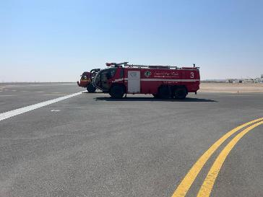
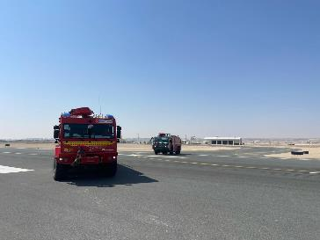
PDO Second Alert
Date: Time: | 18.02.2025 02:15 AM | Incident title: PIM# | HiPo#13 1175011 | Risk Category: Injury / Asset Damaged: | MVI First Aid Case | Actual Severity: Potential severity: | 3A C4P | Activity: Location: | Exercise Fahud Airport
Target Audience: Drilling, Logistics, Operation & Construction
Photo explaining what was done wrong
What happened?
During a response time exercise at Fahud Airport, a fire truck (Tigon 1) rolled over while making a left turn from Taxiway Alpha onto the runway. Three firefighters inside the truck self-evacuated without injuries, but the truck sustained significant damage. The airport runway was closed, and emergency response teams were mobilized immediately.
Why it happened/Finding :
High Speed During Turn: The fire truck was traveling at 67 km/h, which was excessive for the sharp turn radius.
Pressure to Meet Response Time: Driver aimed to achieve the 2-minute response requirement.
No Specific SOP: There was no dedicated Standard Operating Procedure for driving fire trucks inside the airport during emergencies.
Competency Gap: Driver held required licenses but lacked specialized emergency vehicle handling experience.
Parallel Movement Practice: Fire trucks moved in parallel during turns, reducing maneuvering space and stability.
Your learning from this incident..
Do you adjust speed according to road and turn conditions?
How do you ensure defensive driving principles during emergency response?
What steps do you take as a driver and passenger to maintain safety?
How do you plan for dynamic risks during non-routine tasks?
Do you know when and how to activate Stop Work Authority?
Photo explaining how it should be done right
Always ensure to follow the defensive driving technique
Notes:
Ensure all dates and titles are input
A short description should be provided without mentioning names of contractors or individuals. You should include, what happened, to who (by job title) and what injuries this resulted in. Nothing more!
Four to five bullet points highlighting the main findings from the investigation. Remember the target audience is the front line staff so this should be written in simple terms in a way that everyone can understand.
The strap line should be the main point you want to get across
The images should be self explanatory, what went wrong (if you create a reconstruction please ensure you do not put people at risk) and below how it should be done.

Slide 2
Effective Learning
To make sure learning is translated to the site day to day activities , please answer the below questions :-
Confirm the following:
Do your personnel know the PDO emergency number and when to call?
Are all hazardous tasks covered in your risk register?
How does your organization plan non-routine work?
Does your organization sufficiently assess environmental and weather-related risks?
Notes:
Guideline for Effective Learning & Sustainability
•Can be replicated across similar contractor / activities
•Shall be SMART- Specific ,Measurable , Achievable ,Realistic & Timebound
•Can be implemented in a months' time

