Slide 1
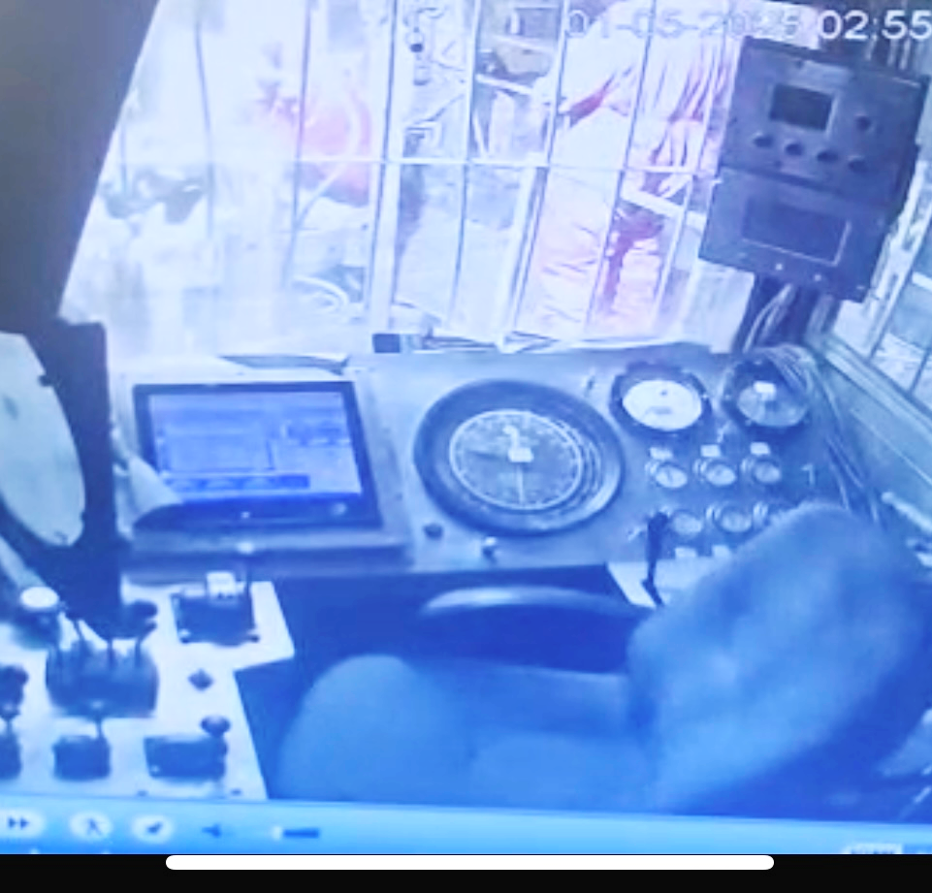
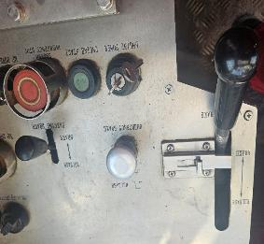
PDO Second Alert
Date: Time: | 01-05-2025 02:55 | Incident title: PIM# | HiPo#16 1177404 | Risk Category: Injury / Asset Damaged: | Drop No damage | Actual Severity: Potential severity: | 0P C4P | Activity: Location: | Pulling Out of Hole Qarn Alam
Target Audience: Floormen, Assistant Drillers,Drillrers, Rig Mangers and Night Tool Pushers
Handle moved to ‘NO BRAKE’ position
What happened?
Prior to starting Pulling Out Of Hole (POOH), the Floorman observed the power tong dies required replacement. In response, the Driller engaged the main brake, by utilizing the brake handle, and exited the Driller’s Cabin to supervise the work. However, the mechanical lock on the handle or parking brake was applied. While exiting the Cabin, the Driller inadvertently moved the chair which came into contact with brake handle. This caused the handle to shift upward to "no brake" position. As a result, the Block began descending slowly and made contact with the string suspended in the air slips and with rig floor.
Why it happened/Finding :
The brake handle in the Driller’s Cabin was left unsecured and was inadvertently moved to the “no brake” position prior to leaving the Cabin.
The “floor saver” safety device, used to prevent the Block contacting the rig floor, was shut down as the system was triggering the floor saver before the Block reached the required height, thus obstructing smooth operating of the Block up and down.
The Maintenance Team did not have adequate competency to calibrate the new Encoder used on the “floor saver” device.
Inadequate implementation of the daily verification checks.
Reflective Questions:
What process do you have in place to ensure the main brake, controlling the Block, is ‘parked’ before leaving the Driller’s Cabin?
How do you know your Work Crew are aware of all safety critical devices on the equipment they are responsible for using?
If safety critical equipment is not functioning correctly, does the Work Crew know how to address this type of situation?
How do you check the competency of Maintenance staff who are responsible for maintaining safety critical equipment?
Brake handle in CLOSED position
Always ensure the Brake is secured and parking brake applied before leaving Cabin
Notes:
Ensure all dates and titles are input
A short description should be provided without mentioning names of contractors or individuals. You should include, what happened, to who (by job title) and what injuries this resulted in. Nothing more!
Four to five bullet points highlighting the main findings from the investigation. Remember the target audience is the front line staff so this should be written in simple terms in a way that everyone can understand.
The strap line should be the main point you want to get across
The images should be self explanatory, what went wrong (if you create a reconstruction please ensure you do not put people at risk) and below how it should be done.

Slide 2
Effective Learning
Date: Time: | 01-05-2025 02:55 | Incident title: PIM# | HiPo#16 1177404 | Risk Category: Injury / Asset Damaged: | Drop No damage | Actual Severity: Potential severity: | 0P C4P | Activity: Location: | Pulling Out of Hole Qarn Alam
To make sure learning is translated to the site day to day activities , please answer the below questions :-
How learning can be implemented at site ?
Ensure the driller follows the SOP and engages the mechanical brake lock and parking brake before exiting the cabin..
Verify that the floor saver system is operational before starting any work.
How can you sustain the action ?
Conduct routine supervision to verify the driller is following SOPs and brake protocols?
Rig Manager to verify that the mechanical brakes are functional and fully engaged before operations begin.
Coach drillers on step-by-step system calibration procedures of floor savers.
Notes:
Guideline for Effective Learning & Sustainability
•Can be replicated across similar contractor / activities
•Shall be SMART- Specific ,Measurable , Achievable ,Realistic & Timebound
•Can be implemented in a months' time

