Slide 1
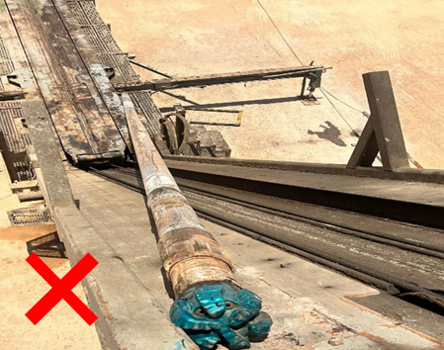
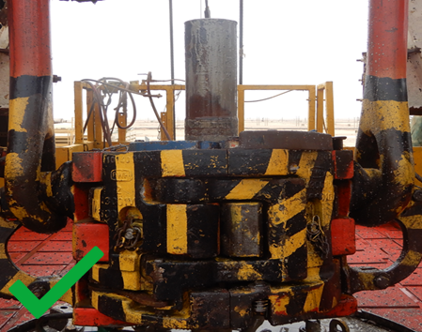
PDO Second Alert
Date: Time: | 13.08.2025 11:55 Am | Incident title: PIM# | HiPo# 23A 1180783 | Risk Category: Injury / Asset Damaged: | Drops Minor damage | Actual Severity: Potential severity: | 1A C4P | Activity: Location: | Make up BHA Nimr
Target Audience: Driller & Rig Manager
What happened?
After picking up the 6.125” motor, the crew hand-tightened the bit and placed it in the bit breaker. The Acting Driller then slacked off the BX elevator to begin making up the connection using manual tongs. At this point, the BX elevator unexpectedly opened, causing the motor assembly to fall from the Rig floor, striking the pipe-cat and rested on it. The Acting Driller immediately instructed the crew to move out from Red Zone. Fortunately, no injuries occurred at the time of the incident and pipe-cat “No-Go Zone“ was respected.
Why it happened/Finding :
The TBT was conduct and SOP was followed, and roles were clearly understood.
The Pipe-cat area and “No-Go” zone management fully respected, hard barrier were installed around the Pipe-cat.
Good response and quick evacuation by crew from Red-Zone.
The BX elevator malfunctioned, as it unexpectedly opened (without command from driller) and the Amphion screen was still showing ‘close’ status, despite the BX was fully inspected on 20th May 2025 and pre-use function test has been performed.
The valve was stuck and not responding to reduce the pressure due to corrosion.
Amphion date/time wasn't synchronized with actual time.
Your learning from this incident :
Maintenance team to increase inspection frequency for checking the condition/function of the pressure reducing valve.
Maintenance team to Review Maintenance Craft Procedure (MCP) to address the function of the pressure reducing valve and align with OEM recommendation.
Rig manager to ensure implementing the updated SOP of P/U BHA to check the function of BX elevator.
Chief Electrician to ensure date/time on Amphion software time is synchronized with actual date/time before spud the well.
Equipment must be thoroughly inspected and function tested to ensure it is free from defects or wear before use
Notes:
Ensure all dates and titles are input
A short description should be provided without mentioning names of contractors or individuals. You should include, what happened, to who (by job title) and what injuries this resulted in. Nothing more!
Four to five bullet points highlighting the main findings from the investigation. Remember the target audience is the front line staff so this should be written in simple terms in a way that everyone can understand.
The strap line should be the main point you want to get across
The images should be self explanatory, what went wrong (if you create a reconstruction please ensure you do not put people at risk) and below how it should be done.

Slide 2
Effective Learning
To make sure learning is translated to the site day to day activities , please answer the below questions :-
How learning can be implemented at site ?
Increase inspection frequency for checking the condition/function of the pressure reducing valve
Update SOP of P/U BHA to check the function of BX elevator
Keep the date/time synchronized on Amphion software matching with actual date/time
How can you sustain the action ?
Implementation of Weekly checklist, PMS/Maintenance team to confirm via frequent audits
SOP to be discussed in TBT and recorded
Follow the updated Pre Spud checklist
Notes:
Guideline for Effective Learning & Sustainability
•Can be replicated across similar contractor / activities
•Shall be SMART- Specific ,Measurable , Achievable ,Realistic & Timebound
•Can be implemented in a months' time

