Slide 1
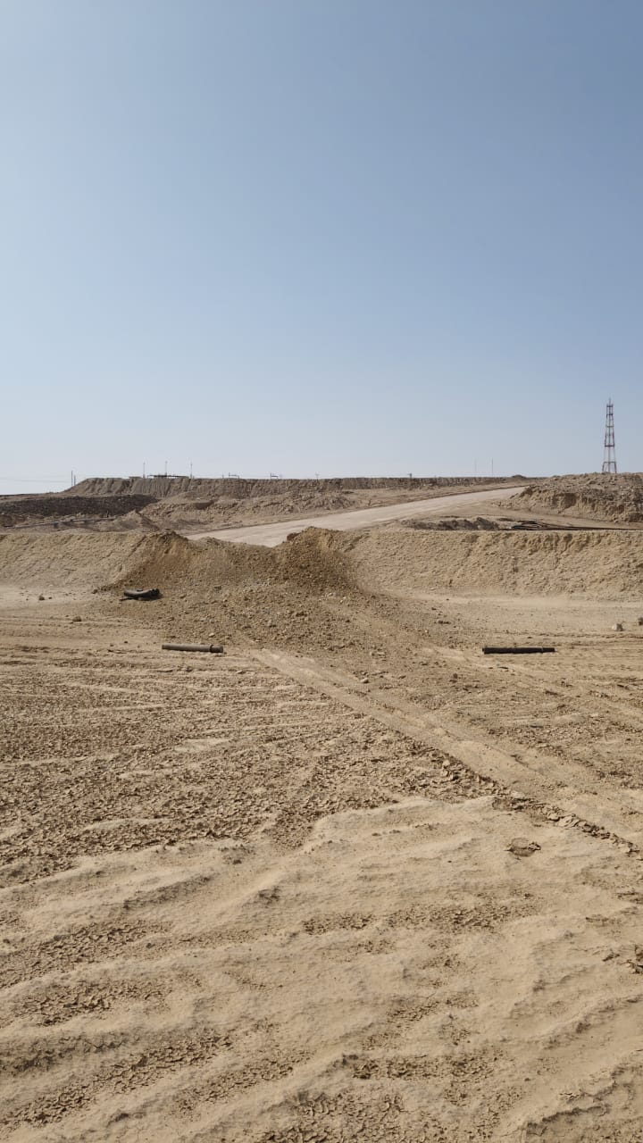

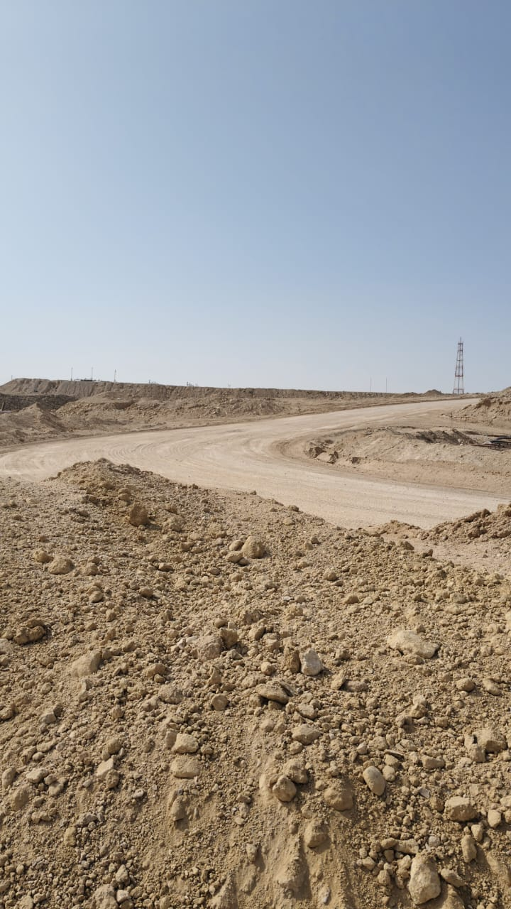
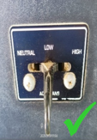
PDO Second Alert
Date: Time: | 07.09.2025 08:36 Am | Incident title: PIM# | HiPo#24 1181554 | Risk Category: Injury/Damage : | MVI Minor Damage | Actual Severity: Potential severity: | 2A/0P C4P | Activity: Location: | Driving (Rig Move) Fahud
Target Audience: Rig moving contractors
What happened?
A motor vehicle incident (MVI) occurred during advance load movements in Fahud. While transporting loads (26 Tone) from the old location to the new location in Jabal Area, vehicle lost control while descending a slope & unable to stop. As a result, the vehicle left its intended path, going over a sand mound of 2-meter height , and hit nearby stationary equipment, including a flow line and a signal receiver box. The vehicle came to a stop just in front of a 4.3m dip. No injuries were reported in this incident.
Why it happened/Finding :
The evidence and post incident analysis point towards the driver not selecting the proper gear (low gear) while driving over the decline. This caused the truck to speed up beyond the driver’s control.
The driver opted not to make a turn as this might cause the truck to roll over.
Although the inclines and declines were discussed during the TBT preceding the move, the driver failed to make use of the imparted instructions.
Road safety signage was not adequate as there is no sign to indicate the hazard associated with the steep slope and limit the speed.
Your learning from this incident..
Selecting the correct gear and managing vehicle speed are crucial, particularly when driving on inclines and declines (Low Gear Ratio).
Always execute the operation inline with the PTW, HEMP and SOPs.
Enhance training programs to all drivers on the imperative actions that needs to be followed especially while maneuvering through challenging terrains.
All roads, including infield graded roads, must be equipped with proper signage to indicate any road safety hazards in line with the local regulations.
Photo explaining what was done wrong
Photo explaining how it should be done right
Always use low gears when driving up or down slopes to maintain better control of the vehicle.
Notes:
Ensure all dates and titles are input
A short description should be provided without mentioning names of contractors or individuals. You should include, what happened, to who (by job title) and what injuries this resulted in. Nothing more!
Four to five bullet points highlighting the main findings from the investigation. Remember the target audience is the front line staff so this should be written in simple terms in a way that everyone can understand.
The strap line should be the main point you want to get across
The images should be self explanatory, what went wrong (if you create a reconstruction please ensure you do not put people at risk) and below how it should be done.

Slide 2
Effective Learning
To make sure learning is translated to the site day to day activities , please answer the below questions :-
How learning can be implemented at site ?
Educate drivers on the significance of selecting the appropriate gear when navigating inclines and declines in mountainous terrain, particularly in the Jebel areas. This can be achieved by conducting awareness sessions and incorporating discussions on this topic during daily Toolbox Talks (TBTs) before Jebel moves.
Install posters about gear selection for inclines and declines inside the driver cabins to improve driver awareness. This visual communication will be more effective than verbal instructions.
The concerned team should install road safety signs in incline and decline areas to alert drivers in advance, to reduce their speed.
How can you sustain the action ?
Quarterly verification to evaluate and analysis the effectiveness of this awareness sessions and daily TBTs
Physical verification and assurance process to ensure all vehicles have occupied with the safety posters inside the cabins.
Conduct physical verification and maintain effective communication with the client to ensure that all Jebel areas are equipped with safety alert signboards.
Notes:
Guideline for Effective Learning & Sustainability
•Can be replicated across similar contractor / activities
•Shall be SMART- Specific ,Measurable , Achievable ,Realistic & Timebound
•Can be implemented in a months' time

