Slide 1
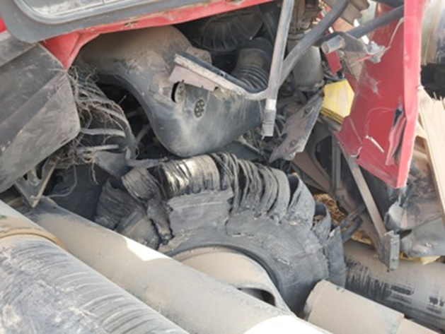
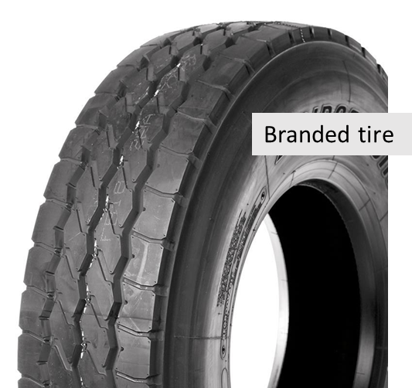
PDO Second Alert
Date: Time: | 19.09.2025 12:01 | Incident title: Event # | HiPo#25 25237888 | Risk Category: Injury/Damage : | MVI Finger Injury (LWC) | Actual Severity: Potential severity: | 3A C4P | Activity: Location: | Driving Hima
Target Audience: Driver & Journey Manager
Photo explaining what was done wrong
What happened?
While route to Nimr with casings load, about 50 km from Haima towards Nimr, the o/s (driver-side) steering tyre burst, causing the truck to veer off-road and stop on the left side. Due to the impact, the casings were dislodged and rested on the ground.
No injuries were reported, and no other parties were involved.
Why it happened/Finding :
Tires used in front steering axle are branded Sailun Tires.
Tires were in good condition during morning inspection of same day (inspected by vehicle inspector) Vehicle and load security checks showed brakes, and load restraints were okay
Load shifted but driver inside the cabin was not hurt
Reflective Question:
Do you report any unusual vehicle behavior immediately?
If you were the driver that day, what extra checks would you do next time?
Do you ensure the steering axle tires are branded tires?
Do you inspect the tires before starting the journey?
Do you ensure purchased tires are PDO authorized?
Do You know how to inspect the Tire?
Notes:
Ensure all dates and titles are input
A short description should be provided without mentioning names of contractors or individuals. You should include, what happened, to who (by job title) and what injuries this resulted in. Nothing more!
Four to five bullet points highlighting the main findings from the investigation. Remember the target audience is the front line staff so this should be written in simple terms in a way that everyone can understand.
The strap line should be the main point you want to get across
The images should be self explanatory, what went wrong (if you create a reconstruction please ensure you do not put people at risk) and below how it should be done.

Slide 2
Management Reflective Questions
As a learning from this incident and to ensure continual improvement, all contract managers must review their HSE risk management against the questions asked below
Confirm the following:
- Do you ensure all tires are inspected before each trip?
- Do you ensure Drivers report unusual vehicle behavior right away especially related to tires?
- Do you ensure Supervisors verify load checks before vehicles leave the yard?
- Do you ensure Driver/Vehicle inspector confirm the tire pressure is correct?
* If the answer is NO to any of the above questions please ensure you take action to correct this finding
Please refer to the notes section for guidance
Notes:
Make a list of closed questions (only ‘yes’ or ‘no’ as an answer) to ask others if they have the same issues based on the management or HSE-MS failings or shortfalls identified in the investigation.
Imagine you have to audit other companies to see if they could have the same issues.
These questions should start with: Do you ensure…………………?

