Slide 1


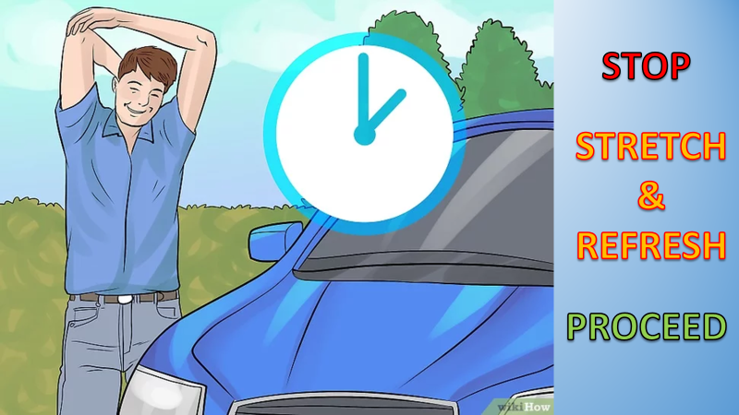
PDO Second Alert
Date: Time: | 02.10.2025 11:16 hrs | Incident title: IFADAH# | HiPo#27 25360017 | Risk Category: Injury / Asset Damaged: | MVI Minor damage | Actual Severity: Potential severity: | 1P C4P | Activity: Location: | Driving Bahja
Target Audience: Logistics, Operation & Construction
Photo explaining what was done wrong
What happened?
While driving from Sahma Station to Al Fasil Field, the operator had microsleep due to fatigue, veered off-road, and struck uneven terrain. He sustained a minor leg injury and was transported to Haima Hospital.
Why it happened/Finding :
Operator was inadequately rested.
No fatigue check or pre-trip health screening
No buddy system assigned for the journey >30KM.
No alertness monitoring or journey risk assessment.
Reflective Questions
How do we verify a driver’s fitness before each journey?
How do we ensure buddy systems are enforced for long-distance driving?
What systems are in place to detect and prevent fatigue in real-time?
Are journey plans reviewed and validated for each leg of travel?
Are lone drivers monitored for alertness?.
Photo explaining how it should be done right
If fatigue starts to set in, pull over to a safe rest stop and take a short 20-minute nap.
Notes:
Ensure all dates and titles are input
A short description should be provided without mentioning names of contractors or individuals. You should include, what happened, to who (by job title) and what injuries this resulted in. Nothing more!
Four to five bullet points highlighting the main findings from the investigation. Remember the target audience is the front line staff so this should be written in simple terms in a way that everyone can understand.
The strap line should be the main point you want to get across
The images should be self explanatory, what went wrong (if you create a reconstruction please ensure you do not put people at risk) and below how it should be done.

Slide 2
Management Reflective Questions
As a learning from this incident and ensure continual improvement all contract managers must review their HSE risk management against the questions asked below
Confirm the following:
Do you ensure drivers undergo fatigue screening before long journeys?
Do you enforce the buddy system for all journeys exceeding 30KM?
Do you verify medical fitness for drivers' post-surgery or with known conditions?
Do you ensure IVMS alerts are monitored and acted upon in real-time?
Do you confirm journey plans are updated and validated before each leg?
Do you have backup communication protocols in case of network failure?
Do you audit JM-driver communication logs monthly?
Do you ensure panic button functionality is tested and known to drivers?
Notes:
Ensure all dates and titles are input
Make a list of closed questions (only ‘yes’ or ‘no’ as an answer) to ask others if they have the same issues based on the management or HSE-MS failings or shortfalls identified in the investigation.
Imagine you have to audit other companies to see if they could have the same issues.
These questions should start with: Do you ensure…………………?

