Slide 1
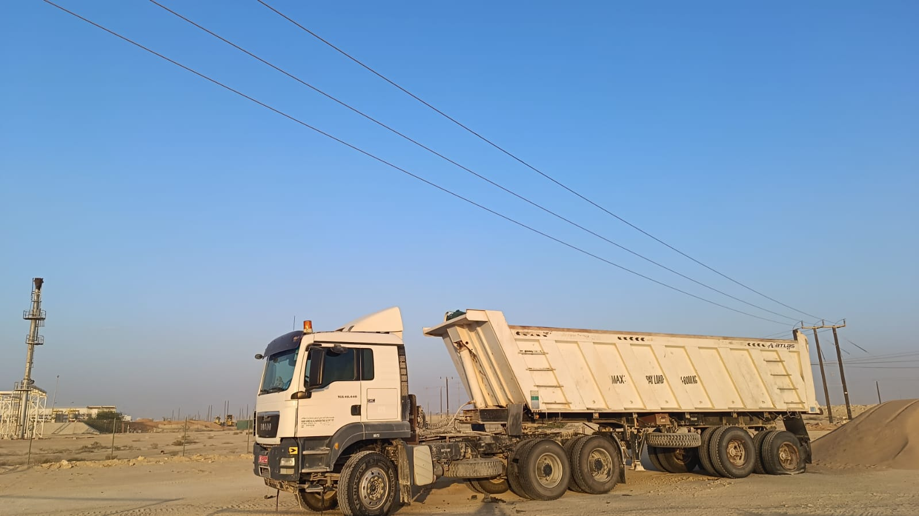
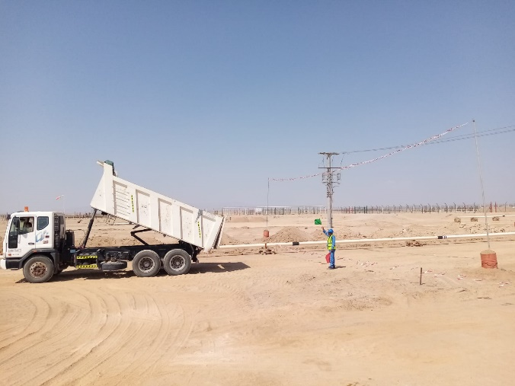
PDO Second Alert
Date: Time: | 20.10.2025 15:50 hrs | Incident title: IFADAH# | HiPo#33 25579500 | Risk Category: Injury / Asset Damaged: | OHL Oil Deferment | Actual Severity: Potential severity: | 2A/0P C4P | Activity: Location: | Offloading Marmul
Target Audience: Logistics, Operation & Construction
What happened?
A tipper trailer with crusher material was offloading sand. After completing the offloading, while moving forward, the raised tipper body came into contact with an overhead 33 kV power line at an approximate height of 8.5 meters. This resulted in damage to five tyres of the tipper truck and damage to the overhead grid line, no injury was reported.
Why it happened/Finding :
Operation of a vehicle in close proximity to an energized overhead line
Failure to comply with the permit-to-work system & SP 1242 (Working near OHL)
Risk Normalization and complacency of the supervisor and the driver
No banksman present to guide the movement.
Inadequate supervision and poor communication between involved departments.
Supplier Mobilization process not followed.
Your learning from this incident..
Always comply with the PTW System
Always assess the risks of the unloading area
Maintain clear communication and coordination between store, civil, and materials teams
‘DO NOT EXECUTE ANY TASK WITHOUT A VALID PERMIT’
Notes:
Ensure all dates and titles are input
A short description should be provided without mentioning names of contractors or individuals. You should include, what happened, to who (by job title) and what injuries this resulted in. Nothing more!
Four to five bullet points highlighting the main findings from the investigation. Remember the target audience is the front line staff so this should be written in simple terms in a way that everyone can understand.
The strap line should be the main point you want to get across
The images should be self explanatory, what went wrong (if you create a reconstruction please ensure you do not put people at risk) and below how it should be done.

