Slide 1
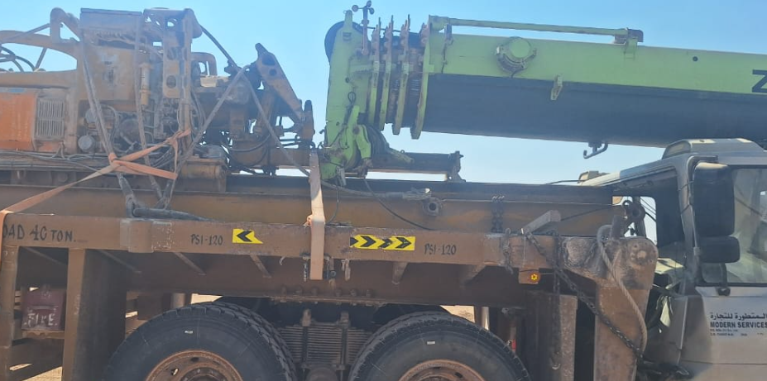
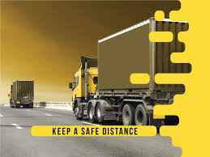
PDO Second Alert
Date: Time: | 04.11.2025 13:30 hrs | Incident title: IFADAH# | HiPo#35 25692862 | Risk Category: Injury / Asset Damaged: | MVI Asset damage | Actual Severity: Potential severity: | 0P/3A C4P | Activity: Location: | Rig Move Bahja
Target Audience: Drivers, Crane operators
Photo explainig what was done wrong
What happened?
During a rig move, the crane positioned last in the convoy failed to stop in time when the convoy halted due to road construction. The crane boom struck the TDS load on the trailer ahead, pushing it into the Diesel Tank Trailer in front. The crane operator was checked at hospital but sustained no injuries. The incident caused equipment damage but no personnel harm highlighting the need for improved situational awareness during convoy operations
Why it happened/Finding :
The crew failed to identify the potential hazard resulting from unsafe hand positioning.
Driver (Crane Operator) was distracted while driving, was not paying attention to the traffic that was slowing down and did not maintain a safe distance from the Trailer in front of him.
The convoy encountered road construction, which created dust and required a diversion. As a result, the ROP convoy stopped to allow only one vehicle to pass at a time for Over Dimension Cargo guidance.
Your learning from this incident:
Always pay attention while driving-Don’t get distracted.
Always ensure that there is adequate distance between the vehicles
Always Identify the Dust Hazard which could impact the visibility During the Rig Move Operation.
Always use defensive driving techniques
Avoid distraction and maintain a Safe following distance
Notes:
Ensure all dates and titles are input
A short description should be provided without mentioning names of contractors or individuals. You should include, what happened, to who (by job title) and what injuries this resulted in. Nothing more!
Four to five bullet points highlighting the main findings from the investigation. Remember the target audience is the front line staff so this should be written in simple terms in a way that everyone can understand.
The strap line should be the main point you want to get across
The images should be self explanatory, what went wrong (if you create a reconstruction please ensure you do not put people at risk) and below how it should be done.

Slide 2
Disclaimer
This document is made available for information only and on the condition that (i) it may not be relied upon by anyone, in the conduct of their own operations or otherwise; (ii) neither the [PDO] company issuing this document nor any other person or company concerned with furnishing information or data used herein (A) is liable for its accuracy or completeness, or for any advice given in or any omission from this document, or for any consequences whatsoever resulting directly or indirectly from any use made of this document by any person, even if there was a failure to exercise reasonable care on the part of the issuing company or any other person or company as aforesaid; or (B) make any claim, representation or warranty, express or implied, that acting in accordance with this document will produce any particular results with regard to the subject matter contained herein or satisfy the requirements of any applicable federal, state or local laws and regulations; and (iii) nothing in this document constitutes technical advice, if such advice is required it should be sought from a qualified professional adviser.

